Slide 1

Military I
Revising Doctrine
Streamlining Force Structure
Professionalizing Personnel
Raising the Budget
Upgrading Weapons
Strengthening Civilian Control

Slide 2
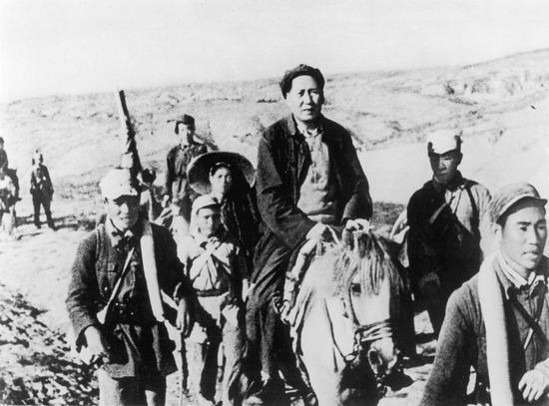

Slide 3
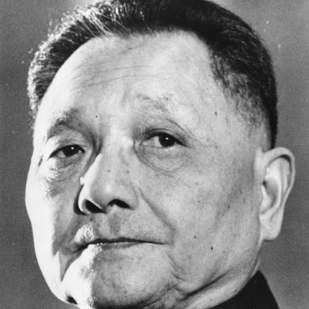

Slide 4
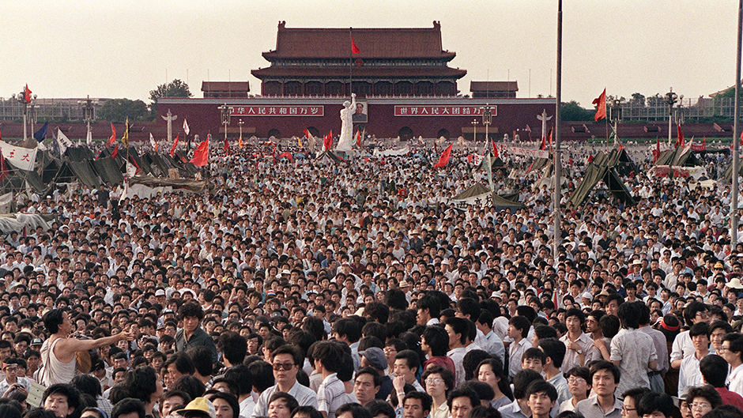

Slide 5
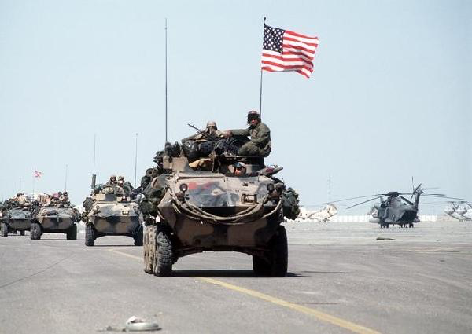

Slide 6
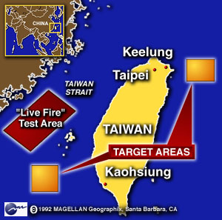
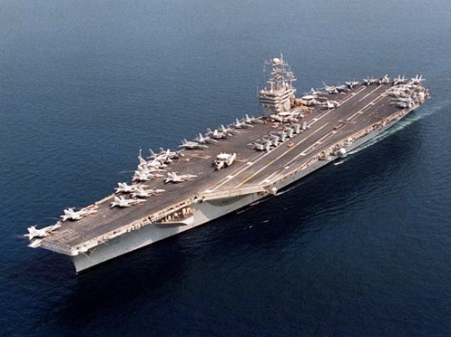

Slide 7
Military I
Revising Doctrine
Streamlining Force Structure
Professionalizing Personnel
Raising the Budget
Upgrading Weapons
Strengthening Civilian Control

Slide 8
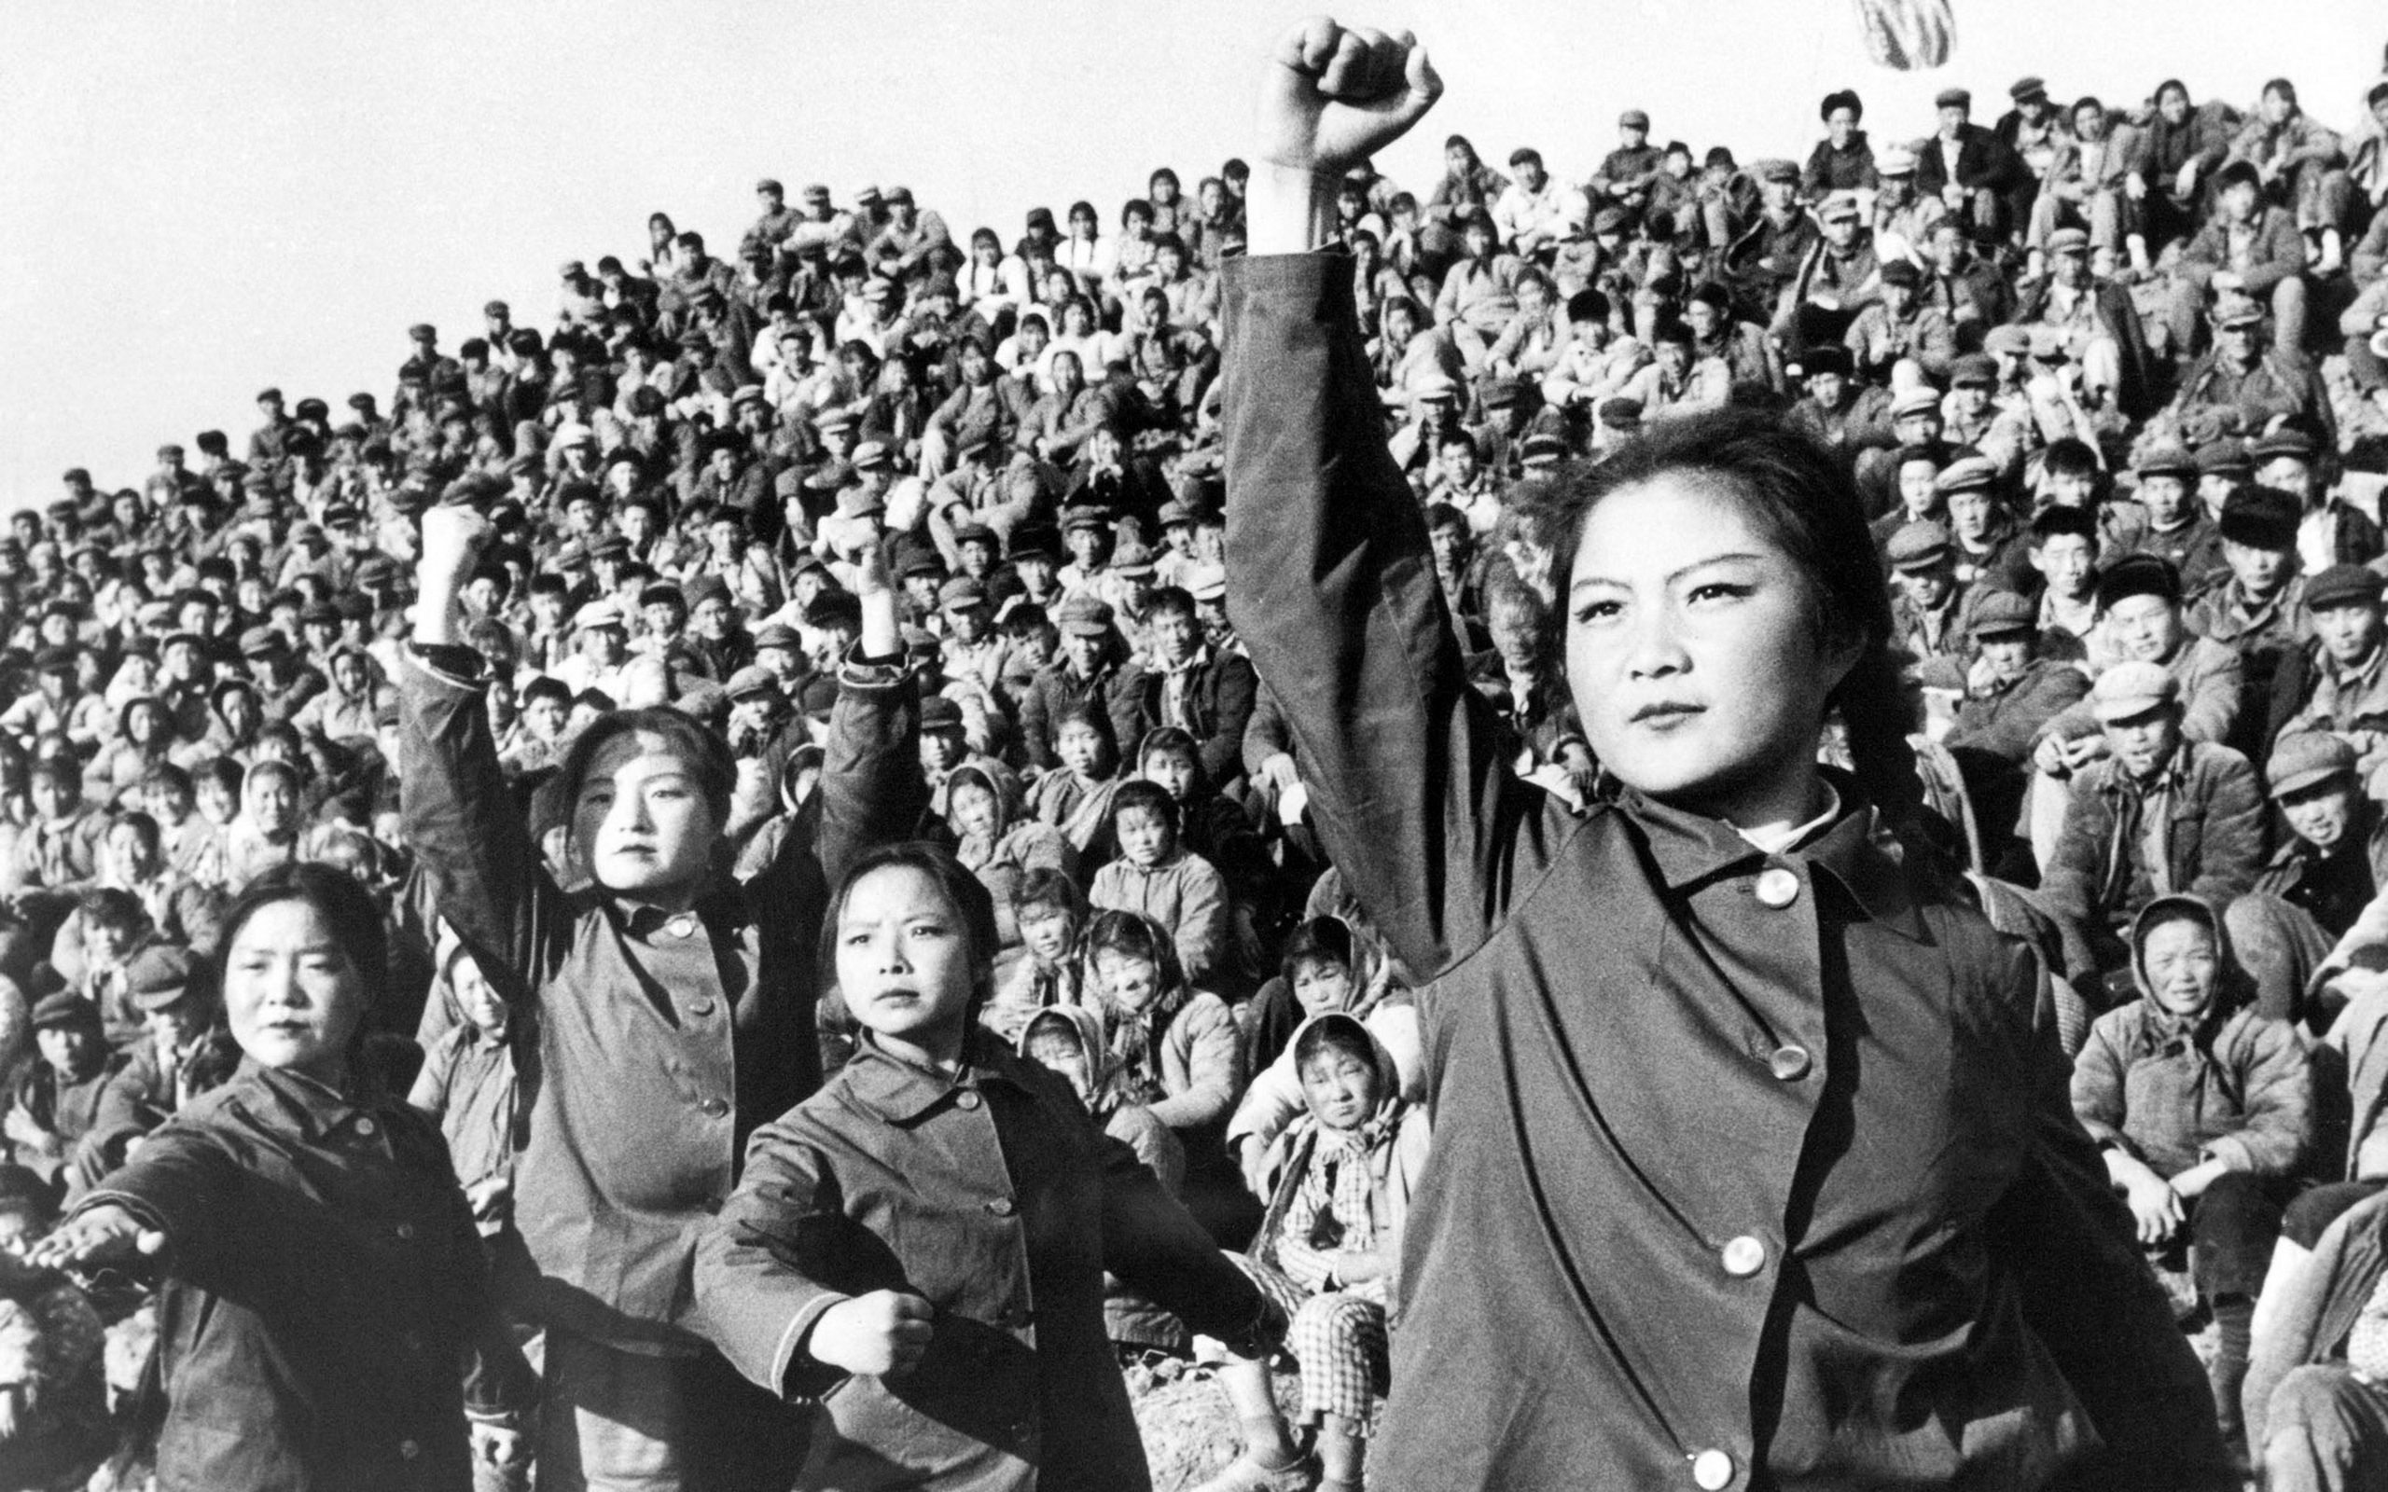

Slide 9
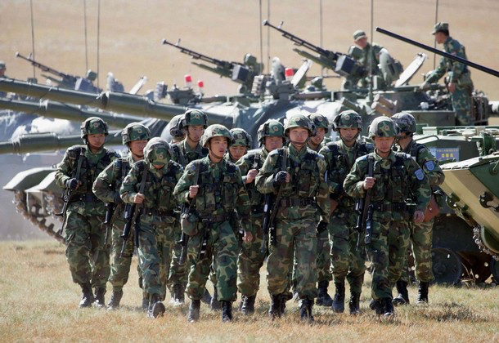

Slide 10
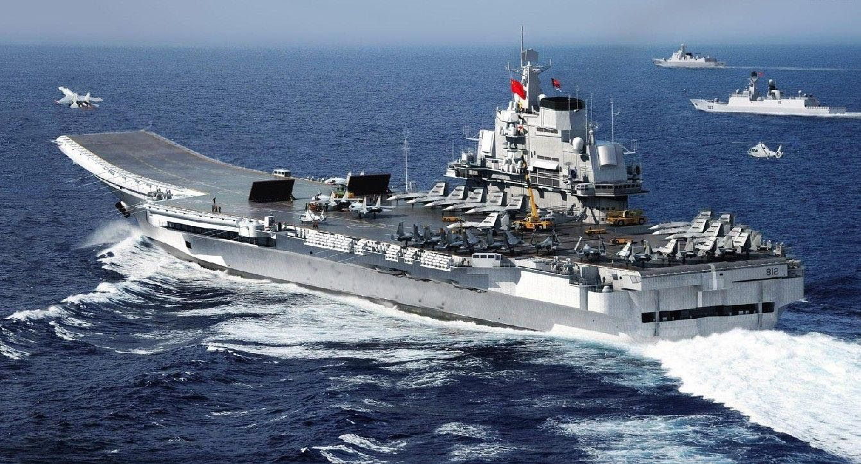

Slide 11
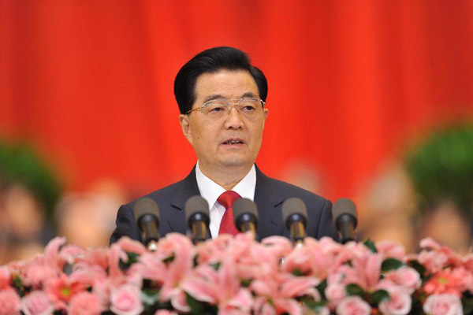

Slide 12
Military I
Revising Doctrine
Streamlining Force Structure
Professionalizing Personnel
Raising the Budget
Upgrading Weapons
Strengthening Civilian Control

Slide 13
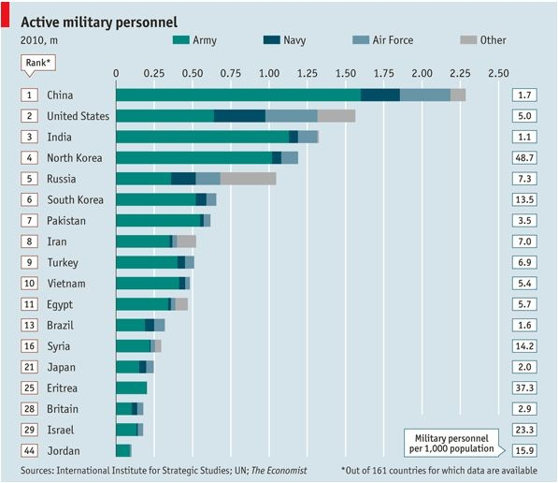

Slide 14
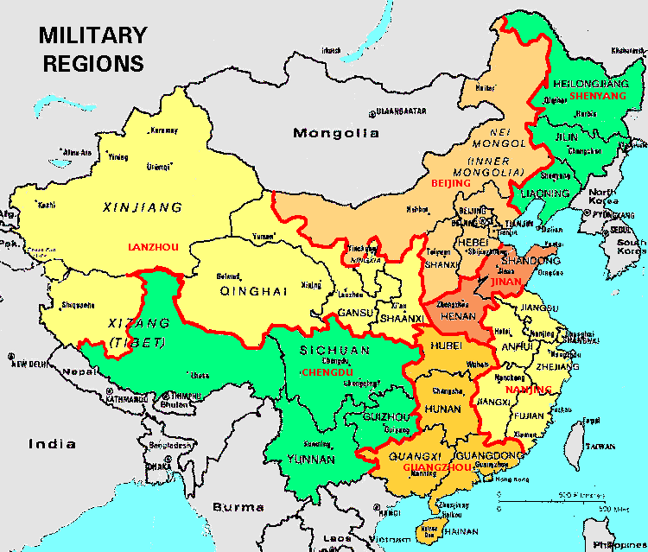

Slide 15
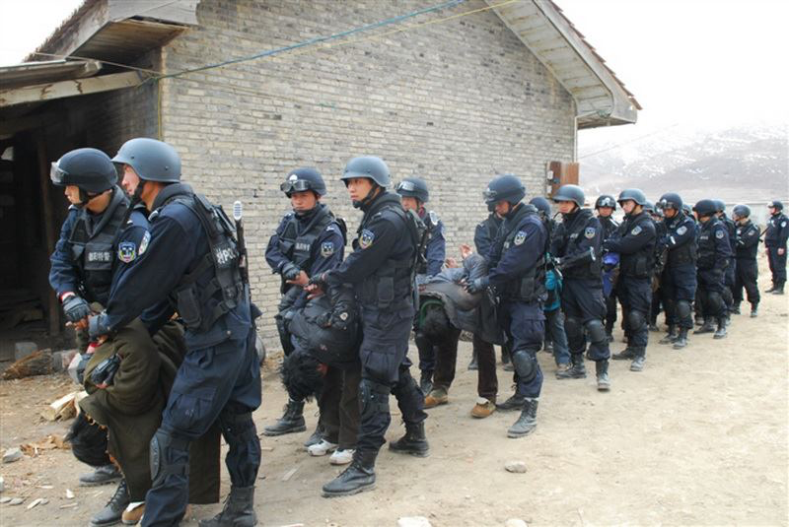

Slide 16
Military I
Revising Doctrine
Streamlining Force Structure
Professionalizing Personnel
Raising the Budget
Upgrading Weapons
Strengthening Civilian Control

Slide 17
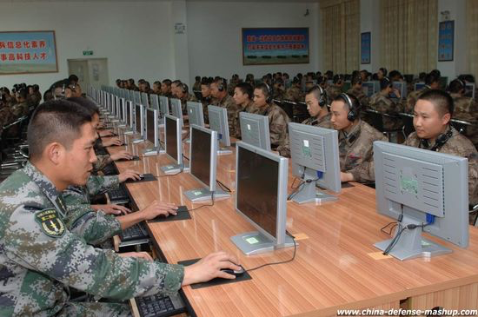

Slide 18
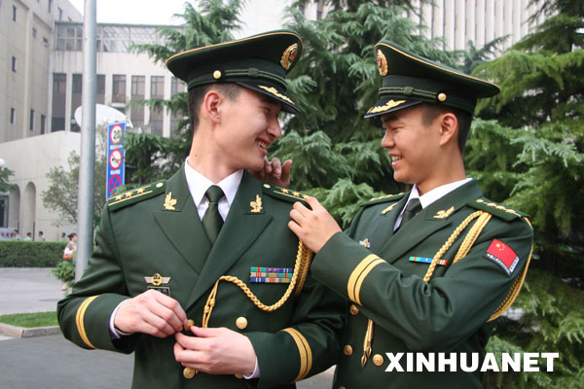

Slide 19
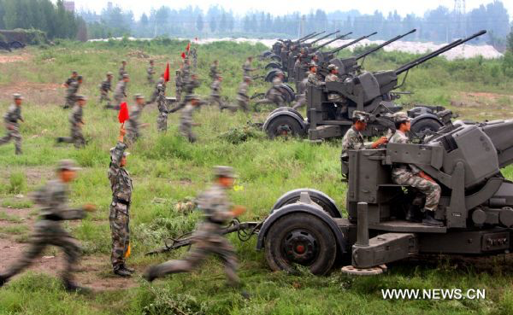

Slide 20
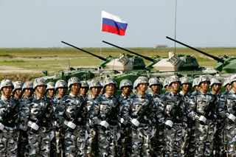

Slide 21
Military I
Revising Doctrine
Streamlining Force Structure
Professionalizing Personnel
Raising the Budget
Upgrading Weapons
Strengthening Civilian Control

Slide 22
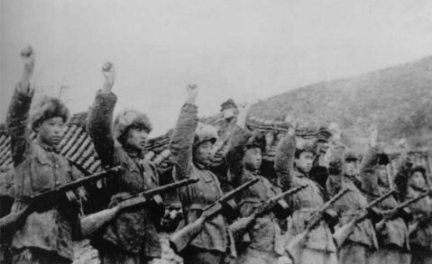

Slide 23
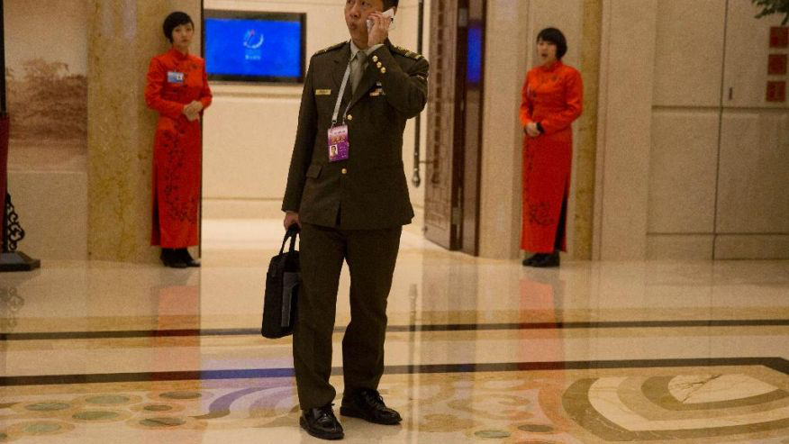

Slide 25
Military I
Revising Doctrine
Streamlining Force Structure
Professionalizing Personnel
Raising the Budget
Upgrading Weapons
Strengthening Civilian Control

Slide 26
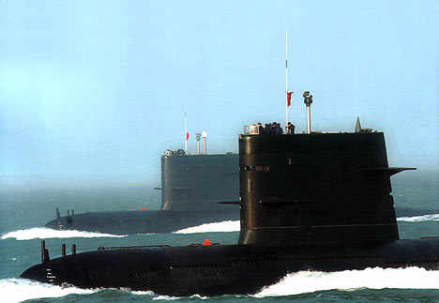

Slide 27
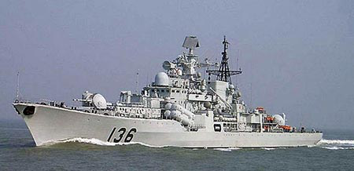

Slide 28
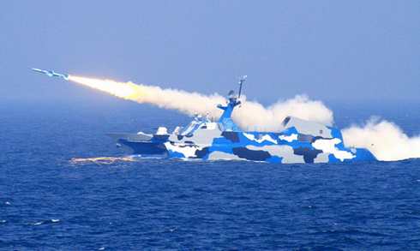

Slide 29
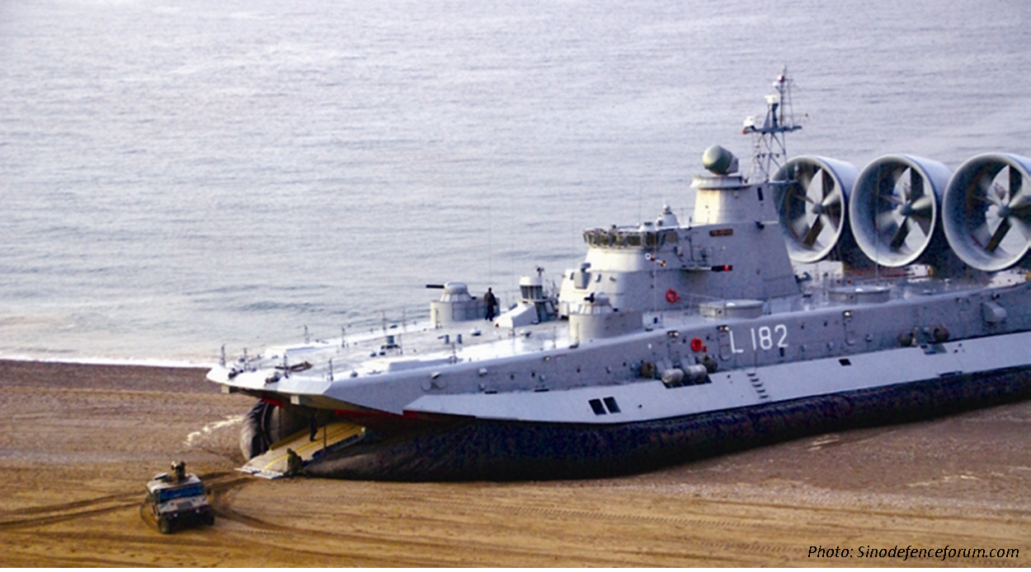

Slide 30
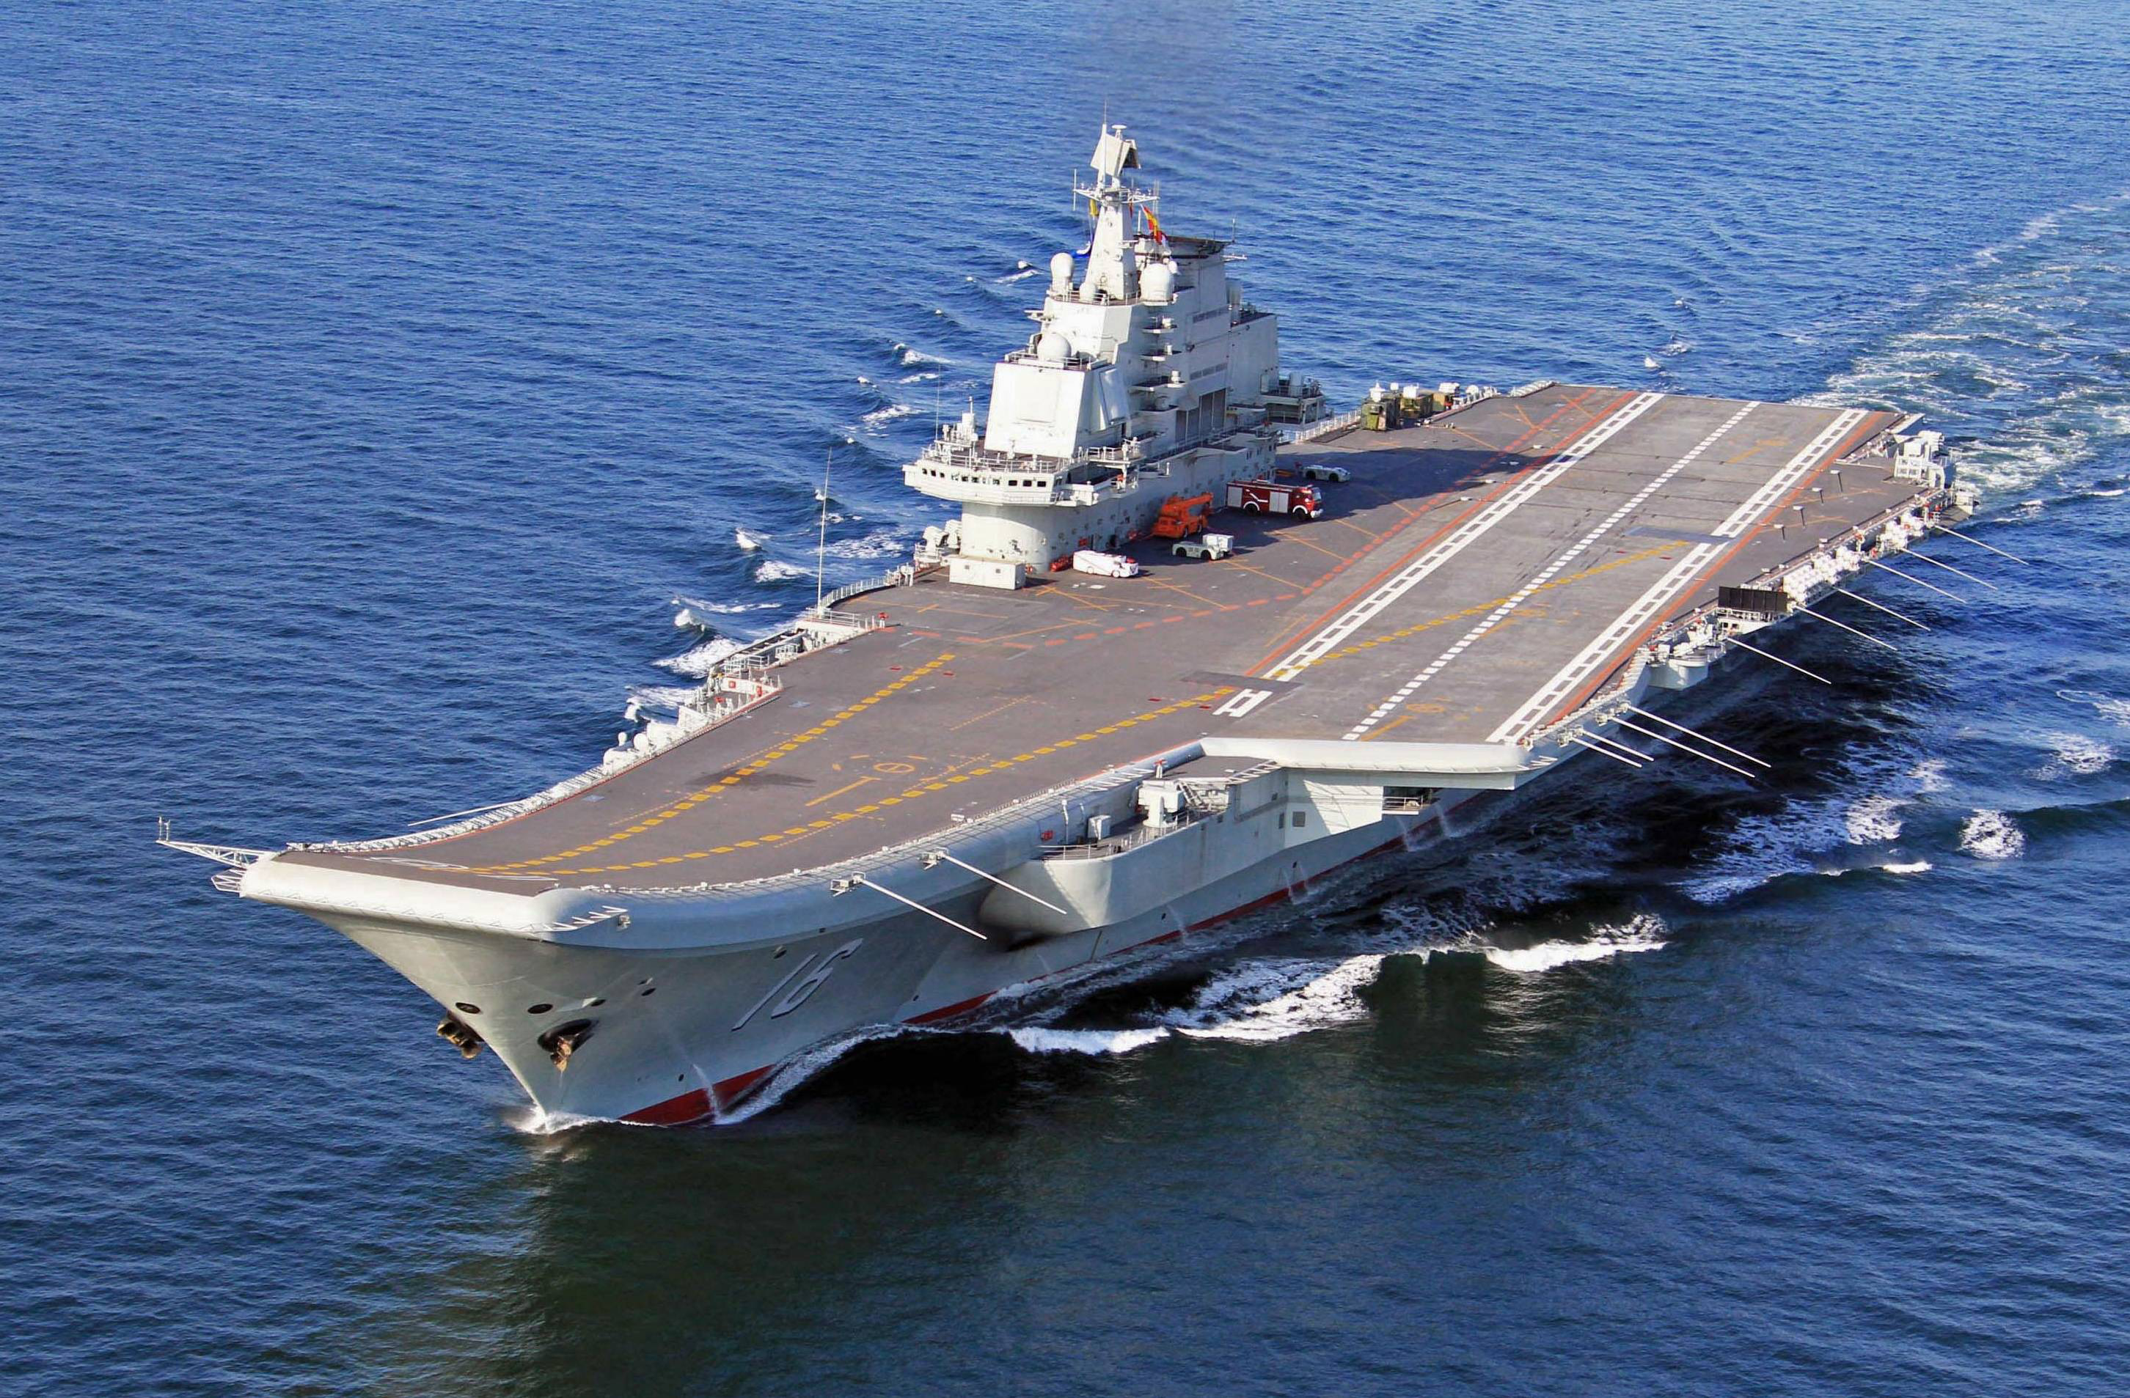

Slide 31
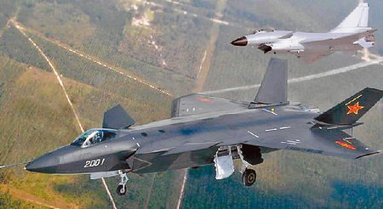

Slide 32
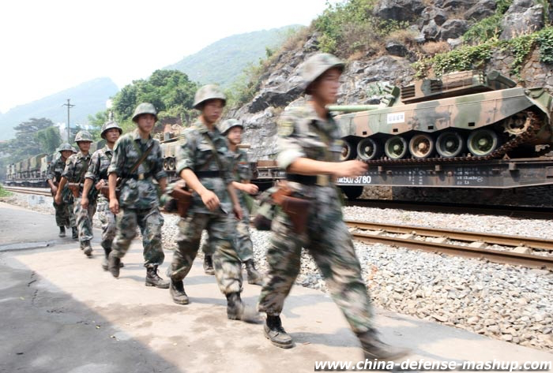

Slide 33
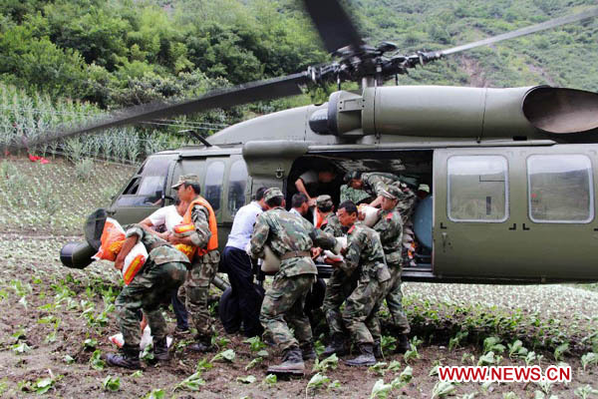

Slide 34
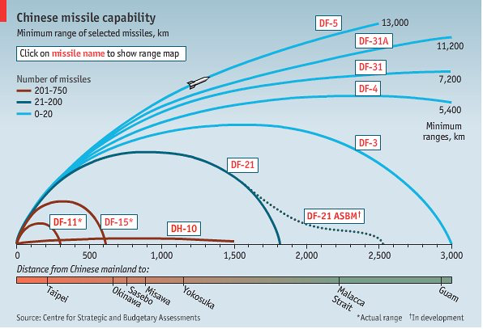

Slide 35
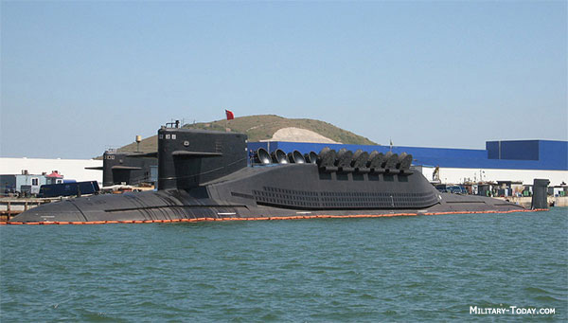

Slide 36


Slide 37
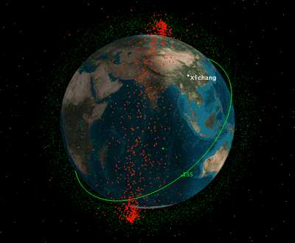

Slide 38
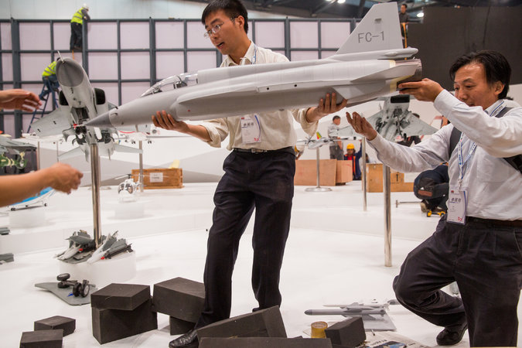

Slide 39
Military I
Revising Doctrine
Streamlining Force Structure
Professionalizing Personnel
Raising the Budget
Upgrading Weapons
Strengthening Civilian Control

Slide 40
