Slide 1

Human Rights
Cold War
Tiananmen
Post-Tiananmen engagement
Activist Strategies

Slide 2
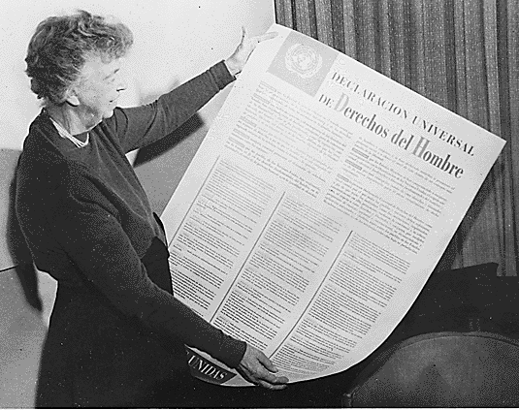

Slide 3
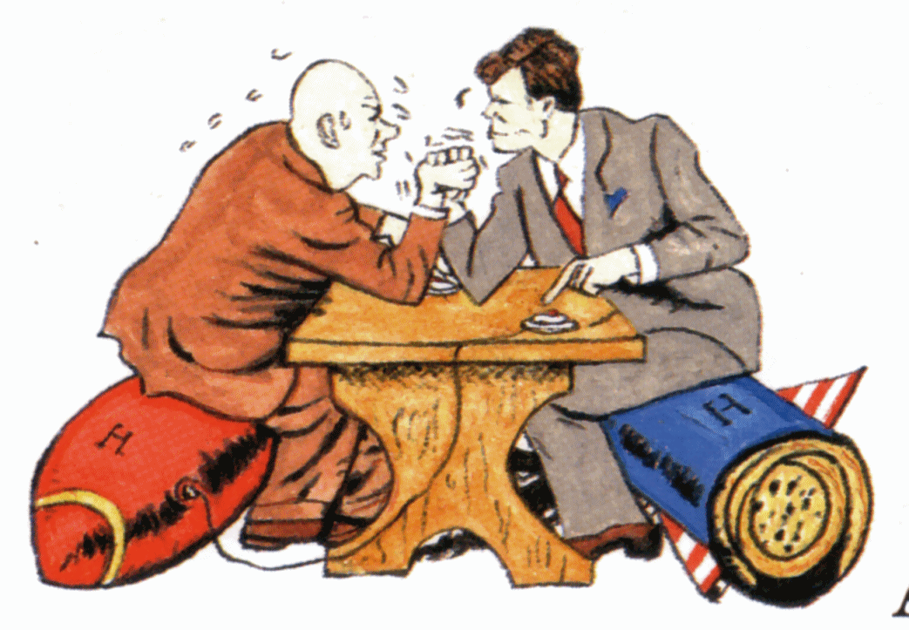

Slide 4
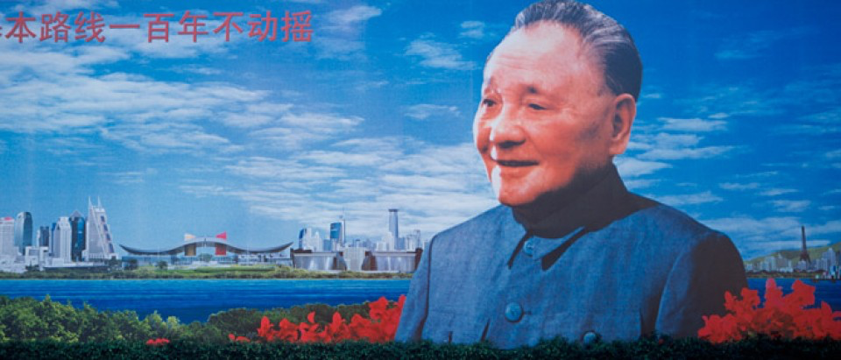

Slide 5
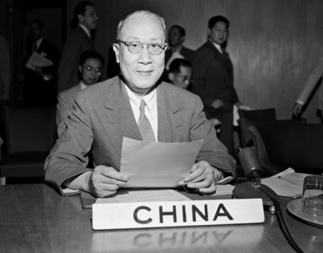

Slide 6
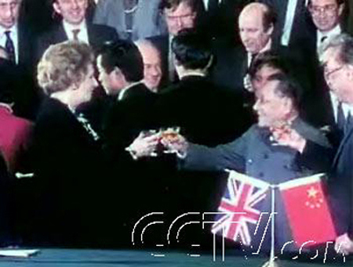

Slide 7
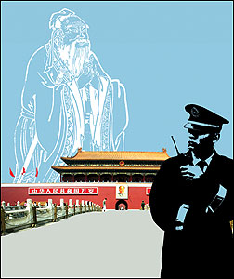

Slide 8
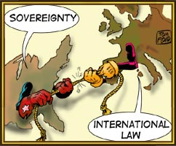

Slide 9
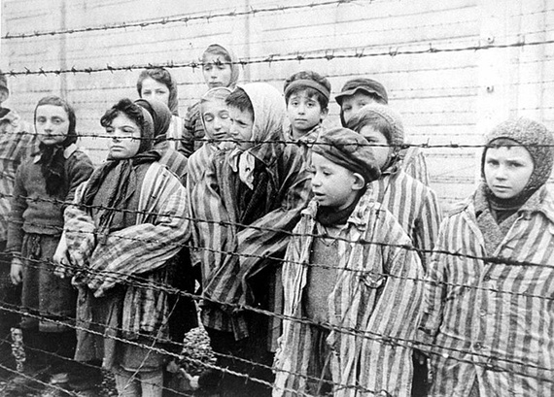

Slide 10
Human Rights
Cold War
Tiananmen
Post-Tiananmen engagement
Activist Strategies

Slide 11
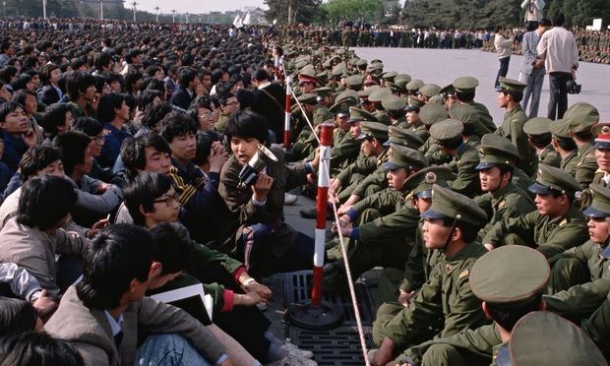

Slide 12
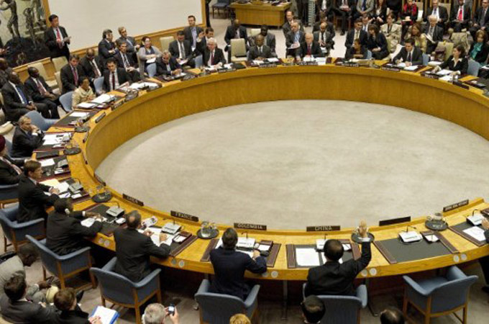

Slide 13
Human Rights
Cold War
Tiananmen
Post-Tiananmen engagement
Activist Strategies

Slide 14



Slide 15
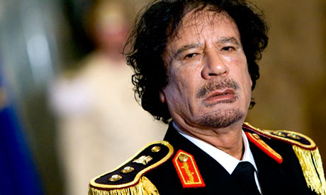

Slide 16
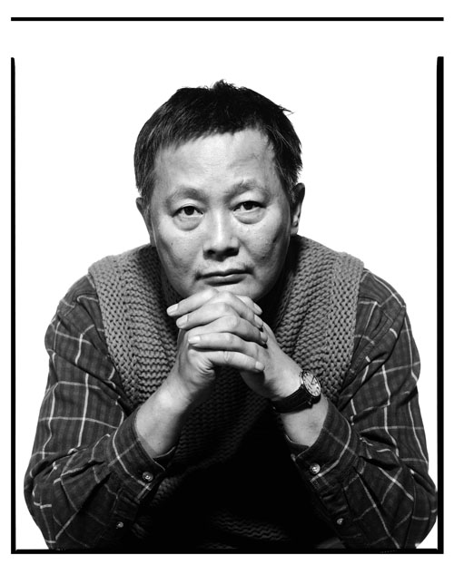


Slide 17
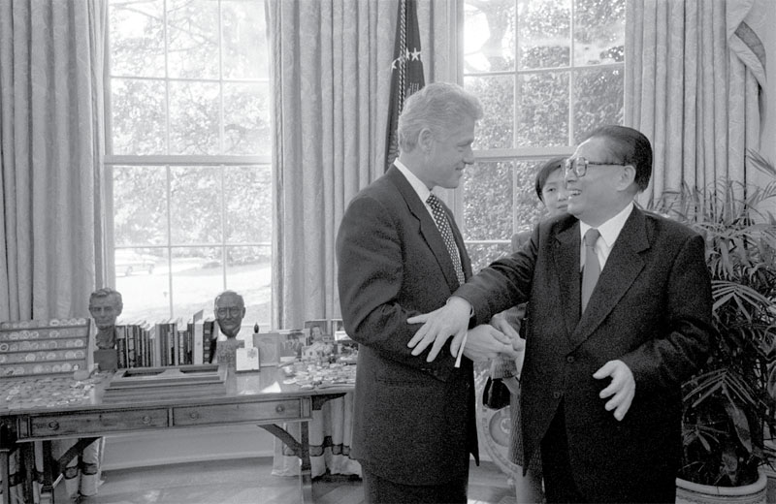

Slide 18
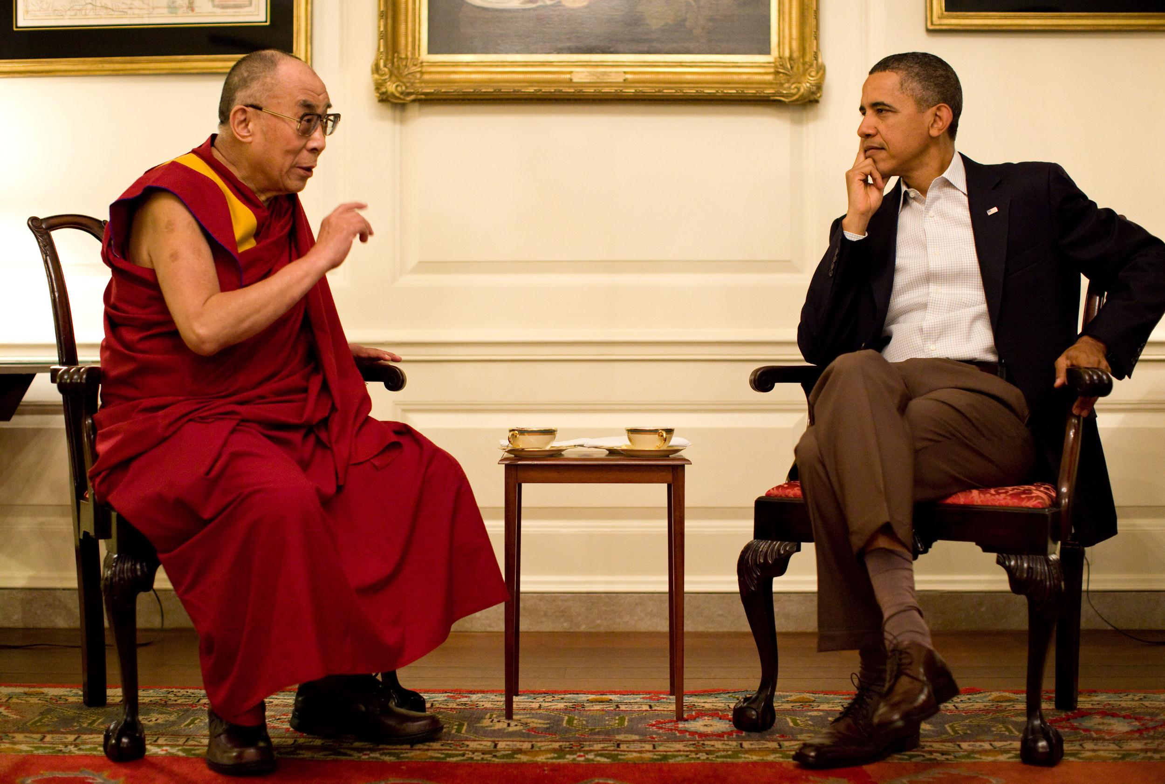

Slide 19
Human Rights
Cold War
Tiananmen
Post-Tiananmen engagement
Activist Strategies

Slide 20
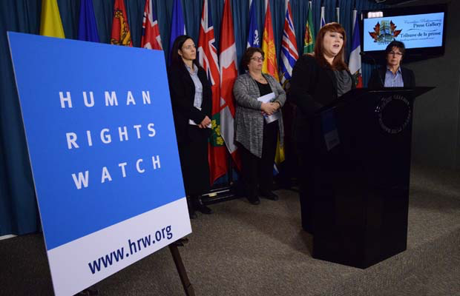

Slide 21


Slide 22


Slide 23
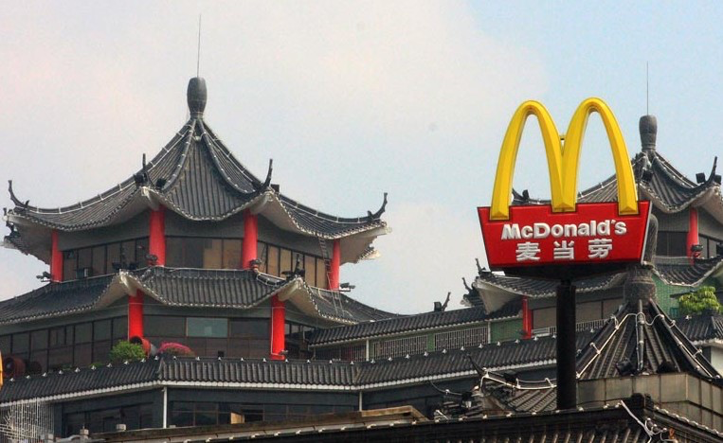

Slide 24
