Slide 1

Shareen Loves to Dance!
By Em Friedman

Slide 2



A Few Accessibility Notes:
If you’d like this book to be read to you out loud, click the headphones on the top of each page.
This book includes sound effects which may be overstimulating for some readers. If you would like to read it without sound effects, please mute your computer.
Enjoy!

Slide 3





Ever since Shareen was a baby, she loved to dance.

Slide 4

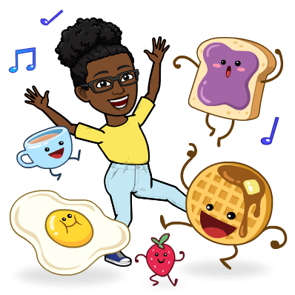

She danced in the car.
She even danced in the supermarket!
She danced on the playground.

Slide 5
Do you like to dance?

Slide 6

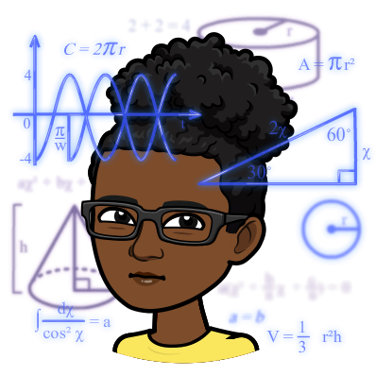

Shareen loved learning and was very very smart.
Her favorite subjects were music and art.
She was a really hard worker and always tried her best.

Slide 7




Even though she was a hard worker, sometimes she found it super difficult to sit through her classes.
Sometimes when she had to sit for too long,
she said she felt like lightning bolts were
zooming up and down and up and down her body!

Slide 8
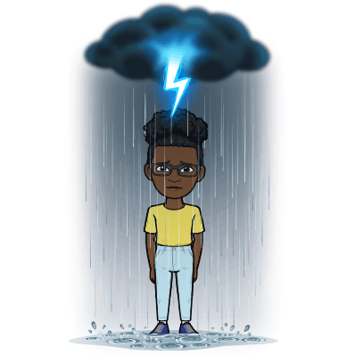
How was Shareen supposed to focus on math, when all she could think about was the lightning!?
It made her want to dance just to let it all out.

Slide 9

Noticing Shareen was having a hard time focusing in class, the school counselor, Ms. Spring, brought Shareen into her office for a chat.
The job of a counselor is to support students, just like you, and find ways to help them do and feel their absolute best in school.

Slide 10
Have you ever met your school counselor?

Slide 11

Shareen told Ms. Spring all about the lightning and the dancing, and how sometimes she just felt like a race car with the biggest engines ever.

Slide 12




Shareen remembered that her moms once told her that
dancing helps her ADHD because she can let out her energy!

Slide 13

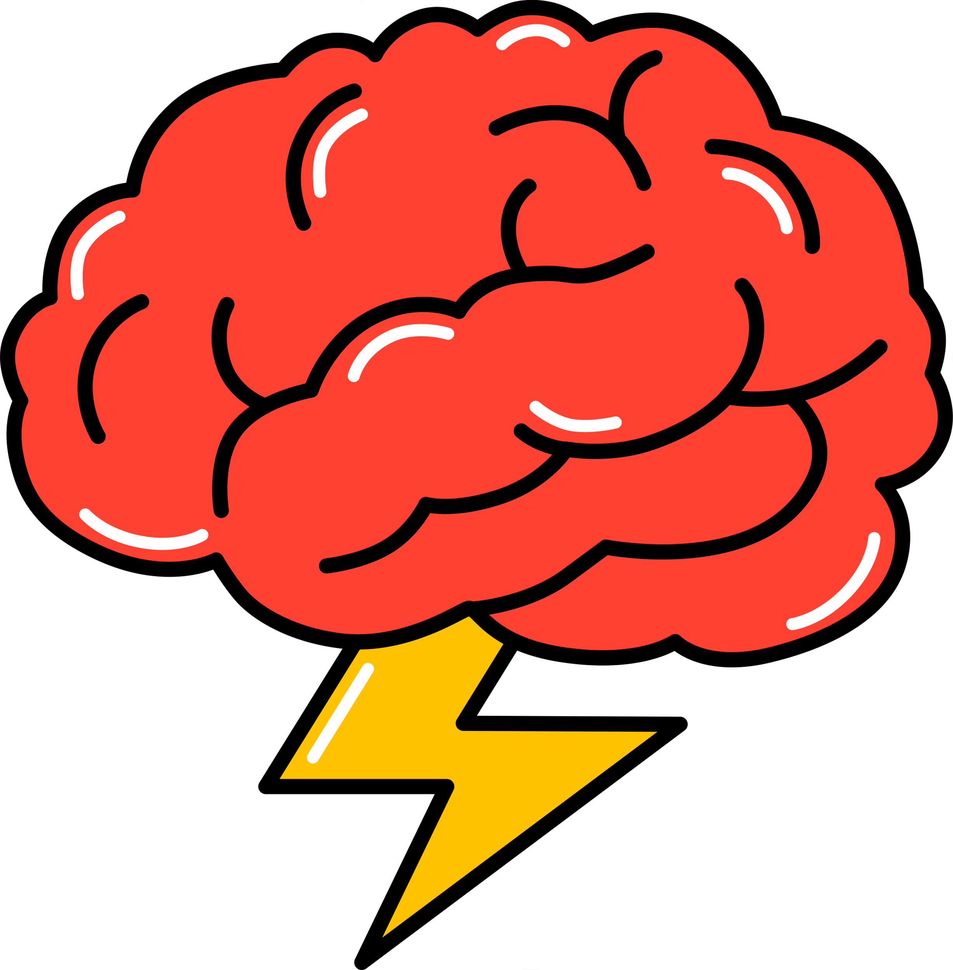
ADHD
“ADHD means your brain is moving at super speed! How cool is that?!” said Ms. Spring.
“It means that you’re really good at using your imagination and noticing things that other people usually don’t notice.”
“It can help you focus on the things you love to do and are really good at, like dance and art.”

Slide 14

“Your moms’ advice gave me an idea!” said Ms. Spring.
“Let’s use the things you’re good at to help you!”
“If you’re having a tough time in class,
ask your teacher to head to my office
and you can dance it all out!”
Notes:
What if during the day, if you’re having a tough time in class, you can ask your teacher to come to my office and you can dance it all out before you head back to class?”

Slide 15

Shareen smiled a big smile….

Slide 16

And on the next day she
danced right back to school.

Slide 17
THE END

Slide 18
Author’s Statement
Thank you for reading “Shareen Loves to Dance!” Shareen Loves to Dance began with the idea that ADHD should be talked about and normalized in conversations with children and their support systems. Too often invisible disabilities don’t get the attention they deserve and are swept under the rug, only furthering the detrimental stigma a diagnosis carries. Many of the details in this book are intentional. It was important to me that Shareen was a Black girl for a few reasons. The first reason is that girls are diagnosed with ADHD at a much lower rate than boys are. While this might lead you to believe it is less prevalent in girls, research points to the real reason being that doctors are more likely to diagnosis boys with ADHD, and girls with ADHD go often undiagnosed which leaves them with a real lack of support. Additionally, I consciously made Shareen Black as Black girls are much more likely to be written off as having behavioral problems, and are subsequently significantly less likely to receive a diagnosis of ADHD due to racism and sexism in the classroom and diagnostic criteria. On the theme of intentionality, I gave Shareen two moms as I feel it is important to normalize queer parenting.
This story is important to me because I believe it shows copious amounts of support and accommodations being made for a student who needs them. Her parents and school counselor didn’t hesitate to come up with creative ways to help Shareen reignite the love of learning she once had. They used her strengths to help her, help herself. I hope this book serves as a reminder that while ADHD may pose challenges, it is the same ADHD that enables kids to find inventive ways to conquer them. My wish is that this book helps young girls like Shareen feel seen and heard.

Slide 19
Credits
Intro and Outro Music: www.bensound.com
Special thanks to Maisie Bull for voicing Ms. Spring and
Olivia Kelly for Ms. Spring’s Bitmoji

