Slide 1
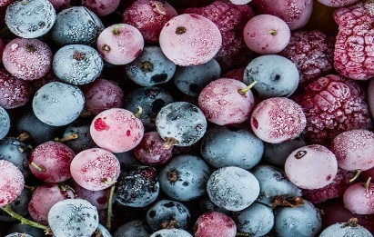
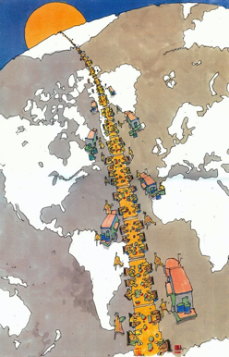
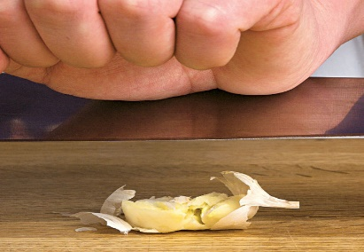
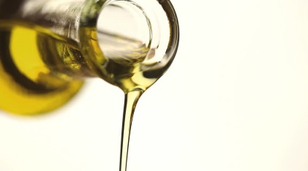
Artist Seitu Jones started a project called Community Meal, in which 2,000 people from his neighborhood shared a meal together to engage in conversations about healthy eating and the food system around them. He invited the farmers and workers that grew and raised the majority of the food that gets sold within their town. The Community Meal was an opportunity to invite people to learn about the food system that they have access to and to encourage healthier food choices.
Community Meal
Seitu Jones
Frozen fruits or veggies can sometimes offer more nutrients than freshly bought produce. Frozen produce is often picked at peak ripeness whereas fresh produce can be picked when unripe yet.
Smash garlic and let sit for 10 minutes before cooking to release potent antioxidants that would have been lost when cooked or directly put in.
Adding oil or fat source to fruits & veggies allows maximum absorption of essential vitamins A, D, E, K and other antioxidants.
Notes:
Diana Lau

