Slide 1

U.S. II
Lessons of History: Negotiations over Taiwan
Congress
Executive
Ideology

Slide 2
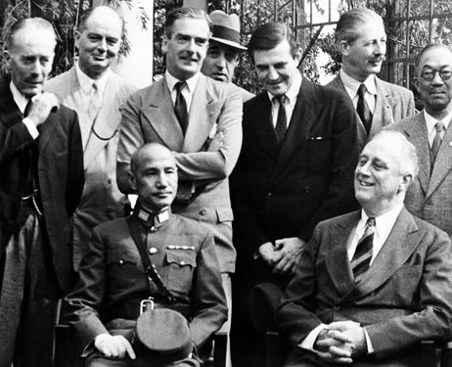

Slide 3
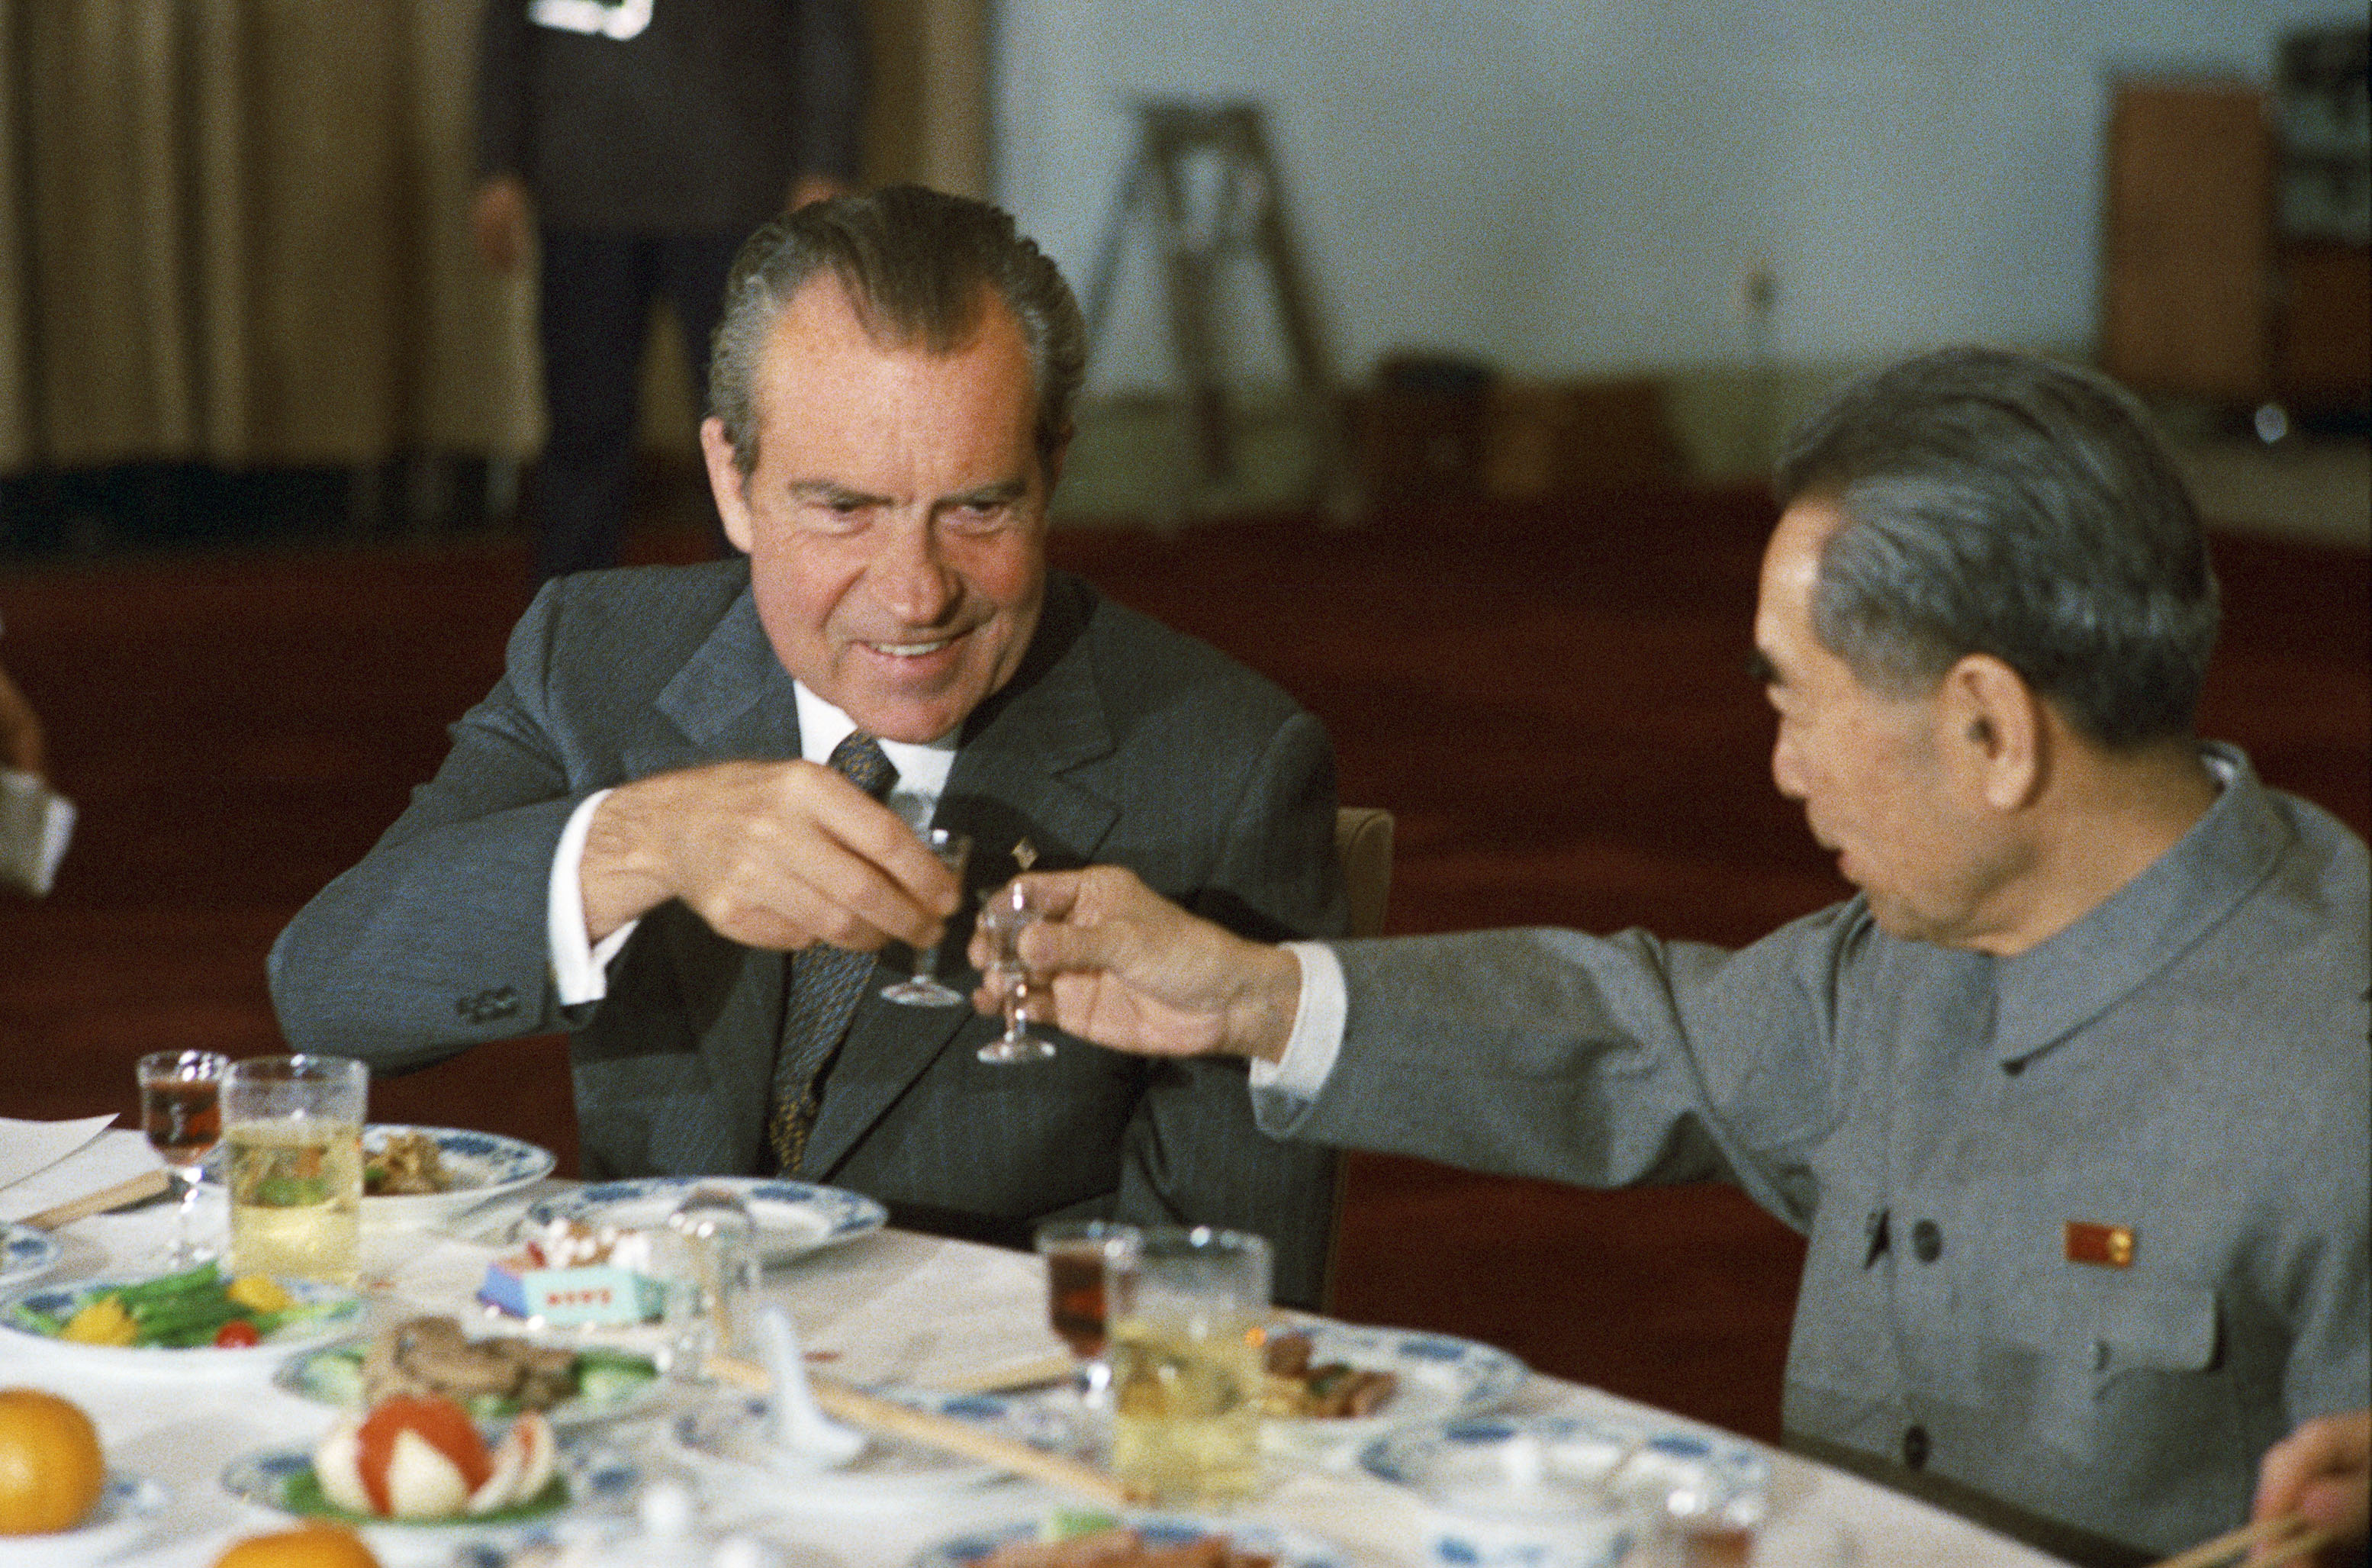

Slide 4
1972 Shanghai Communique
The United States acknowledges that all Chinese on either side of the Taiwan Strait maintain there is but one China and that Taiwan is a part of China. The United States Government does not challenge that position. It reaffirms its interest in a peaceful settlement of the Taiwan question by the Chinese themselves. With this prospect in mind, it affirms the ultimate objective of the withdrawal of all U.S. forces and military installations from Taiwan. In the meantime, it will progressively reduce its forces and military installations on Taiwan as the tension in the area diminishes.

Slide 5
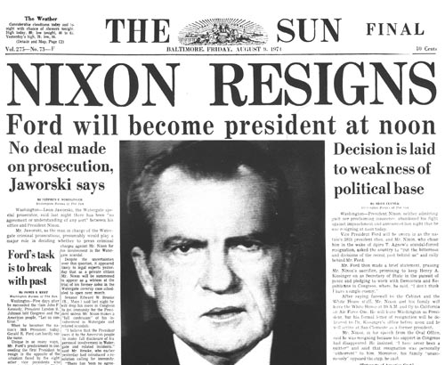

Slide 6
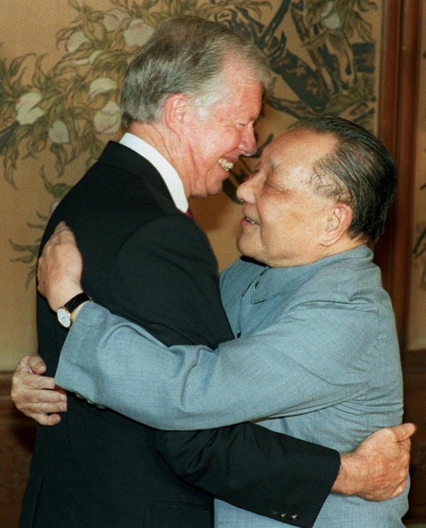

Slide 7
1979 Taiwan Relations Act
It is the policy of the United States—
To make clear that the United States decision to establish diplomatic relations with the People's Republic of China rests upon the expectation that the future of Taiwan will be determined by peaceful means;
To consider any effort to determine the future of Taiwan by other than peaceful means, including by boycotts or embargoes, a threat to the peace and security of the Western Pacific area and of grave concern to the United States;
To provide Taiwan with arms of a defensive character; and
To maintain the capacity of the United States to resist any resort to force or other forms of coercion that would jeopardize the security, or the social or economic system, of the people on Taiwan.

Slide 8
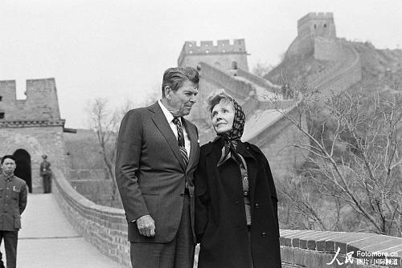

Slide 9
1982 Shanghai Communique
Having in mind the foregoing statements of both sides [that is, that China is seeking peaceful resolution of the Taiwan issue while the US has no intention of infringing Chinese sovereignty], the U.S. Government states that it does not seek to carry out a long-term policy of arms sales to Taiwan, that its arms sales to Taiwan will not exceed, either in qualitative or in quantitative terms, the level of those supplied in recent years since the establishment of diplomatic relations between the United States and China, and that it intends to reduce gradually its sales of arms to Taiwan, leading over a period of time to a final resolution.

Slide 10
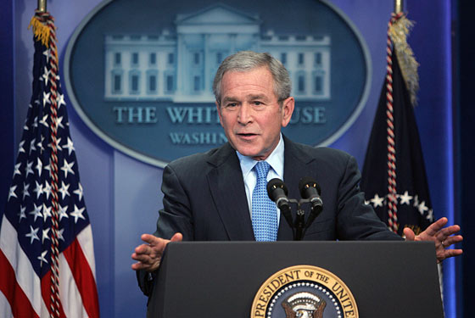

Slide 11
U.S. II
Lessons of History: Negotiations over Taiwan
Congress
Executive
Ideology

Slide 12


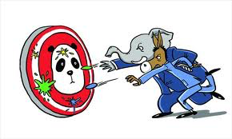

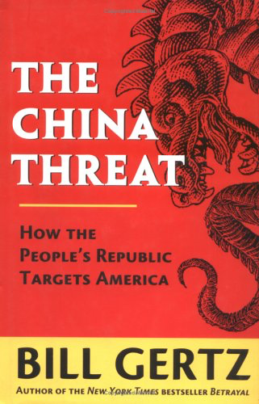

Slide 13
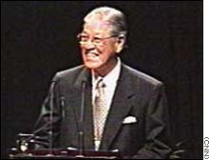
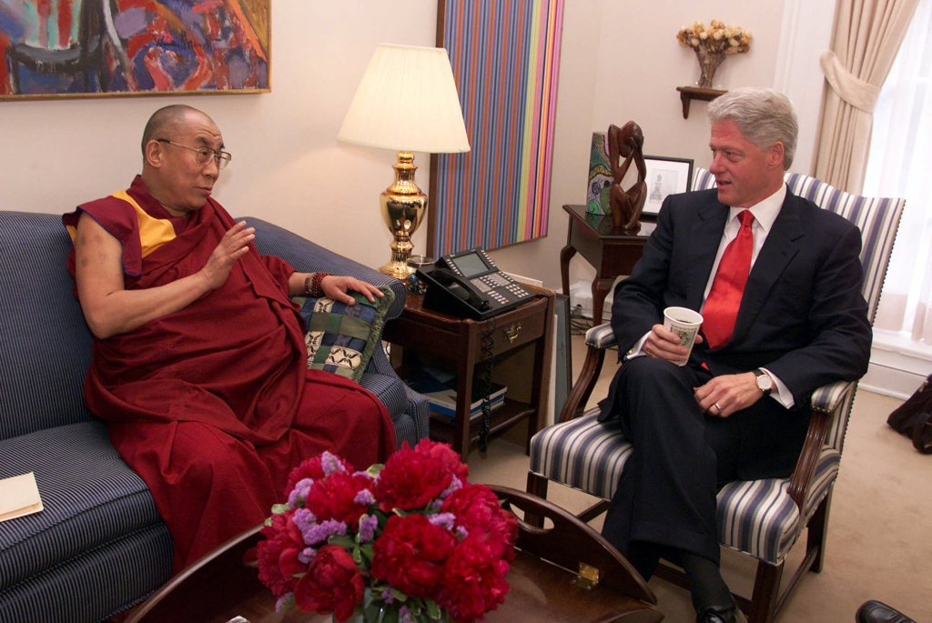
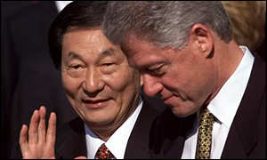

Slide 14
U.S. II
Lessons of History: Negotiations over Taiwan
Congress
Executive
Ideology

Slide 15


Slide 16
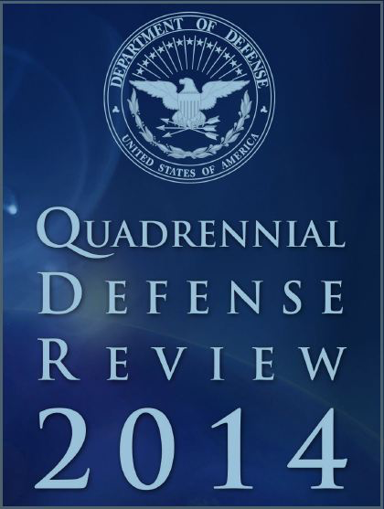

Slide 17
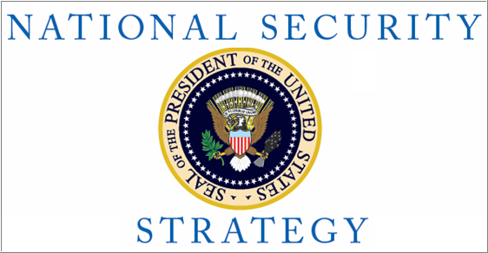

Slide 18
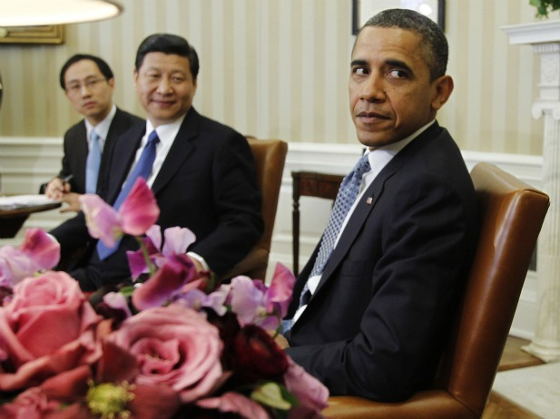

Slide 19
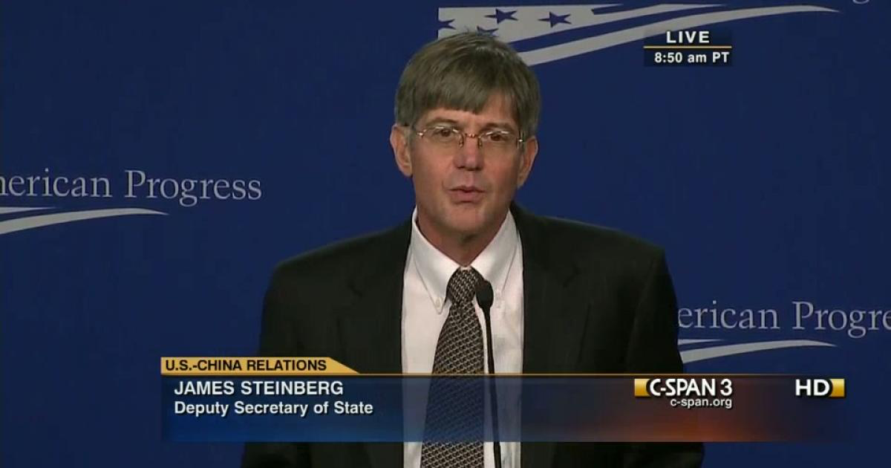

Slide 20
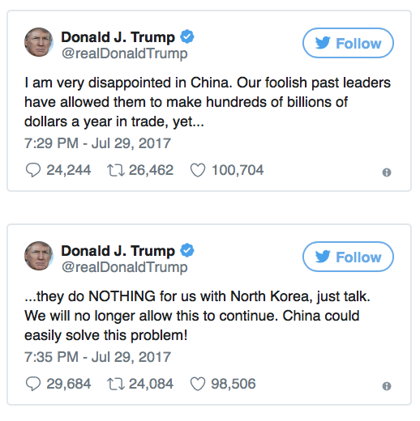

Slide 21
U.S. II
Lessons of History: Negotiations over Taiwan
Congress
Executive
Ideology

Slide 22
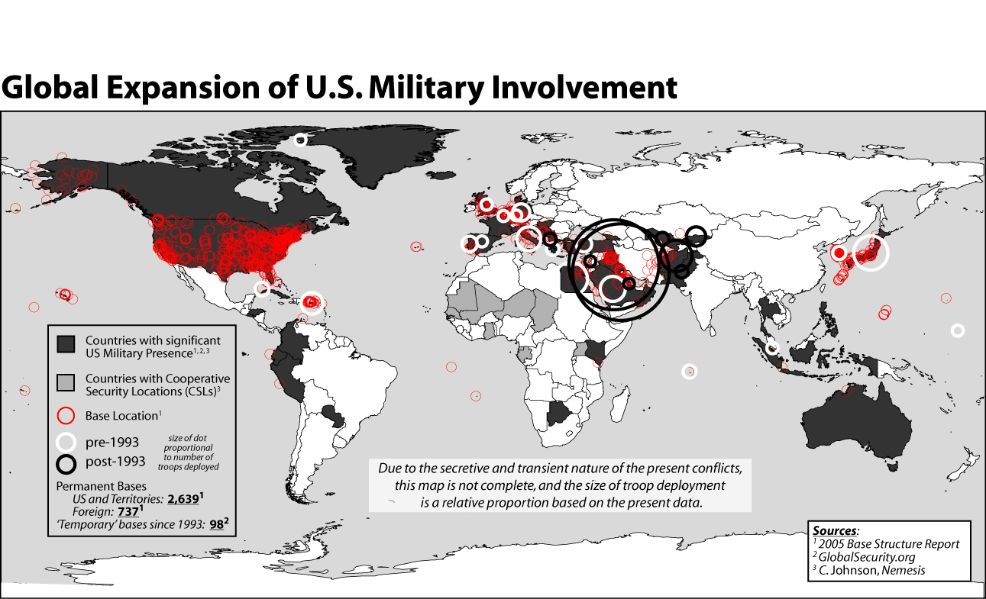

Slide 23


Slide 24
