Slide 1
Explore
Animal
the
Kingdom
Luna
with
By: Kianie Ramirez

Slide 2
Author Statement
Explore the Animal Kingdom with Luna is a depiction of a young girl who has visual impairments. Luna’s mother knows she loves animals, so she takes Luna to the Boston Animal Rescue Center. Acting as a guide, Luna’s mom helps Luna explore the animal kingdom using her sense of touch, smell, and hearing.
While developing this book there were many features I wanted to include, but couldn’t because I was “limited.” However, I realized how ebooks offer ample and different opportunities to provide interactive and inclusive designs. Throughout, I strived to include different features of the animals and their habitats like many images, sounds, and videos. For the senses I could not directly include, I tried using very descriptive explanations using similes and metaphors to familiar things. At the end of the book, I provide an interactive matching activity in order for the child to see what they learned about animals.
Regardless of visual impairments, I hope all children are able to explore the animal kingdom with Luna.

Slide 3


Boston Animal Rescue Center
Welcome to the Boston Animal Rescue Center! You’ll get to meet animals from all over the world.
They hope to send animals back to their homes once they are healthy again!
JUAN
MOM
I love animals!!
LUNA

Slide 4
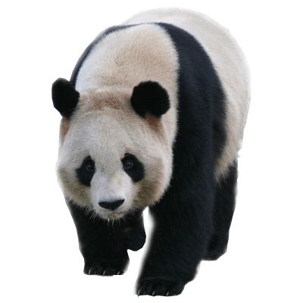
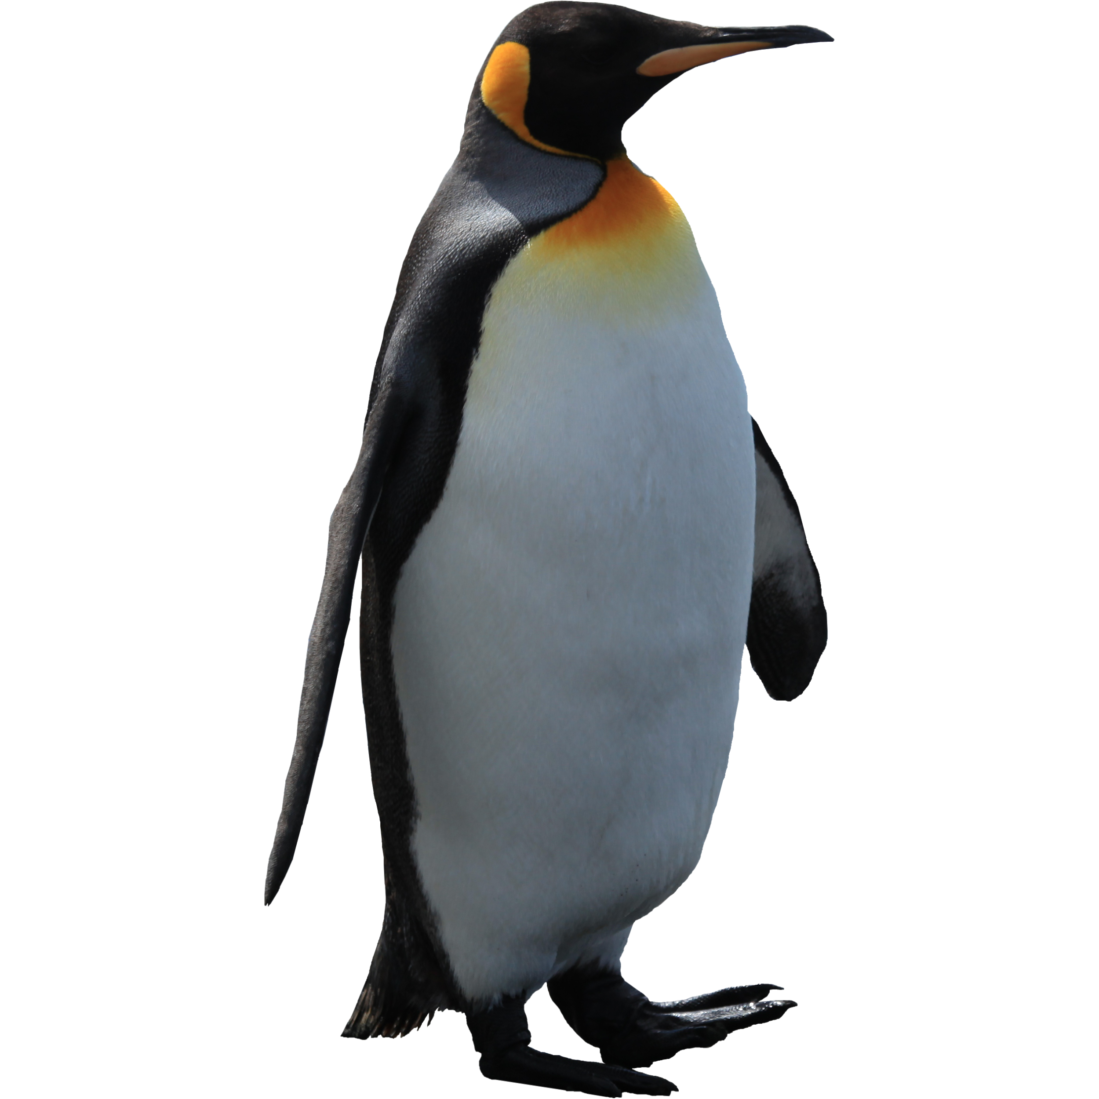
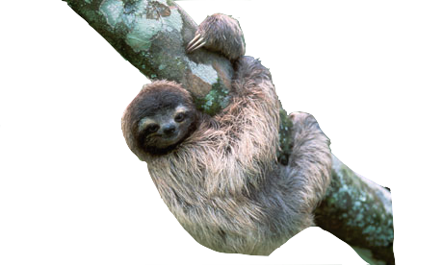
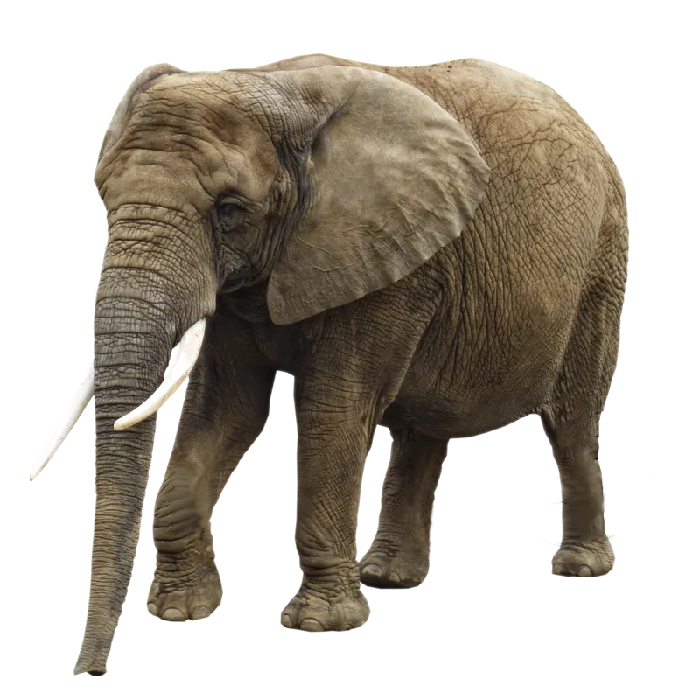
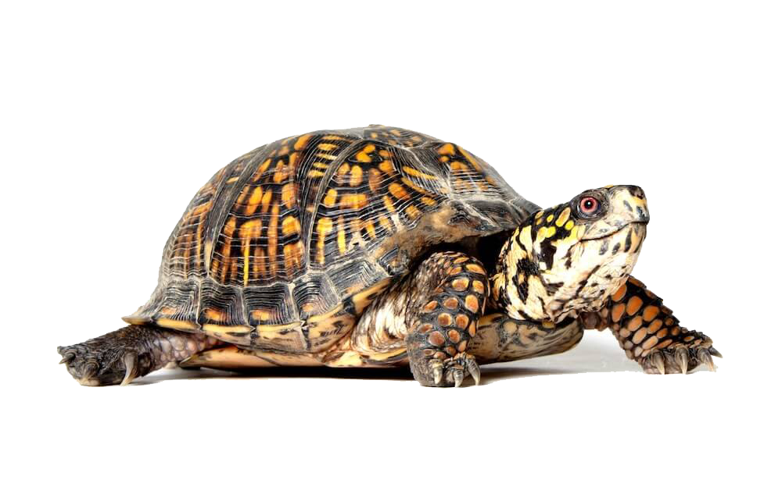

Click on an animal to visit with Luna!

Slide 5

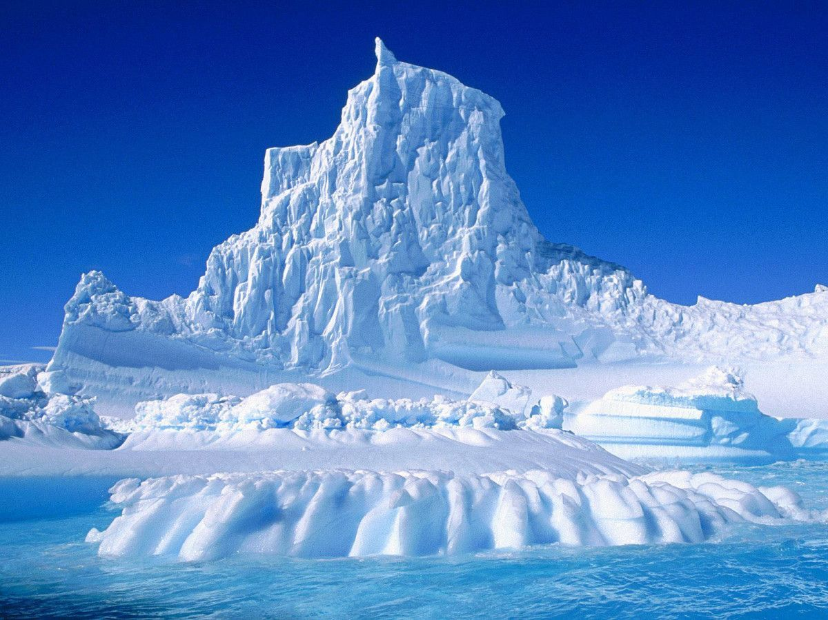
GO BACK
Meet Mr. Penguin
Juan: Once his wings are healed and strong, he can return home in Antarctica.
Mom: Antarctica is all ice and colder than our Boston winters
Luna: Brrr, I would need to drink a lot of hot chocolate if I was there!
Press button to hear Mr. Penguin say Hi!
BRRR!!!

Slide 6
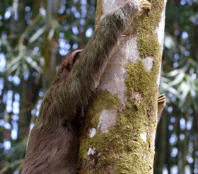


GO BACK
Meet Mr. Sloth
Juan: At home, he likes to relax and sleep in trees. He’s originally from the rainforest where you can hear birds faintly chirping, the rain pitter-pattering, and the thunder rumbling.
Luna: Mr. Penguin smelt like fish, but I can’t smell Mr. Sloth.
Juan: In order to hide from predators sloths don’t have a scent.
Press button to hear
the rainforest!

Slide 7
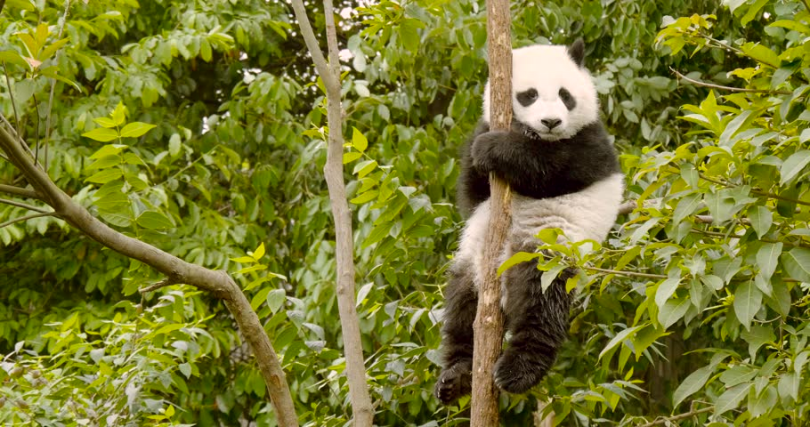
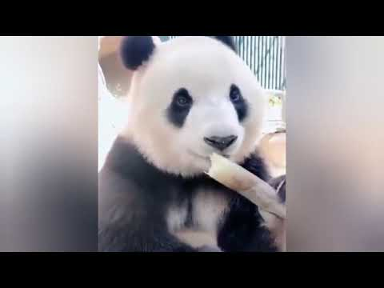
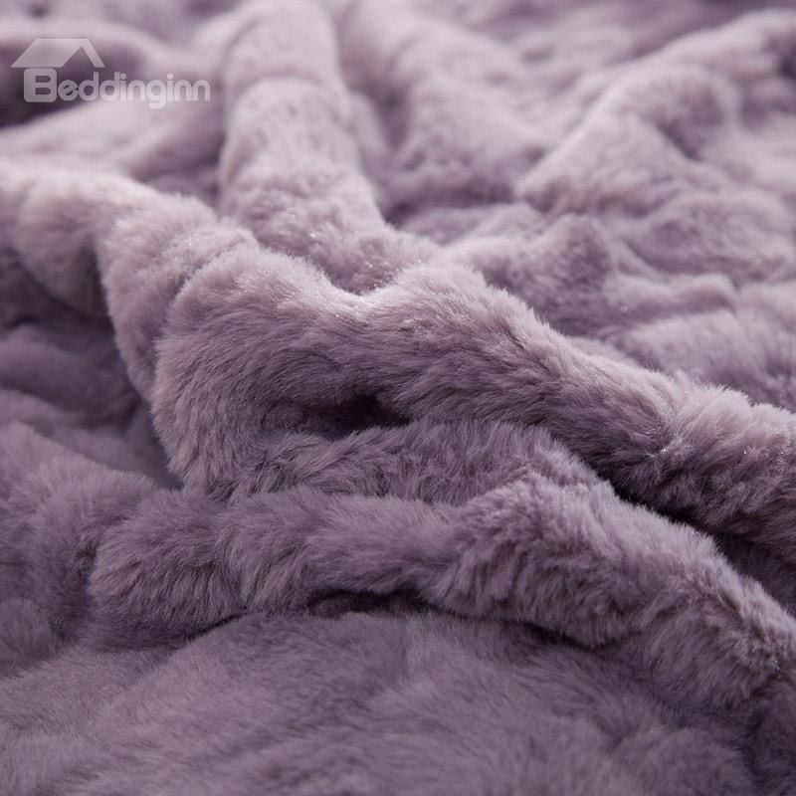
Meet Baby Panda
GO BACK
Juan: She loves climbing huge trees as strong as steel, wandering in bright green forests, and eating yummy green leaves from bamboo trees.
Luna: Wow, Baby Panda feels as fuzzy and soft as my fuzzy blanket at home! She also sounds like me when I eat carrots or celery. CRUNCH!
Mom: Yes, she’s munching on bamboo leaves.
Baby Panda’s home
Play video to hear Baby Panda eat!
Luna’s fuzzy blanket

Slide 8
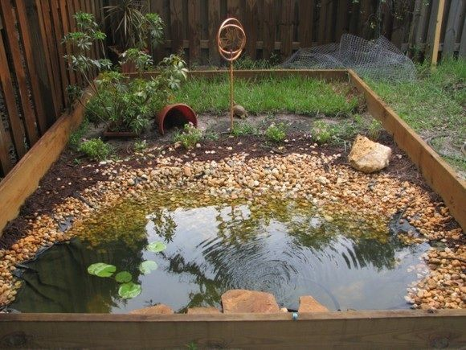


GO BACK
Meet Miss Turtle
Juan: Turtles can be found all over the world. She likes to swim in shallow water up to your ankles and live on land
with pebbles the size of pencil erasers.
Luna: Her shell feels as hard as a rock!
Mom: Be careful though because you are only touching her shell. Her actual body and head is softer, like your skin.
Juan: She can pop her head in and out of her shell, like those whack-a-mole games, in order to hide from predators.
Miss Turtle’s home

Slide 9
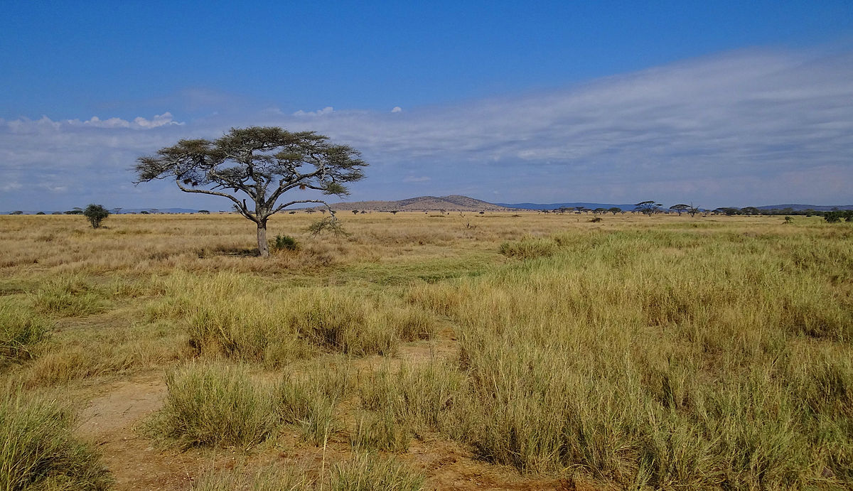
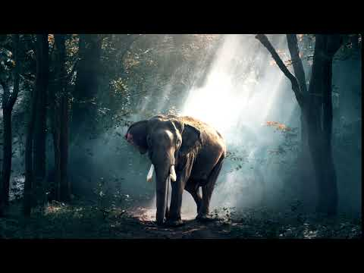
GO BACK
Missy Elephant
Luna: I love elephants! I know they can live in various places in Africa like in dry yellow-brown grasslands or bright green grassy fields.
Mom: They can also live in wetlands which feel like the mucky mud after it rains.
Juan: Here she comes, say hi!
Luna: Hello Missy Elephant
Missy’s
Home
Press video to hear Missy say hi!

Slide 10
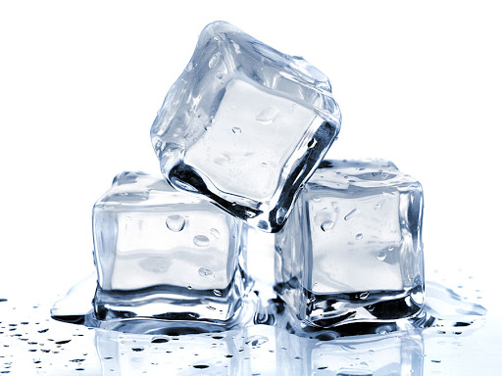


GO BACK
What did Luna and you learn today?
Please exit presentation mode then drag and drop images on the right to corresponding sentences on the left.
Example: Penguins love ___________.
Sloths do not have a __________.
Pandas are fuzzy like __________.
Turtles have a shell as hard as a _________ to protect them.
When done, click arrow to reveal the matches!
Elephants are _________!

Slide 11
GO BACK
What did Luna and you learn today?
Please exit presentation mode. Drag and drop images on the right to match with the animals & sentences on the left.
Example: Penguins love ___________.
Sloths do not have a __________.
Pandas are fuzzy like __________.
Turtles have a shell as hard as a _________ to protect them.
Elephants are _________!

