Slide 1

Let’s Go to the Mosque!
By Hasan Khan

Slide 2
Author Statement:
“Let’s Go to the Mosque!” aims to describe the kind of welcoming Muslim community I experienced while growing up. Mosques beyond just my own provide subtitles for khutbas and services, audiobooks, Qur’ans in braille, open floor plans, and more. Above all else, prayer is not understood as strict physical acts but a state of mind that everyone embodies personally. To these ends, I have provided a narrated version of the story by pressing the action button in the upper left corner. Info buttons are around the page to explain some words in Arabic using slides after the end of the story. You can return to the story using the action button in the bottom right corner (alt text has been provided on these pages).

Slide 3
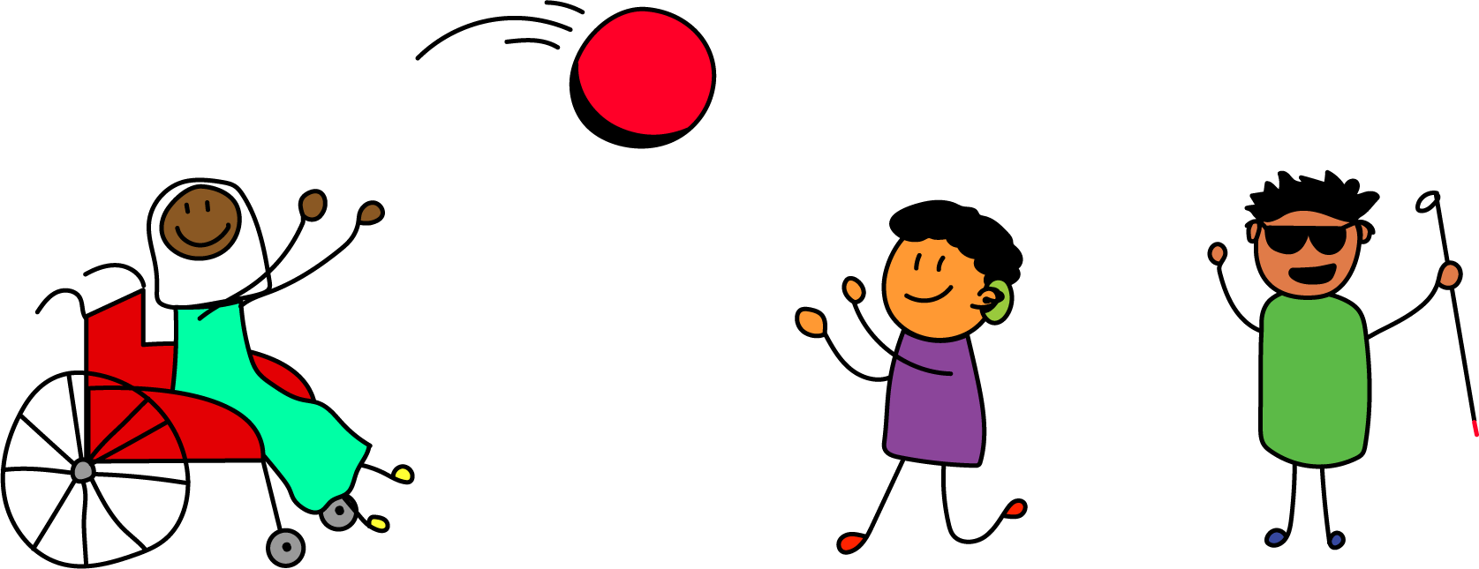
1
Selma, Harris, and Adam know it’s time for Jumu'ah at one o’clock on Fridays. They finish their game and head towards the mosque.

Slide 4

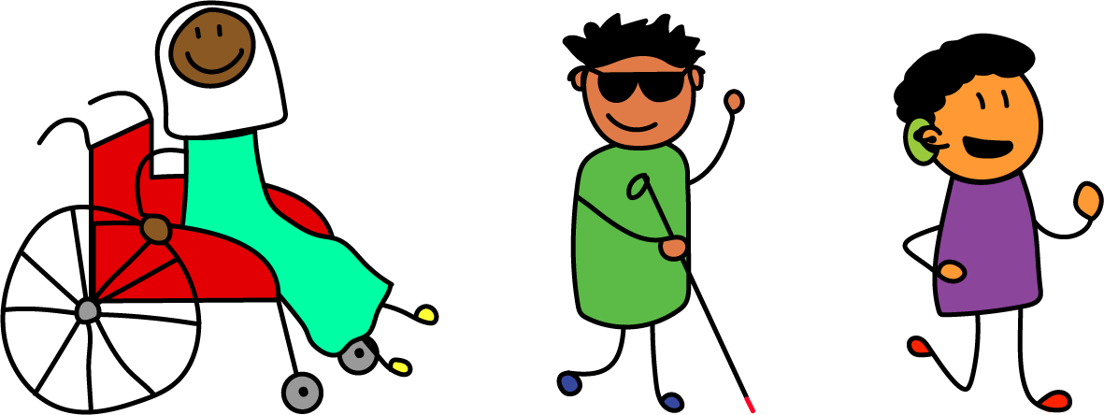
2
As they near the mosque, Harris can see his Baba giving the Athan from the high porch.

Slide 5
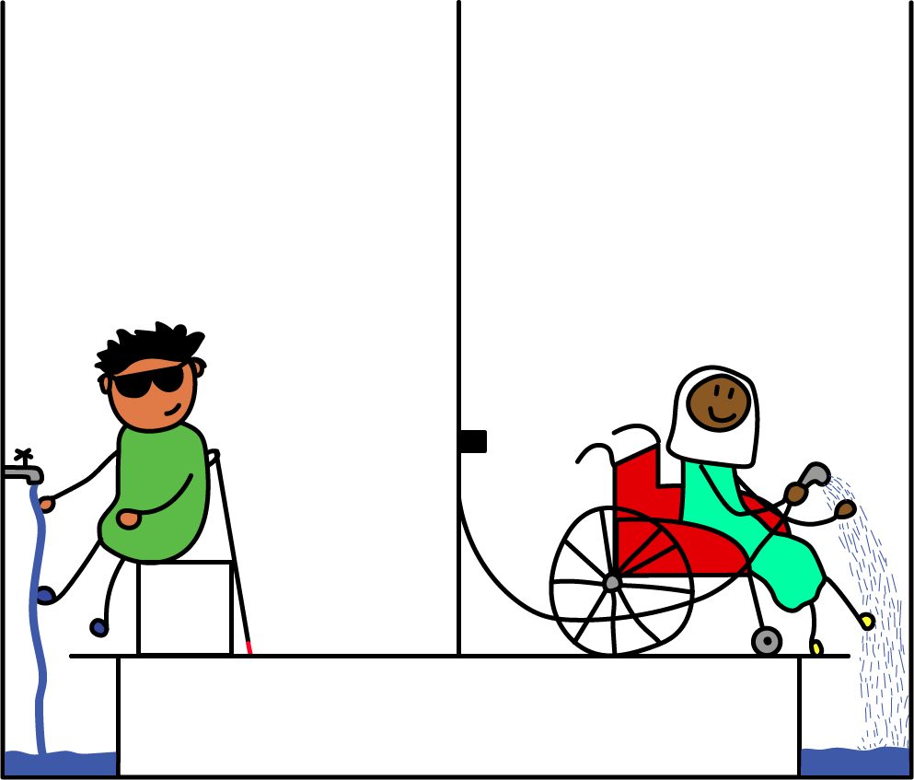
3
Before they can pray, everyone has to make wudu!

Slide 6
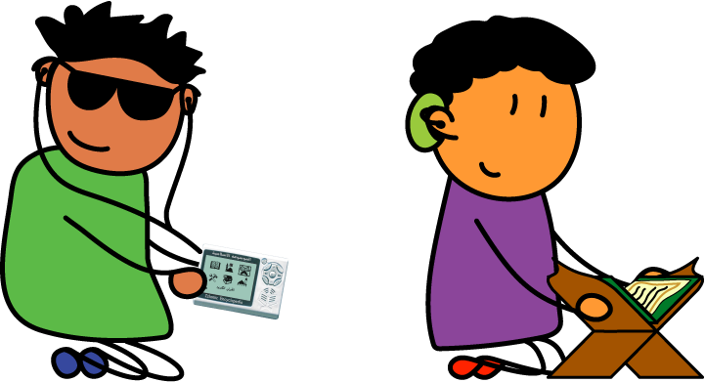
4
Before the service starts, Adam listens to and Harris reads the Qur’an while they wait.

Slide 7
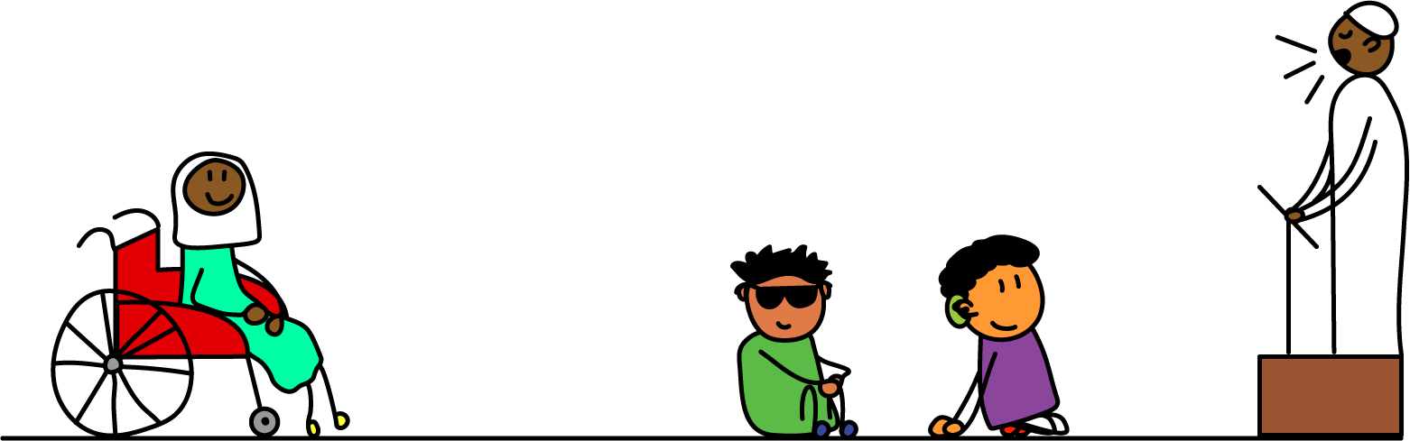
5
There are no seats inside the mosque! Everyone gets to choose the seat that works for them.

Slide 8
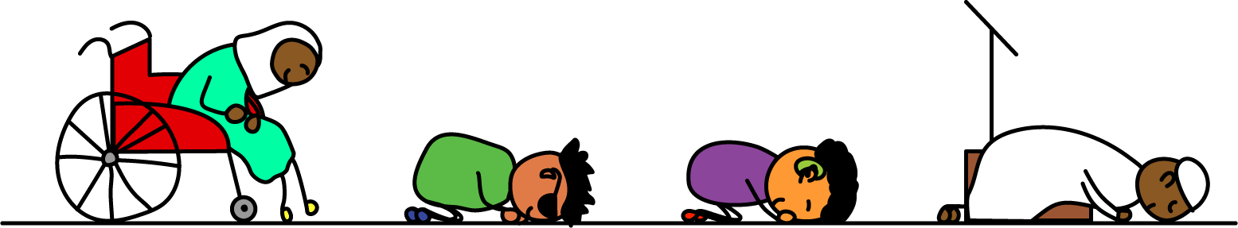
6
Allah has made prayer easy on us—He loves every way we are able to offer it! Before Him, we are each doing exactly as we should be.
The End!

Slide 9
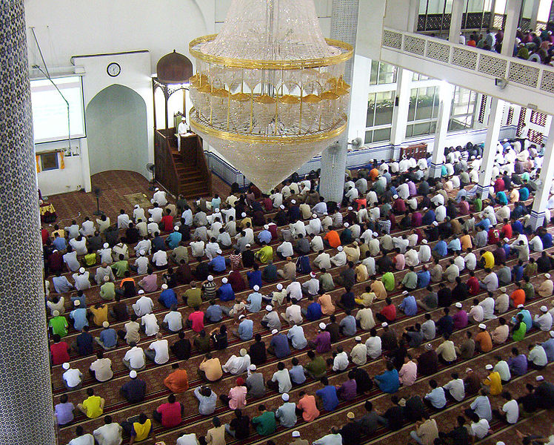
Jumu’ah
Jumu’ah is an Islamic service that occurs in place of the noon prayer on Fridays. A speaker, known as the khateeb, gives a sermon, known as a khutba, before leading prayer.
Copyright Self, 2001

Slide 10
The Athan
The athan is the call to prayer in Islam. The person who makes the call is called the mu’adhin, or caller, and typically does so from the top of a minaret.

Slide 11
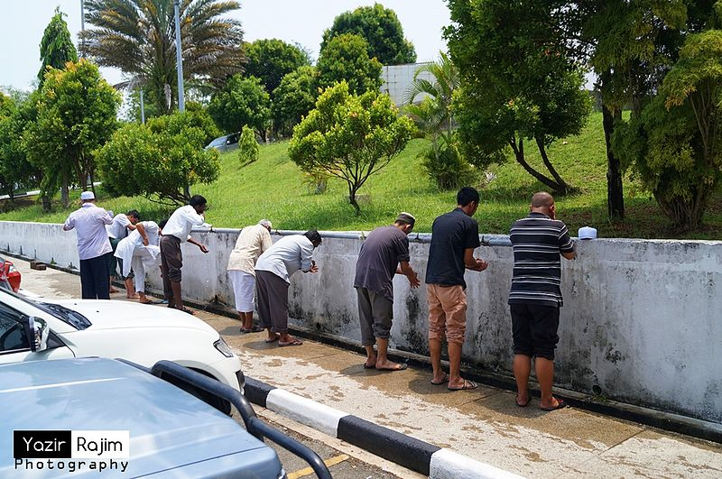
Wudu
Wudu is the mandatory ablution that is performed before saying prayer in Islam. The hands, mouth, nose, face, hair, arms, and feet are all washed.
Copyright Aliazer Abdurajim, 2012

Slide 12
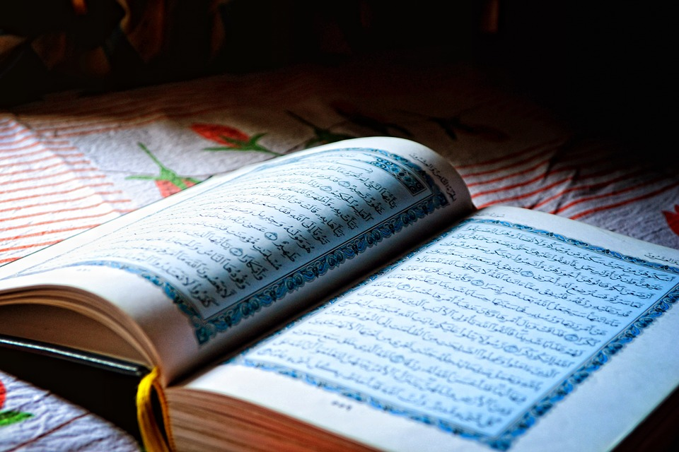
The Qur’an
The Qur’an is the holy text of Islam, said to be the word of God sent down to His last prophet, Muhammed (peace and blessings be upon him).
By Afshad from Pixabay

Slide 13
Credits
Mosque (modified) by parkjisun from the Noun Project
Background Track: Arabic Moon by Martijn de Boer (NiGiD) (c) copyright 2018 Licensed under a Creative Commons Attribution Noncommercial (3.0) license. Ft: Javolenus
“Athan from Aspire” by DohaIslamicEvents is licensed under a Creative Commons License

Slide 14
Credits (cont.)
Presentation Template: SlidesMania
Doodles: Jennifer Leban
Icons: Omar López
Images: Unsplash
Please keep this slide or mention us and the other resources used in the footer of a slide.

