Slide 1

Economic Policy II
Economy
  Jobs
  Commodity Markets
  Foreign Exchange
Environment
Public Health
Internet

Slide 2
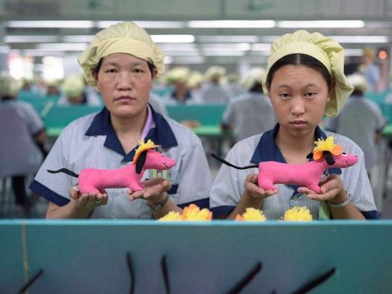

Slide 3
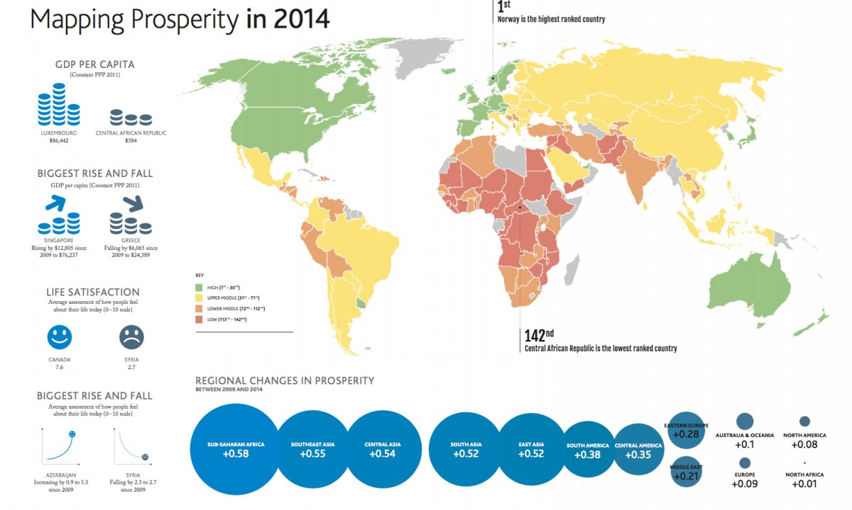

Slide 4
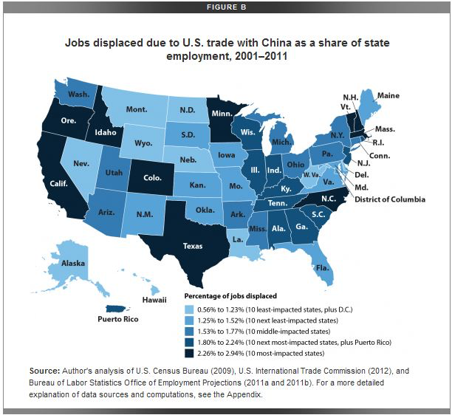

Slide 6
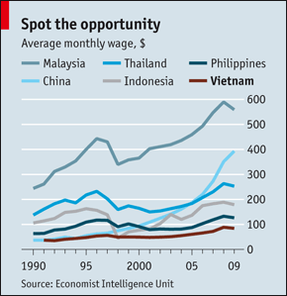

Slide 7





Slide 8
Economic Policy II
Economy
  Jobs
  Commodity Markets
  Foreign Exchange
Environment
Public Health
Internet

Slide 9
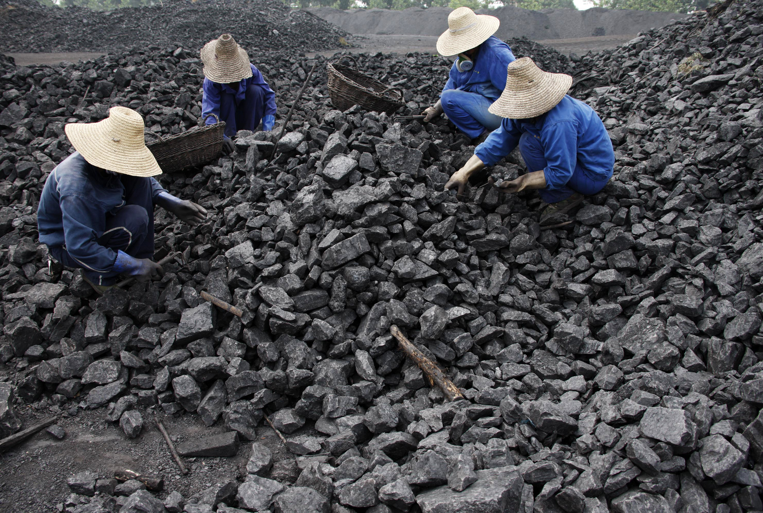

Slide 10
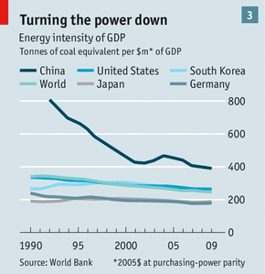

Slide 11
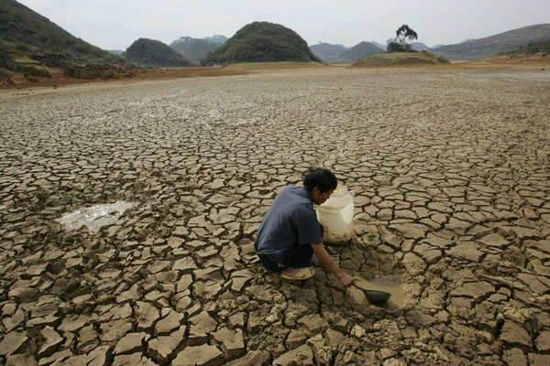

Slide 12
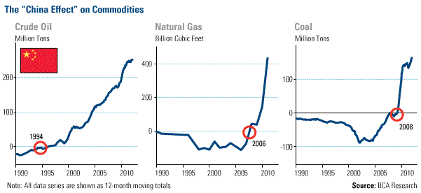

Slide 13
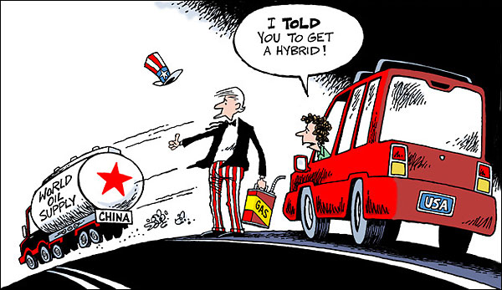

Slide 14
Economic Policy II
Economy
  Jobs
  Commodity Markets
  Foreign Exchange
Environment
Public Health
Internet

Slide 15
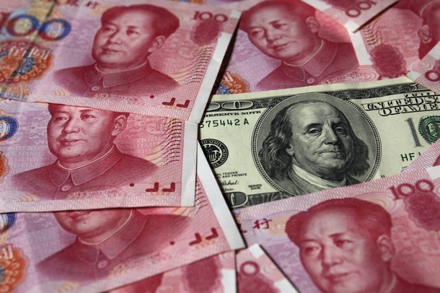

Slide 16

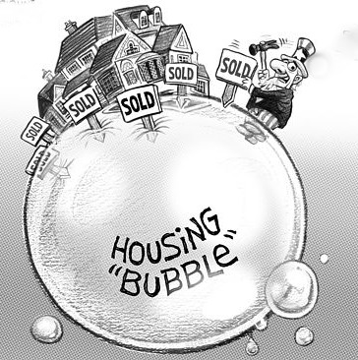
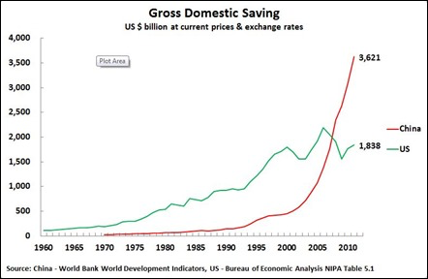

Slide 17
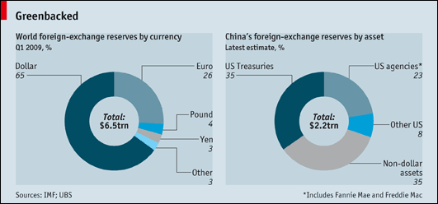


Slide 18
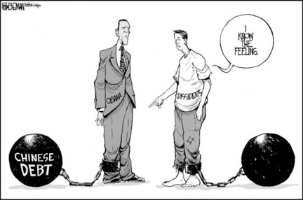

Slide 19
Economic Policy II
Economy
  Jobs
  Commodity Markets
  Foreign Exchange
Environment
Public Health
Internet

Slide 20
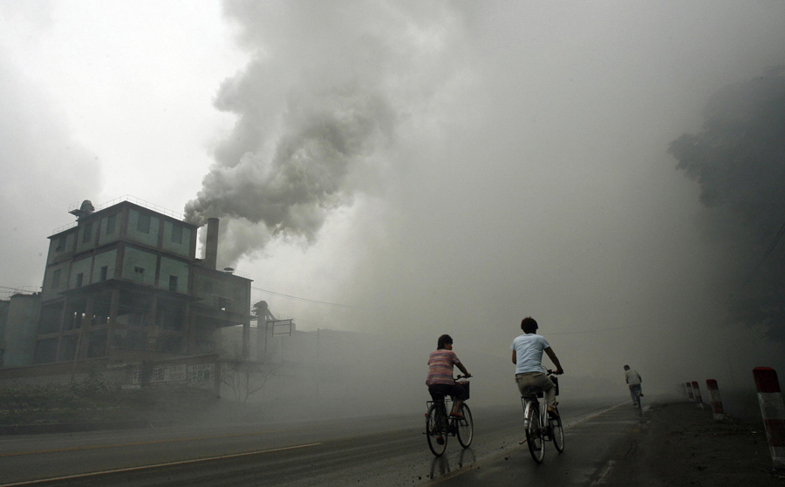

Slide 21
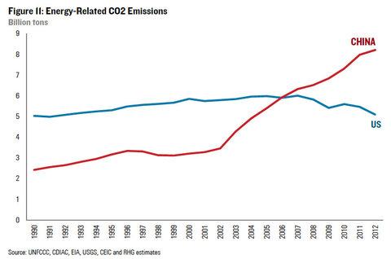

Slide 22



Slide 23
Economic Policy II
Economy
  Jobs
  Commodity Markets
  Foreign Exchange
Environment
Public Health
Internet

Slide 24

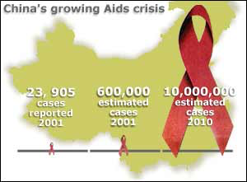

Slide 25
Economic Policy II
Economy
  Jobs
  Commodity Markets
  Foreign Exchange
Environment
Public Health
Internet

Slide 26
