Slide 1
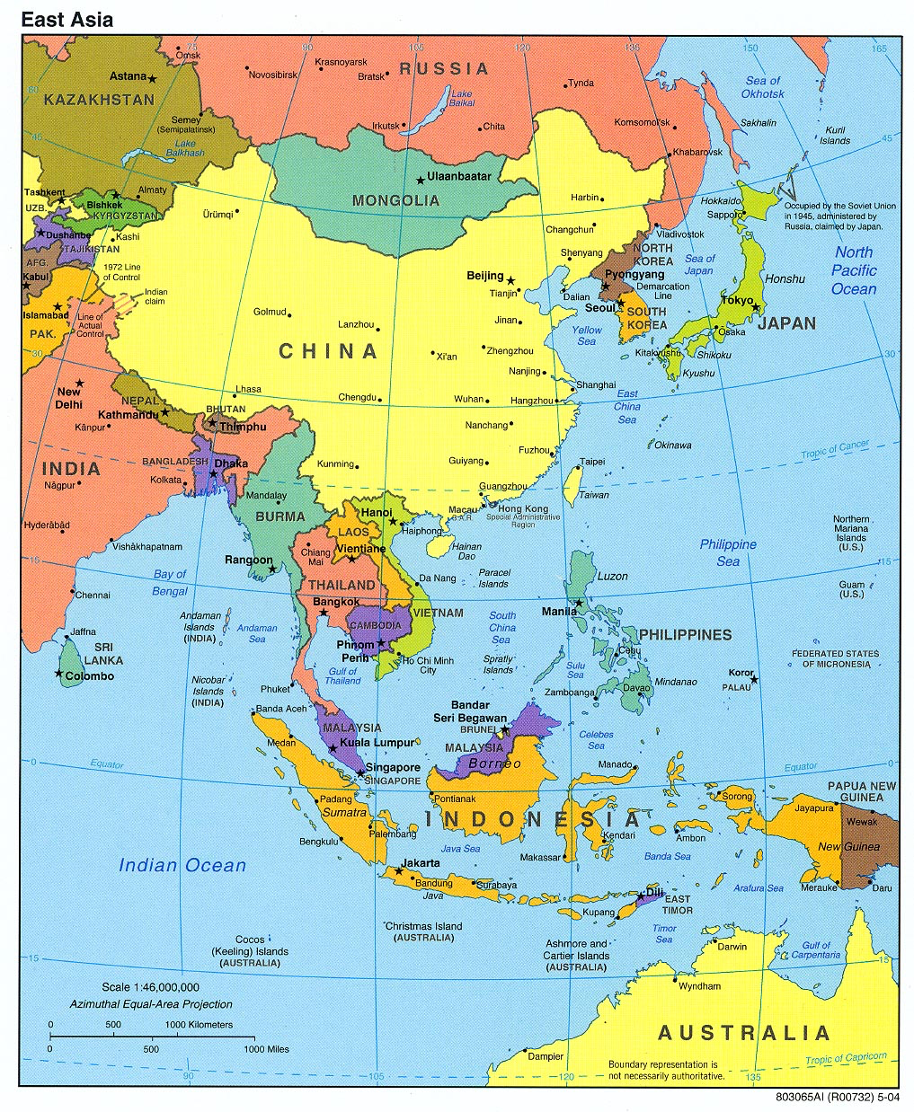


Slide 2
Southeast Asia
Maritime Southeast Asia
Oceania
Continental Southeast Asia
China-ASEAN relations

Slide 3
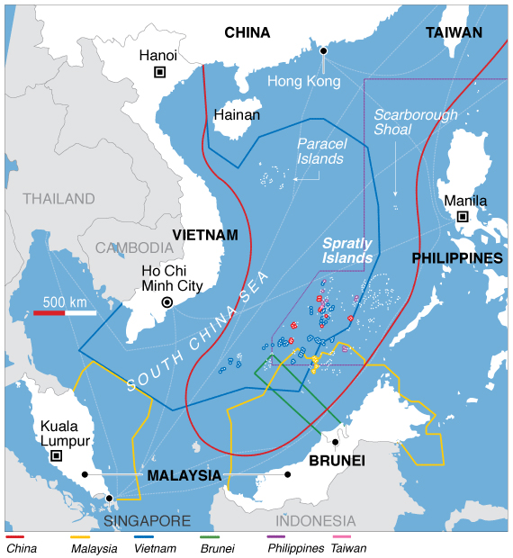

Slide 4
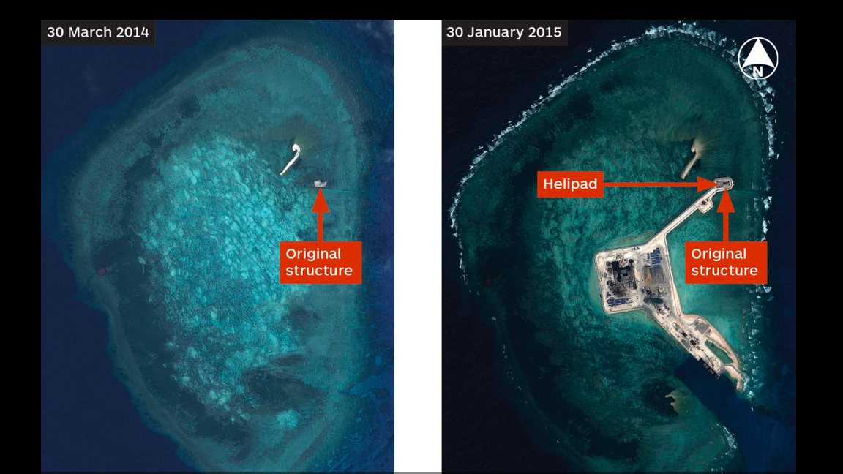

Slide 5
Southeast Asia
Maritime Southeast Asia
Oceania
Continental Southeast Asia
China-ASEAN relations

Slide 6
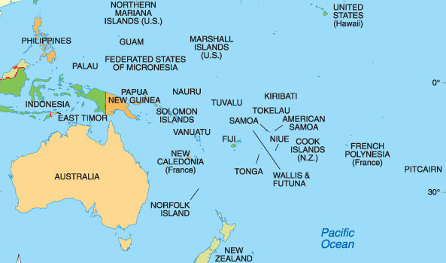

Slide 7
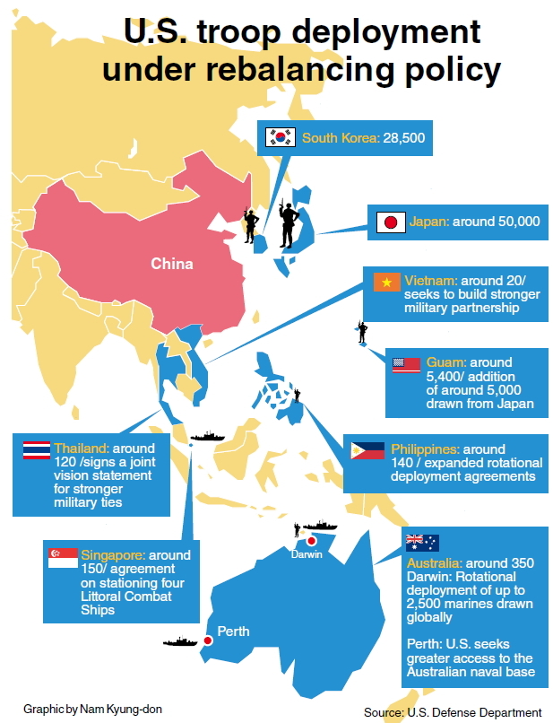

Slide 8
Southeast Asia
Maritime Southeast Asia
Oceania
Continental Southeast Asia
China-ASEAN relations

Slide 9
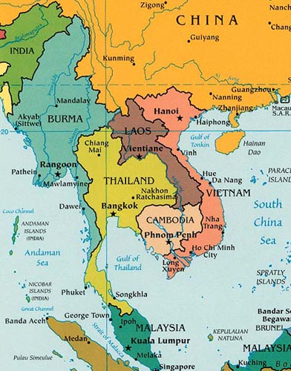

Slide 10
Southeast Asia
Maritime Southeast Asia
Oceania
Continental Southeast Asia
China-ASEAN relations

Slide 11
