Slide 1

Korea
A Tale of Two Koreas
Nuclear Crises
China’s Role in the Nuclear Crises
China’s Korea Strategy

Slide 2
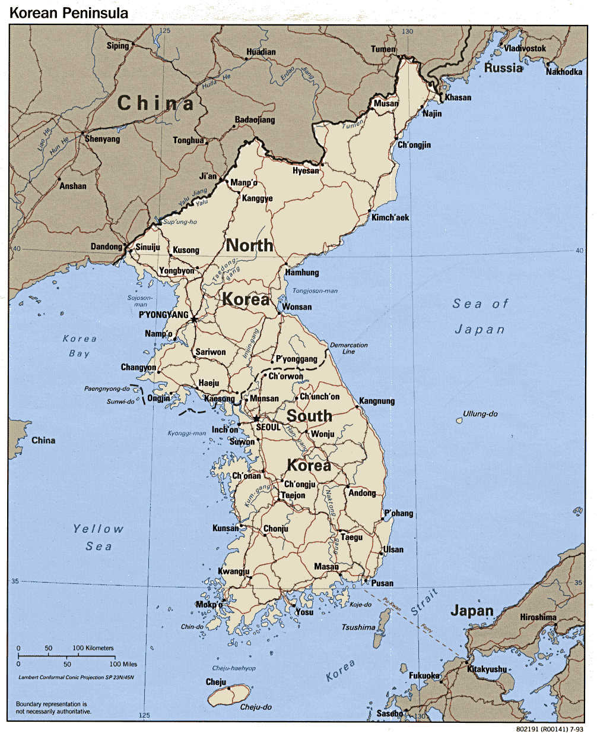

Slide 3
Korea
A Tale of Two Koreas
Nuclear Crises
China’s Role in the Nuclear Crises
China’s Korea Strategy

Slide 4
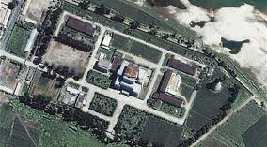

Slide 5
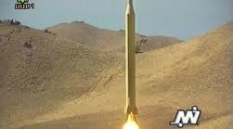

Slide 6
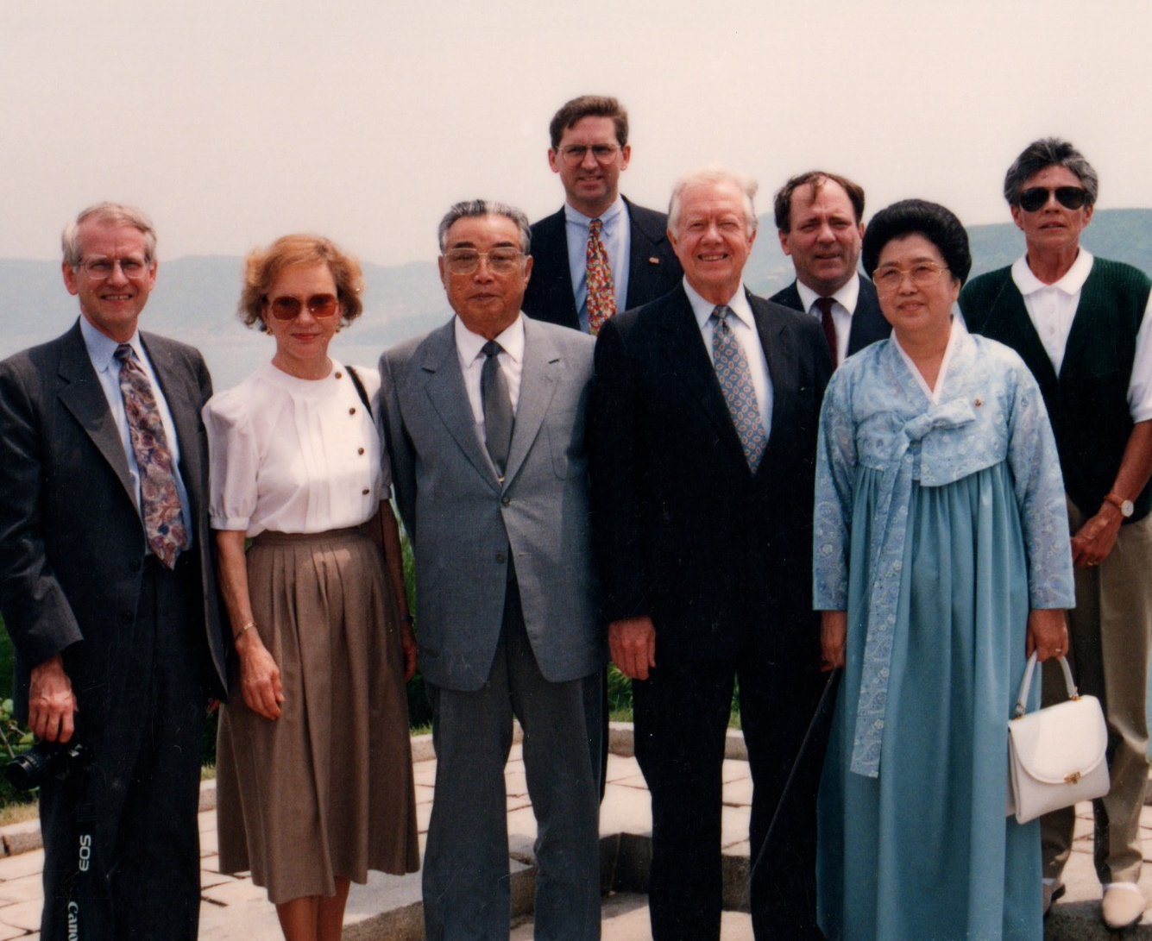

Slide 7
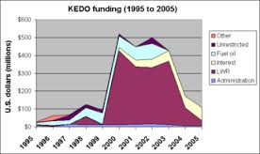

Slide 8
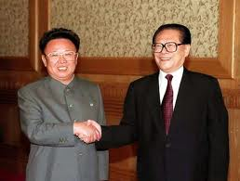

Slide 9
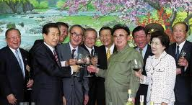

Slide 10
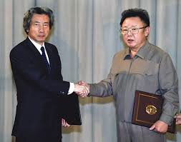

Slide 11
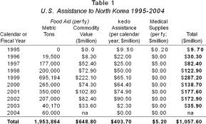

Slide 12
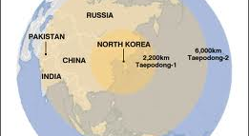

Slide 13
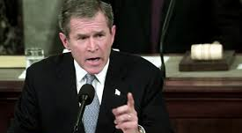

Slide 14
Korea
A Tale of Two Koreas
Nuclear Crises
China’s Role in the Nuclear Crises
China’s Korea Strategy

Slide 15
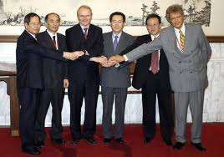

Slide 16
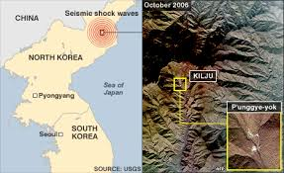

Slide 17
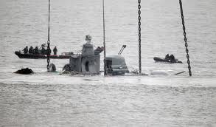

Slide 18
Korea
A Tale of Two Koreas
Nuclear Crises
China’s Role in the Nuclear Crises
China’s Korea Strategy

Slide 19
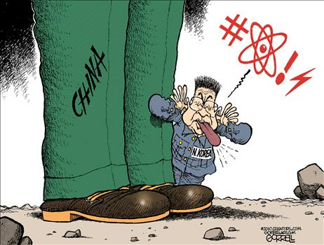

Slide 20
