Slide 1



Slide 2
External Drivers
Threats
Demography
Economics
Geography
History

Slide 3


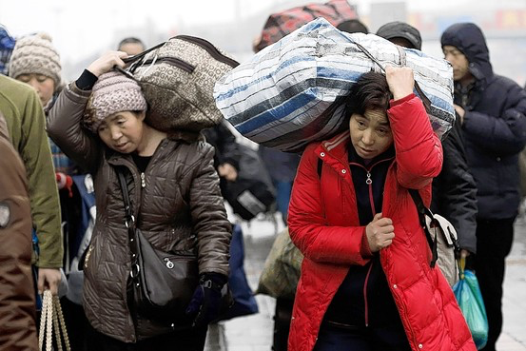

Internal Threats

Slide 4
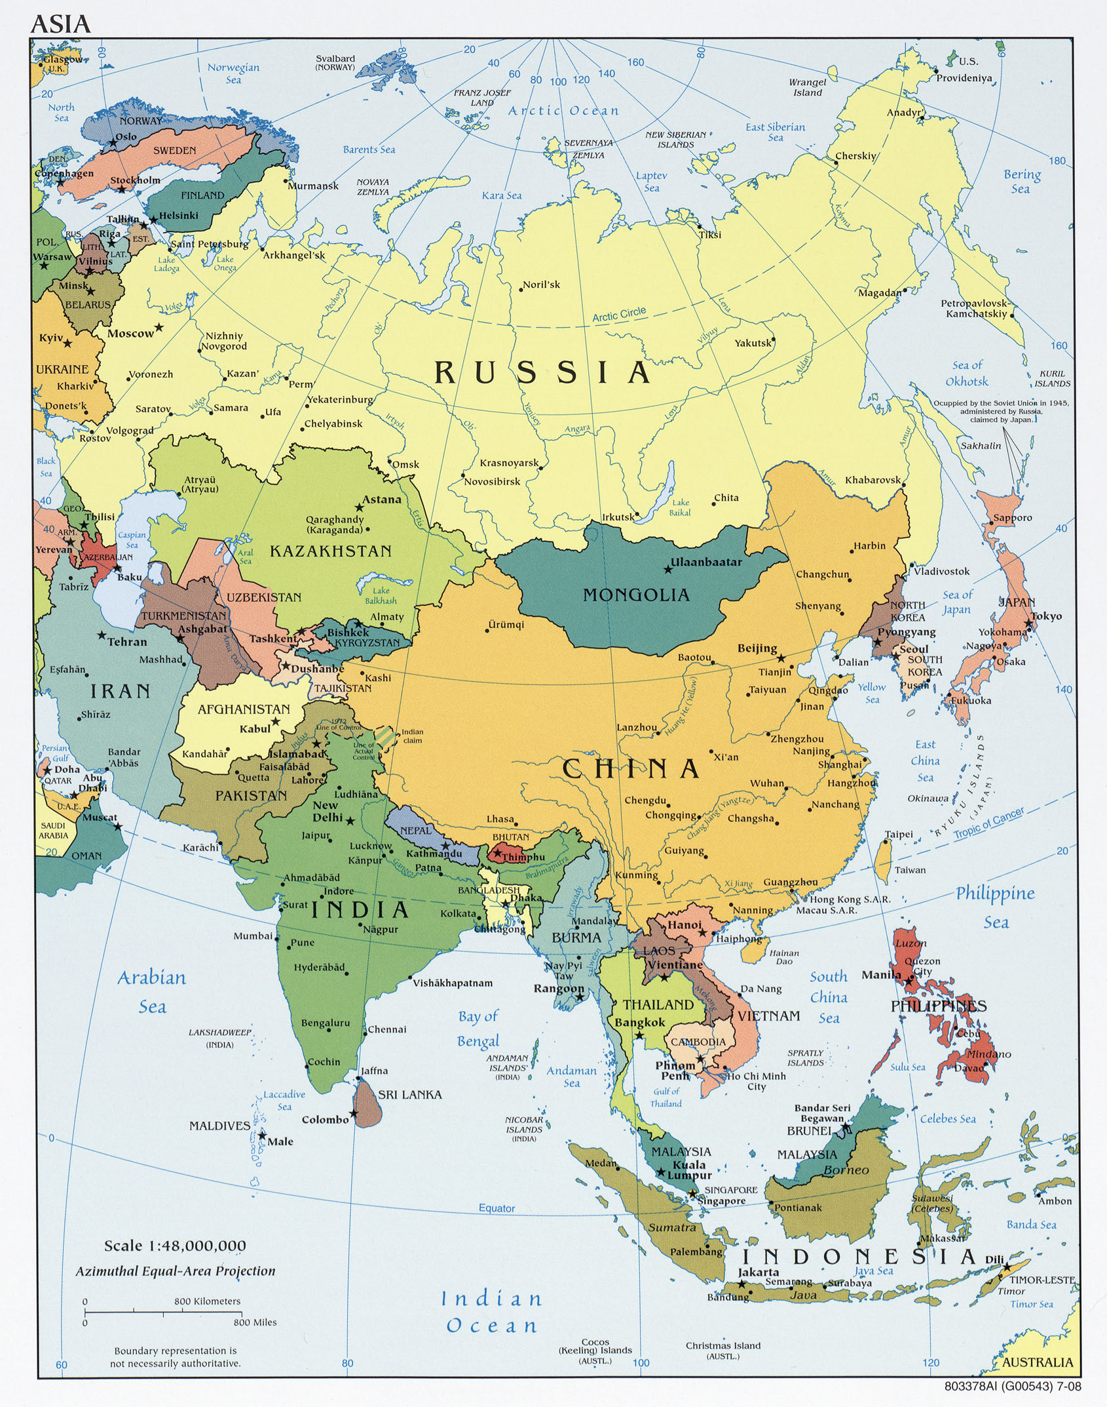
Regional Threats

Slide 5
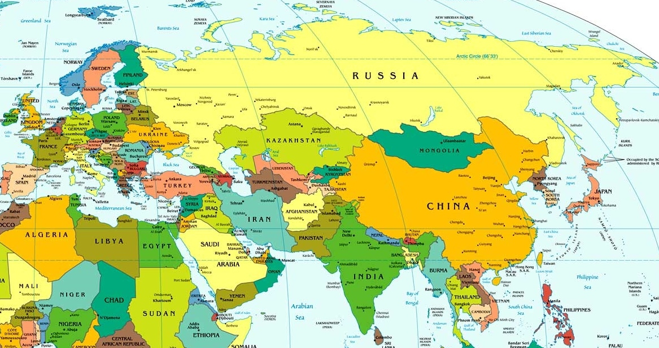
Global Threats

Slide 6
External Drivers
Threats
Demography
Economics
Geography
History

Slide 7
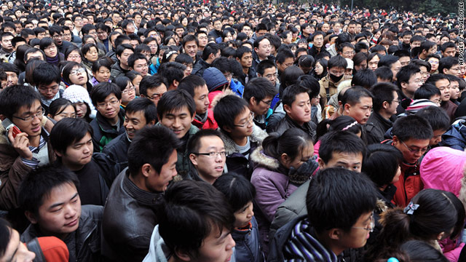

Slide 8
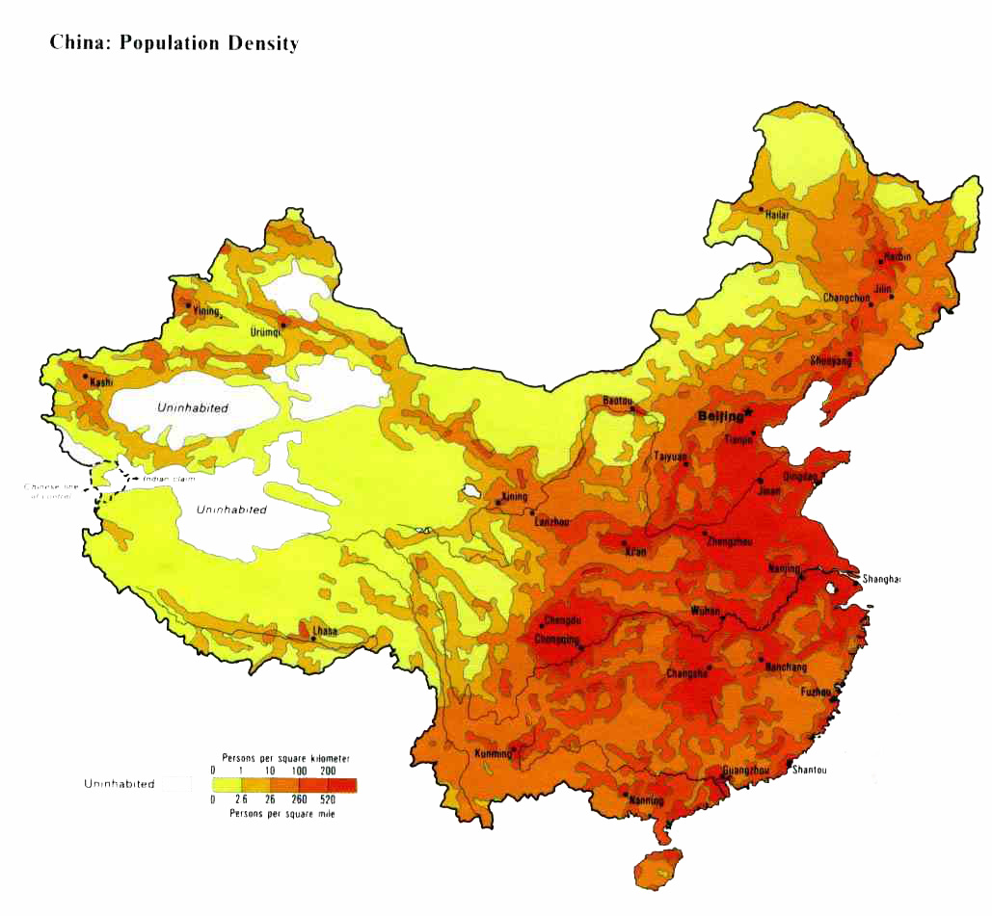

Slide 9
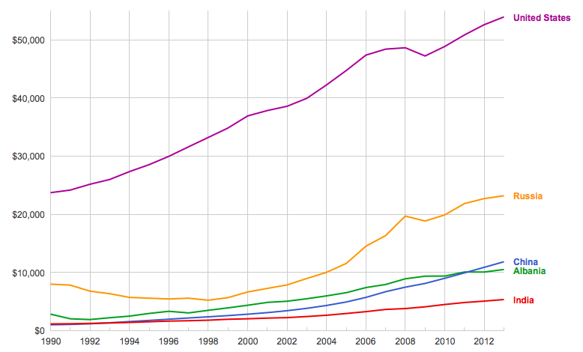

Slide 10
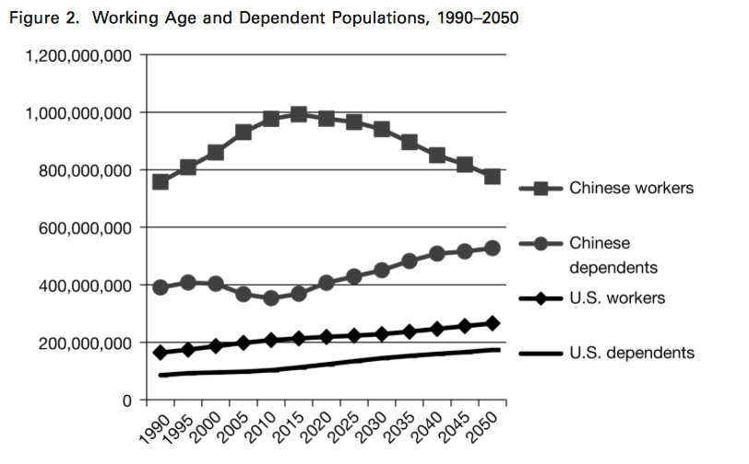

Slide 12
External Drivers
Threats
Demography
Economics
Geography
History

Slide 13
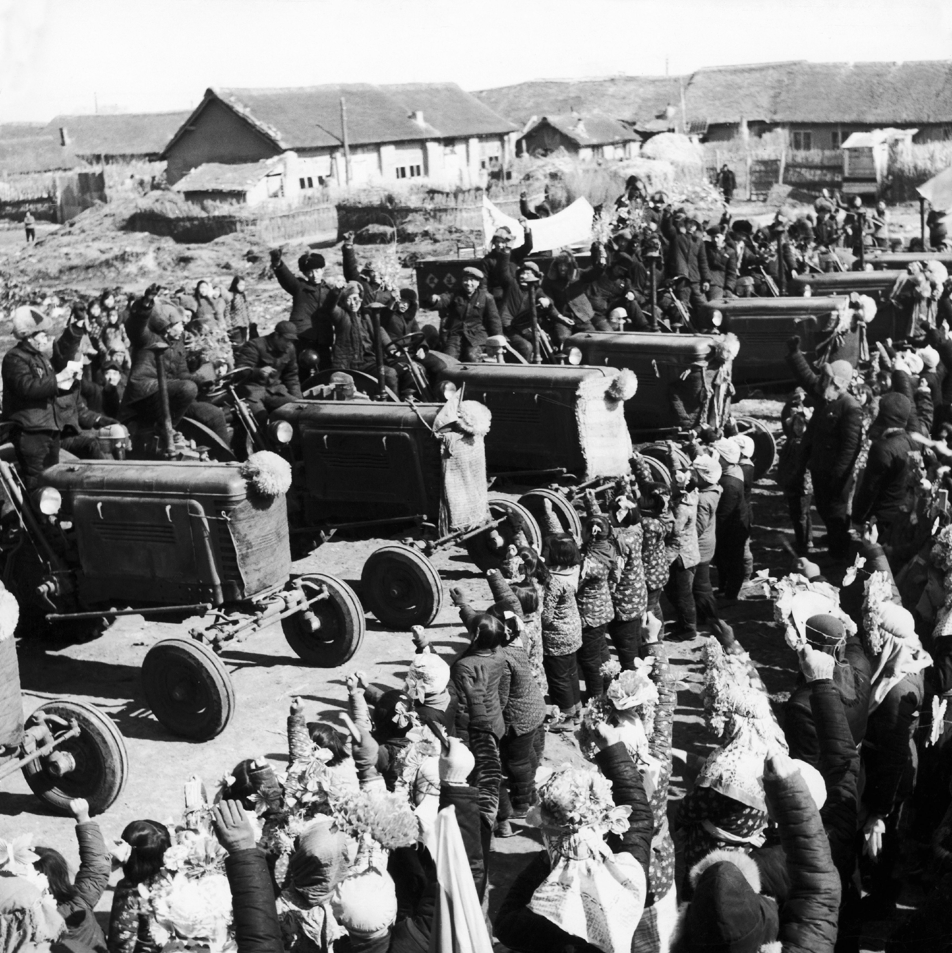

Slide 14
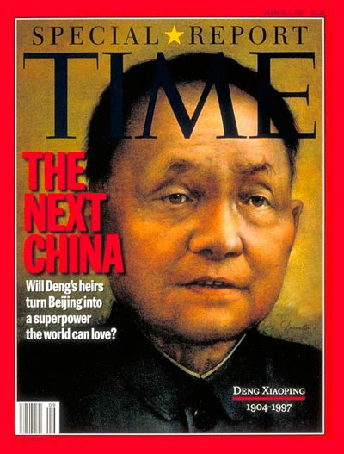

Slide 15


Slide 16
External Drivers
Threats
Demography
Economics
Geography
History

Slide 17
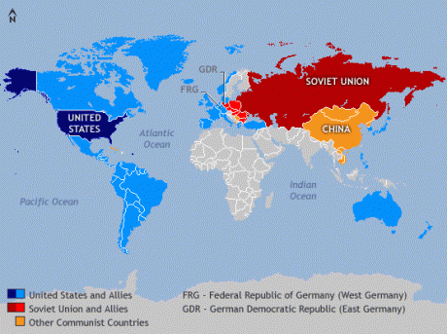

Slide 19
External Drivers
Threats
Demography
Economics
Geography
History

Slide 20
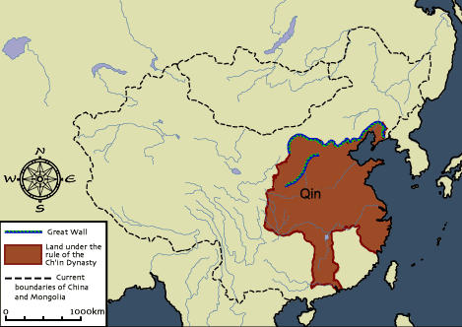

Slide 21
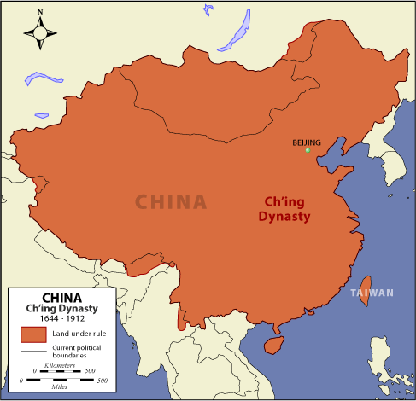

Slide 22
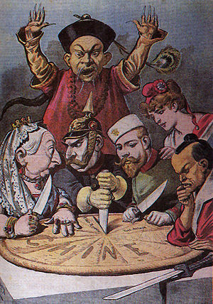

Slide 23
