Slide 1
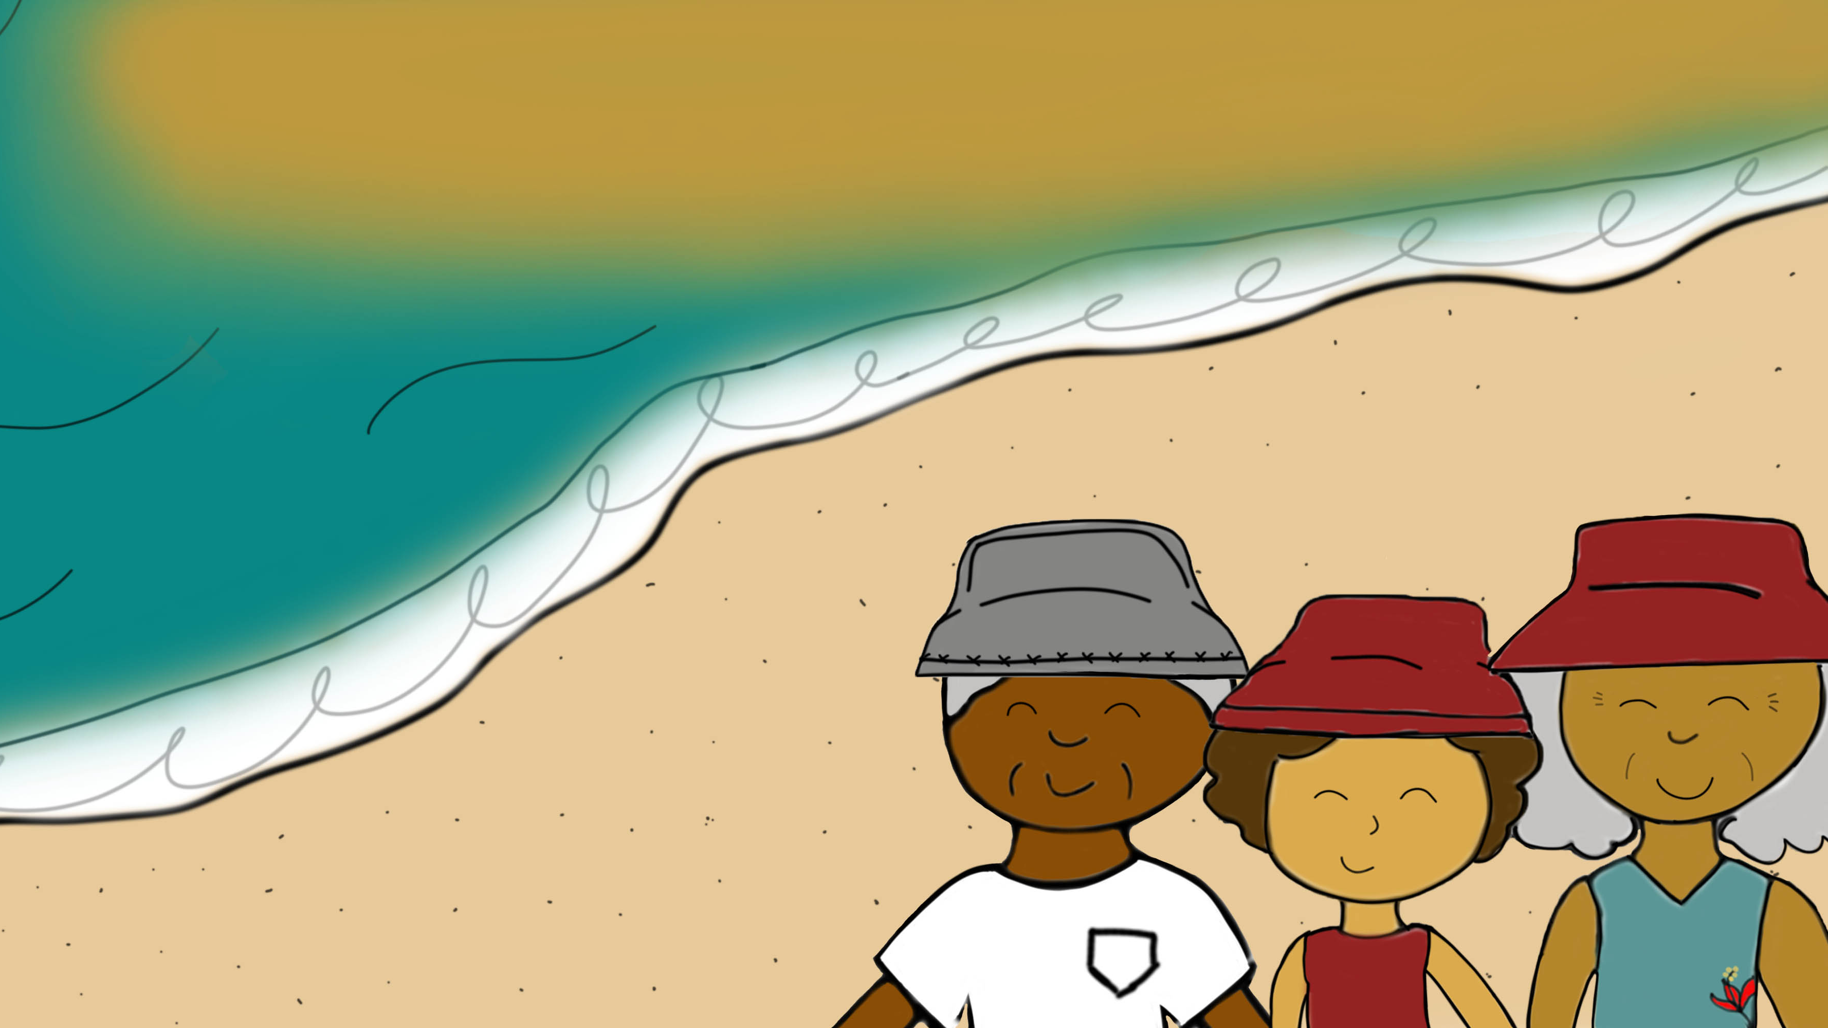

The Sun that Shines from Within
Written and Illustrated by: Zaimarie Vela-Santana

Slide 2



How to explore this book:
= Use ‘enter’ key to play audio buttons and pass the page.
= Click on white audio symbols for audio image description.
= Click on the larger grey audio symbol for story narration.
= Click on yellow audio symbol for sound effects.
= Click on the information symbol for extra information.
Enter

Slide 3
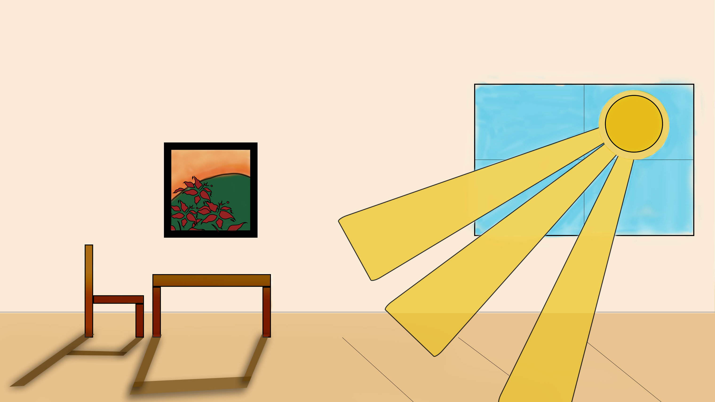
Page 2
The bright sun peeked through the windows of abuelo and abuela’s house, a soft, golden hue creating shadows in the ground.
Can you see the shadows?
As she walked through the house, she could feel the smell of tostones coming from the kitchen. That could only mean one thing: If abuela is making tostones - Yuli thought - we must be going to the beach!

Slide 4
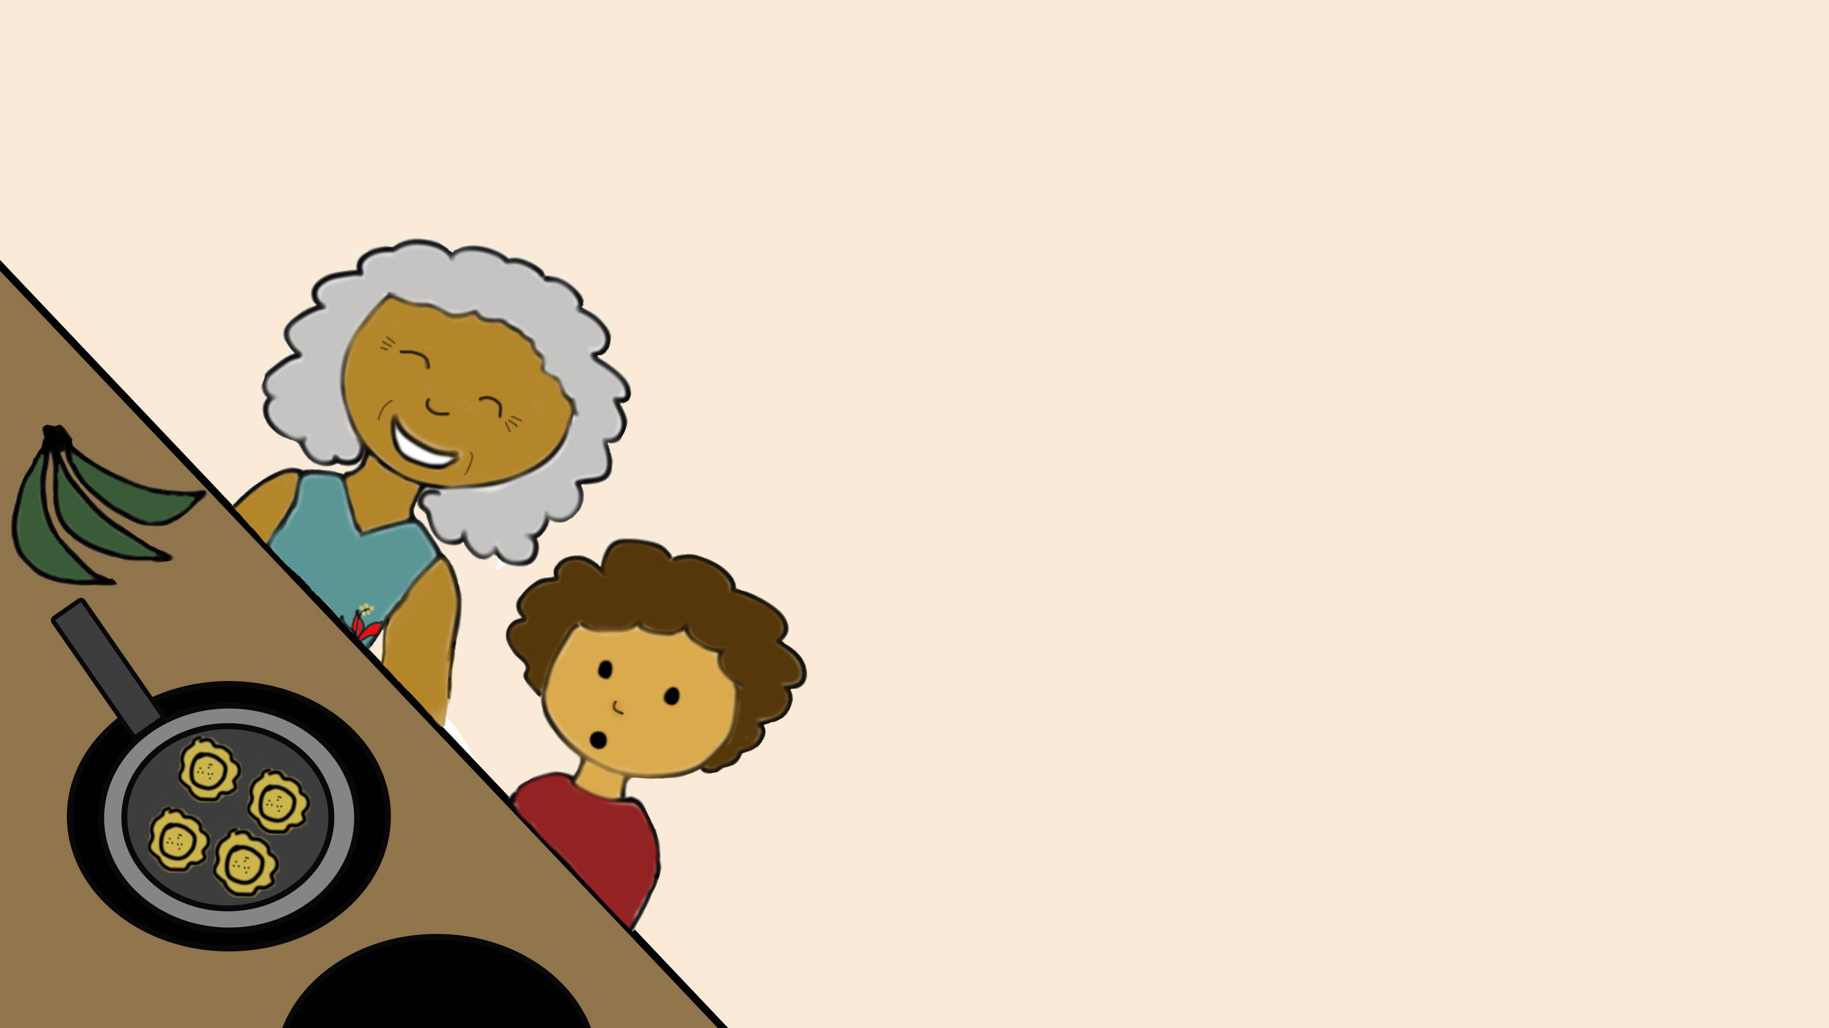

Page 3
"Abuela! Abuela! Are we going to the beach today?"
Abuela chuckled and nodded: "We do always bring tostones to our beach trips."
“Can I help, please?!” Yuli asked excitedly.
"Of course you can!"
Abuela and Yuli then sliced, mashed and fried plantains to make the tostones.
Yuli watched on her tippy toes as the plantain pieces sizzled and crackled in the pot while they waited and waited and waited...
That's when she was sure they were going to the beach.

Slide 5
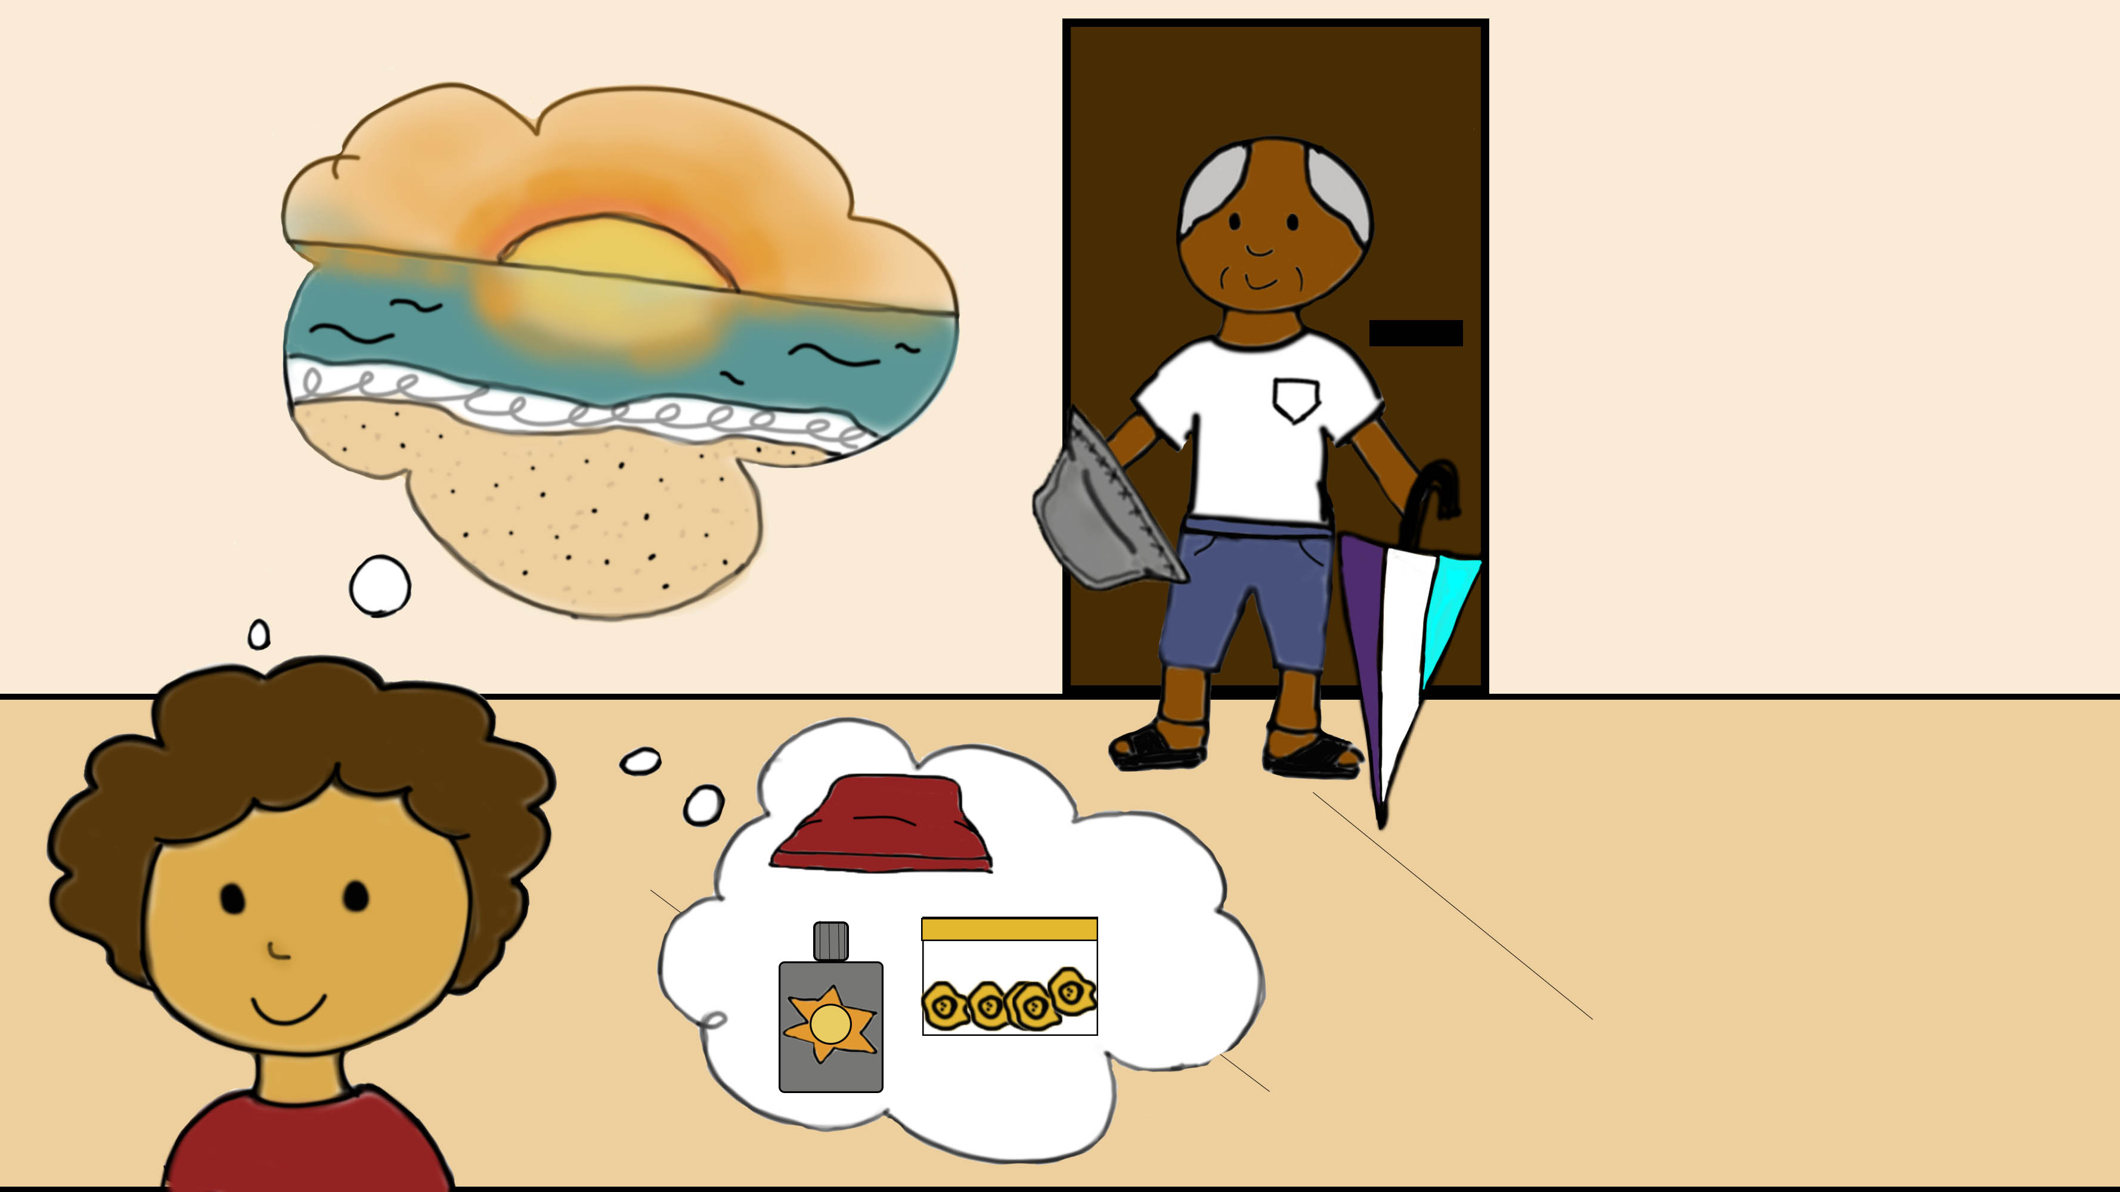
Page 4
Yuli’s favorite time to go to the beach was at sunset. Once a month, abuelo, abuela and her would go and watch how the setting sun made the waves of the sea sparkle.
“We can't forget our hats and beach umbrella!” Abuelo exclaimed while they got ready for the day ahead.
Soon enough, with her favorite red hat, a bottle of sunscreen, a HUGE umbrella and tostones, abuelo, abuela and Yuli left for the beach.

Slide 6
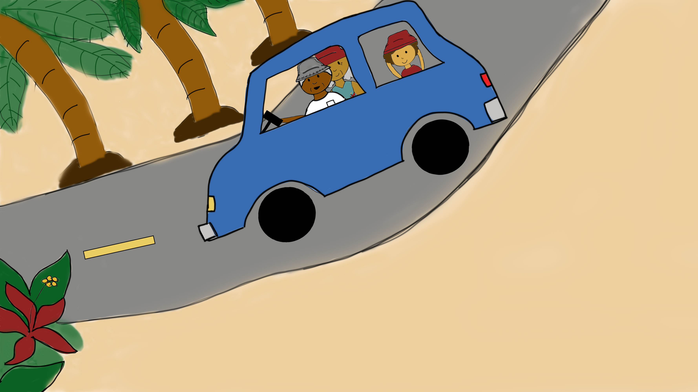
Page 5
The car drove for miles and miles and miles....
Yuli couldn’t help but wonder if the sun had too followed them to the beach.
Still, she clutched her hat with all her might from the wind as abuela yelled from the front passenger seat, “Hold onto your hats!”

Slide 7
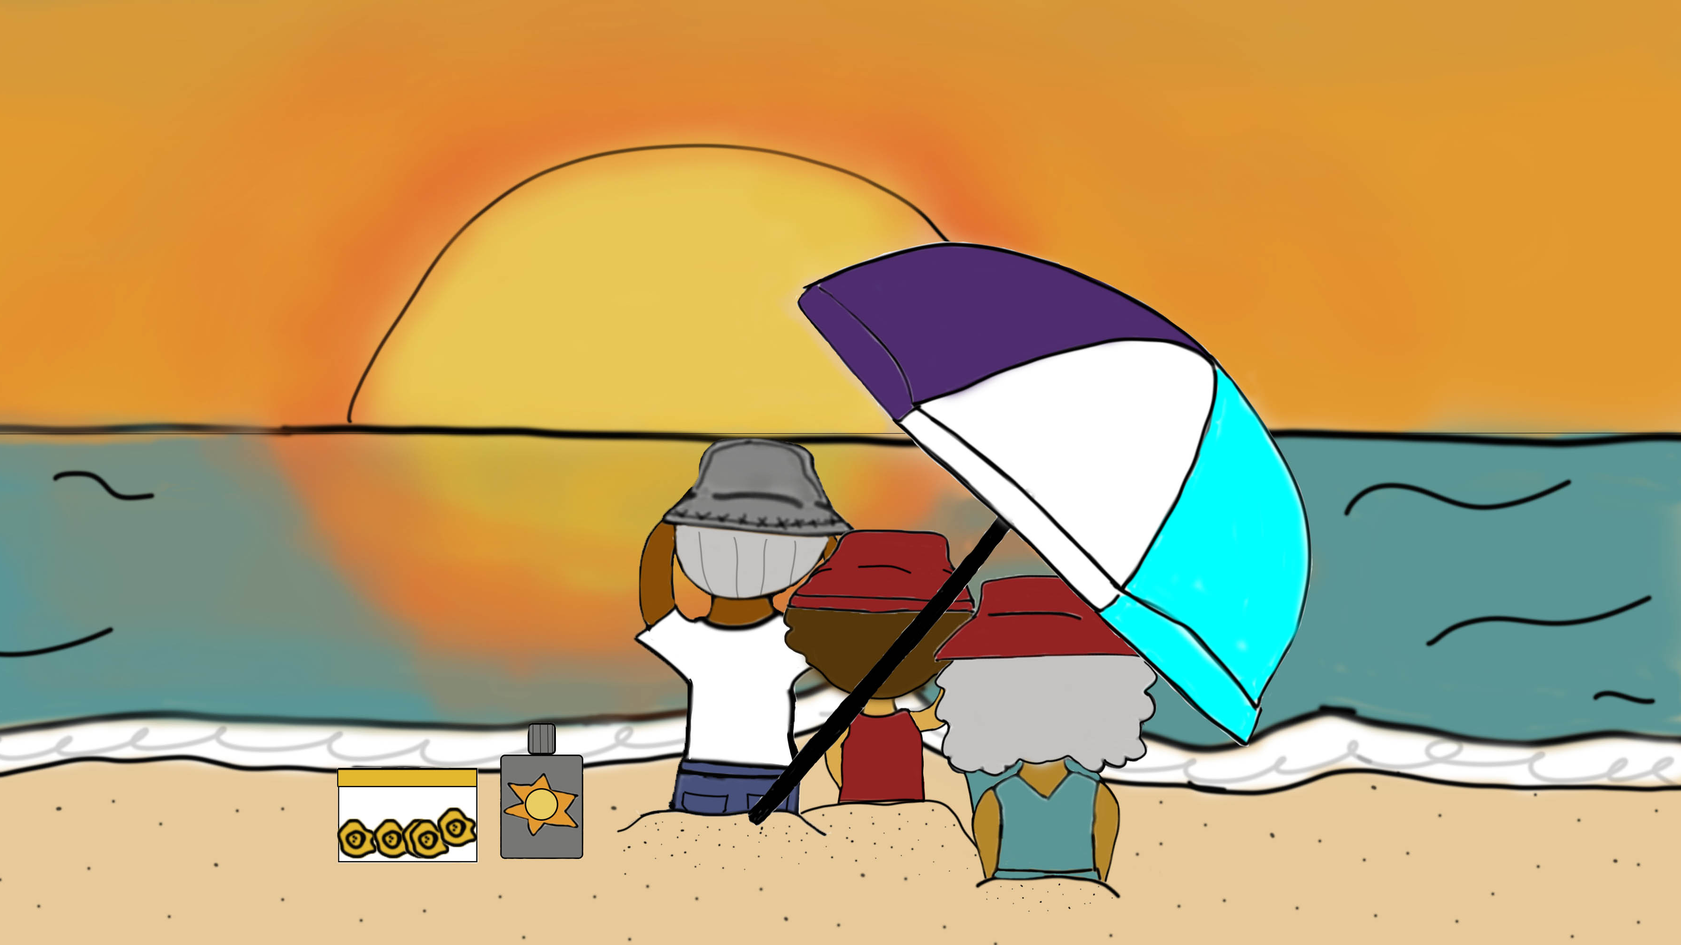
Page 6
The sunlight was silky and smooth over the horizon as abuelo, abuela and Yuli settled under the HUGE umbrella.
And there it was. A bright explosion of reds, oranges and yellows across the sky.
"Abuelo, abuela, why is the sun always there?" Yuli finally asked.

Slide 8
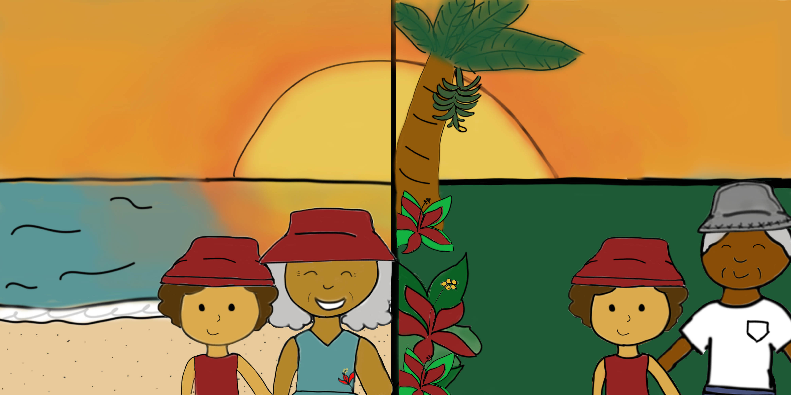
Page 7
They simply smiled, the ends of their eyes crinkling like they always did.
"The sun is like an old friend that knows you well.
It knows where you’ve been and where you will.
It brings life to the island, fills it with warmth and love
and will always be there when you look above.“
“It is a part of you, just like it is a part of the island.
A steady heartbeat that lives inside, connected to the stories of what happened before and causing fruits like plantains, and plants like red hibiscus flowers to grow.”

Slide 9
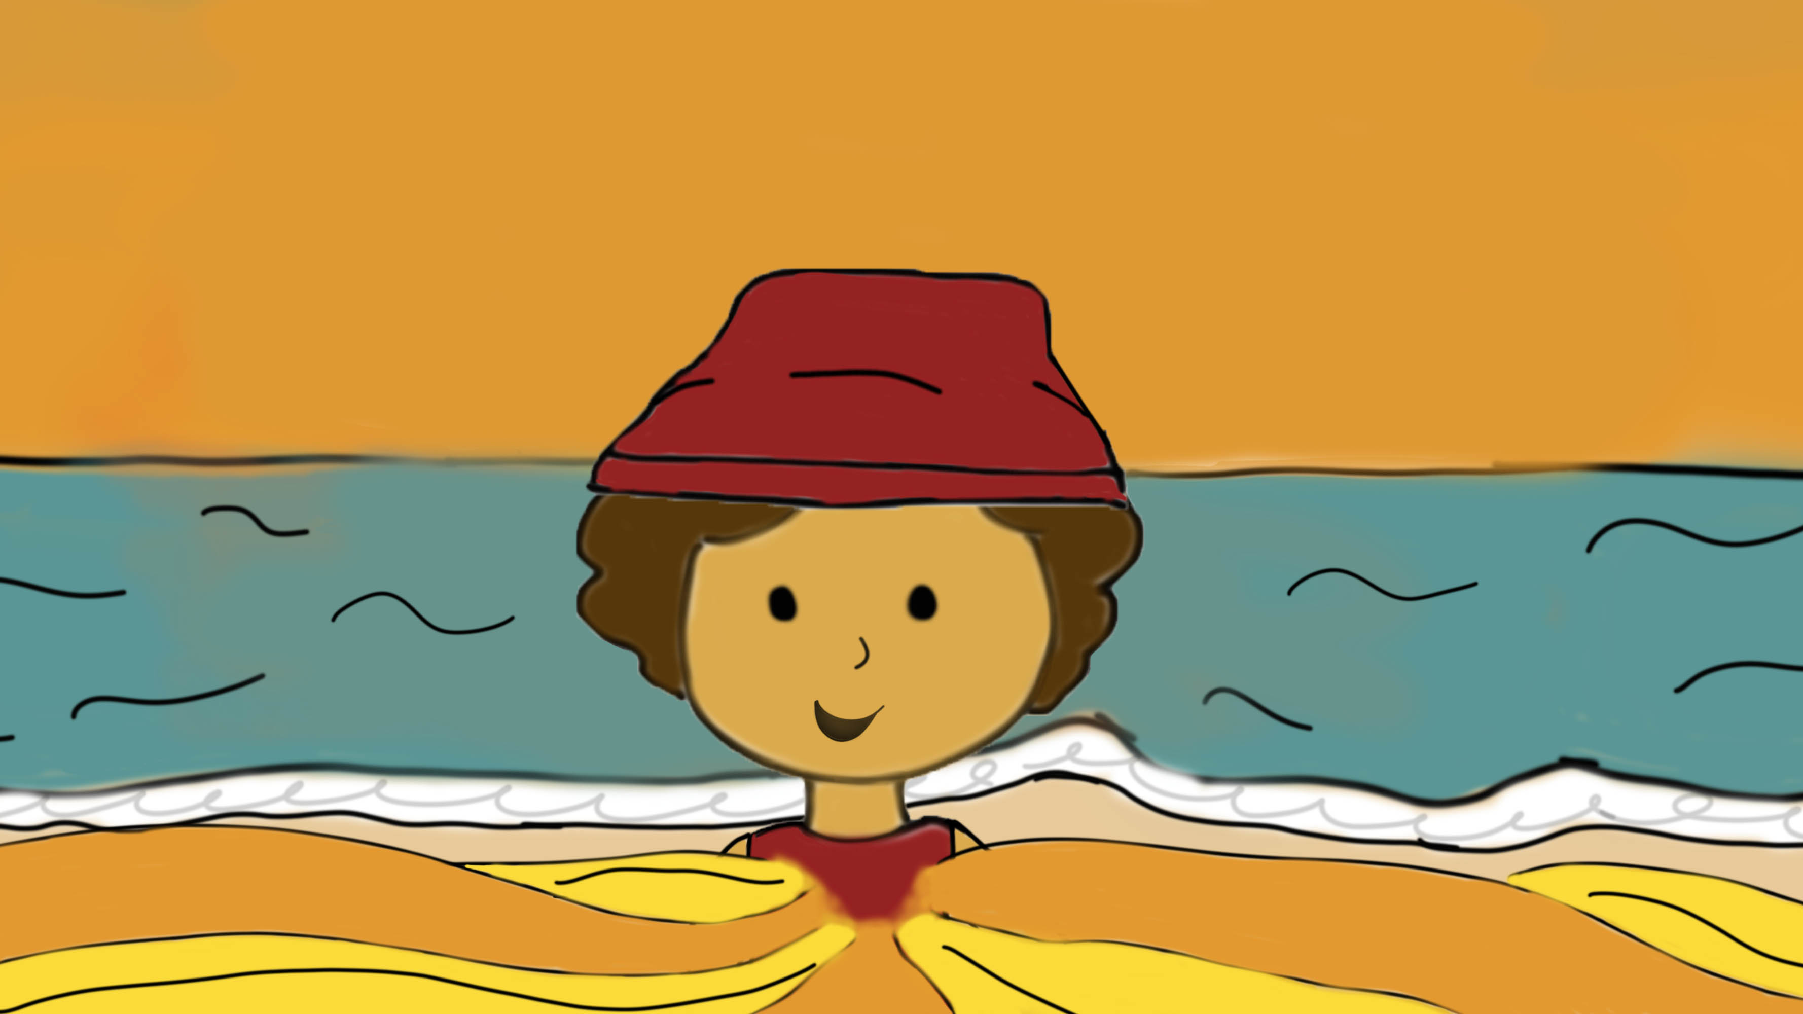
Page 8
“When the sun goes to sleep,
when the day turns into night
or when the sun does not make you feel right,
you will find that the sun will then shine from within.”
With her favorite red hat, a bottle of sunscreen and tostones, while sitting under the HUGE umbrella, Yuli greeted the sun like an old friend.

Slide 10
Author’s Statement:
Abuelo, Abuela and Yuli's story is inspired by my relationship with my grandparents and their role in my disability experience. Not only did I want to create an accessible story about a child with an invisible disability, but I also wanted to write a story about a kind of family and culture that was rarely represented when I was younger. Even though I wrote it with my grandparents and Puerto Rico in mind, I think it is a kind of story that anyone can relate with, whether they are from the Caribbean or not. In the end, it is a story about a family going on an adventure and connecting with their culture in their own way.
In this book, you will find accessibility features such as audio image descriptions, narration, alternative text, use of borders and textures to make images easier to see and links to vocabulary words and extra information on sun protection and invisible disabilities. I decided to showcase Yuli’s story through subtle details like their use of hats, the time and frequency the family goes to the beach, and external links that provide context to readers. Similarly, I also focused on presenting cultural references like elders passing down their knowledge to children through food or nature. With these elements, I hope you, as a reader, can experience a small piece of what families and invisible disabilities can look like.

