Slide 1

Internal Drivers
Culture
Ideology
Nationalism
Grand Strategy
Leadership

Slide 2
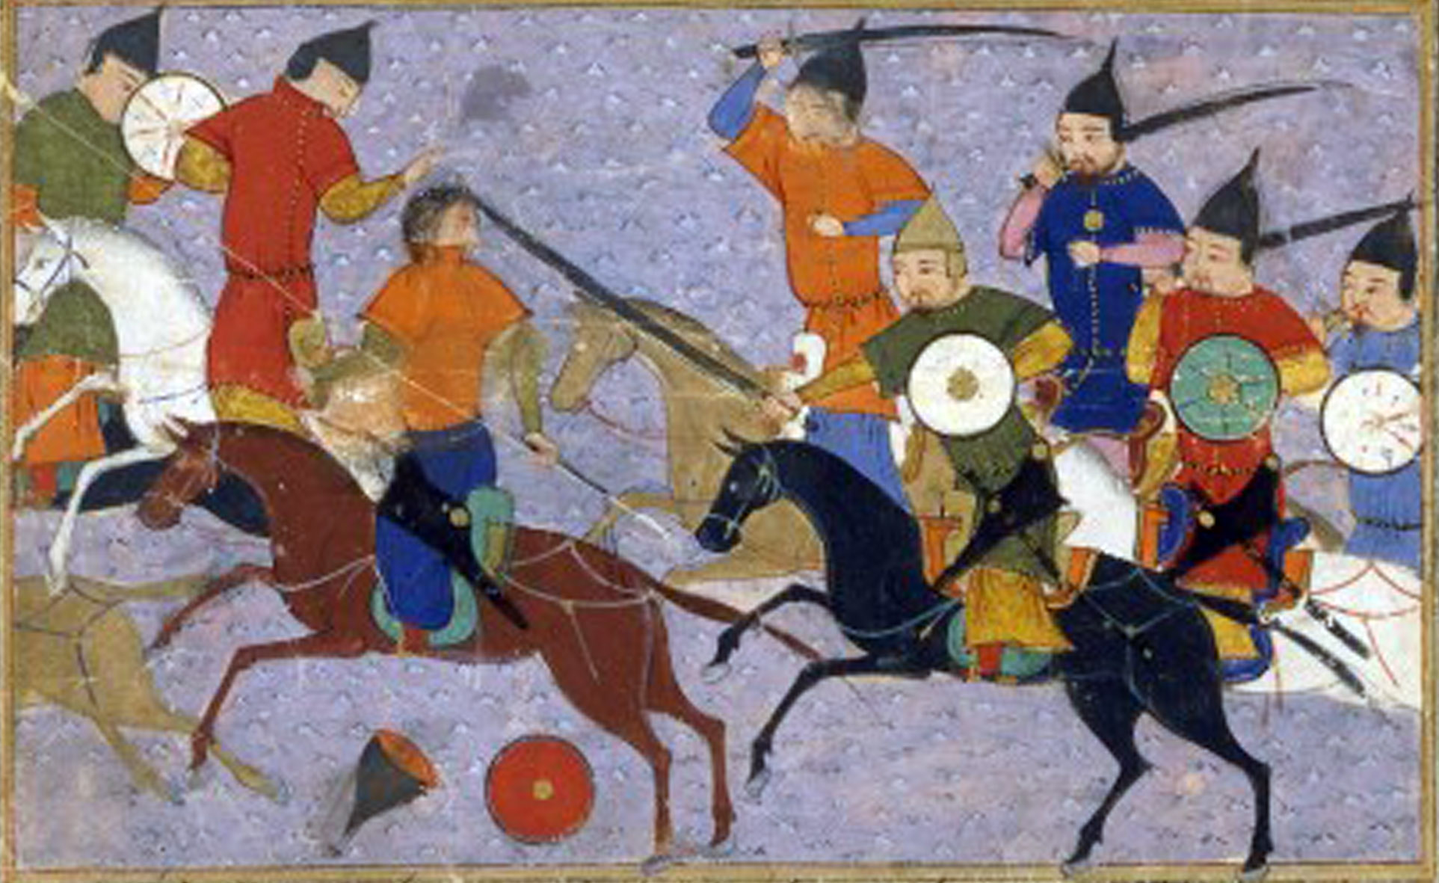

Slide 3
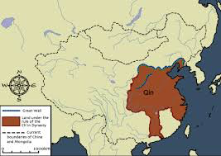

Slide 4
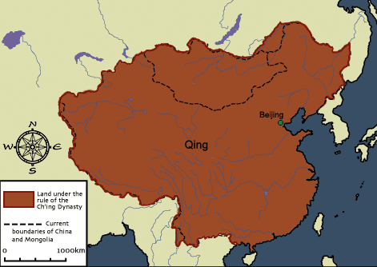

Slide 5
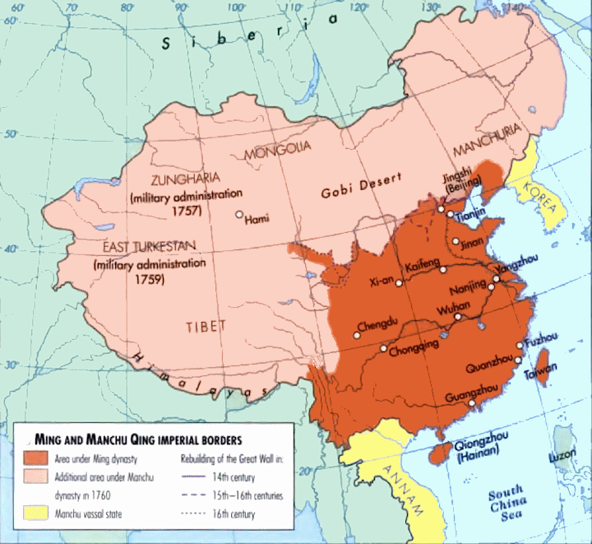

Slide 6
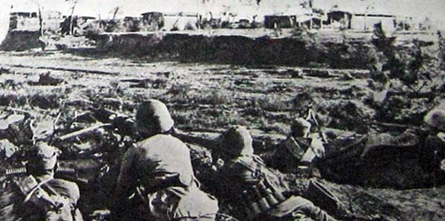

Slide 7
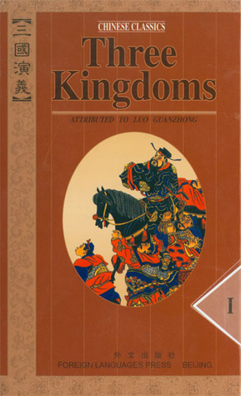

Slide 8


Slide 9
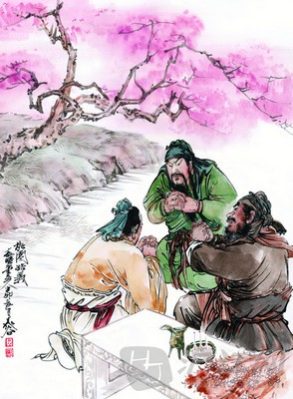

Slide 11
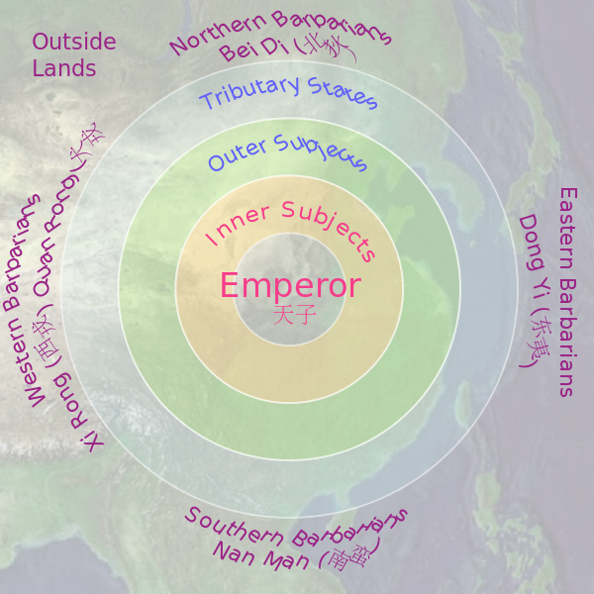

Slide 12
Internal Drivers
Culture
Ideology
Nationalism
Grand Strategy
Leadership

Slide 13
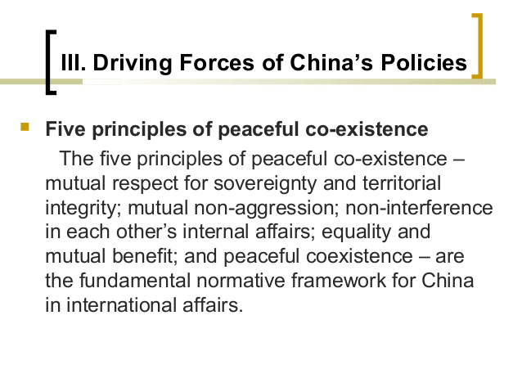

Slide 14
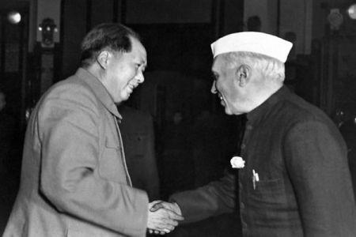

Slide 15
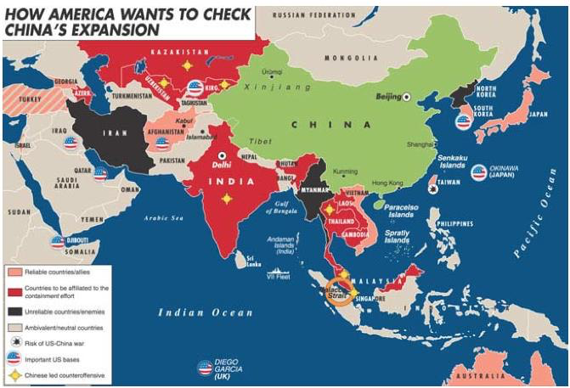

Slide 16
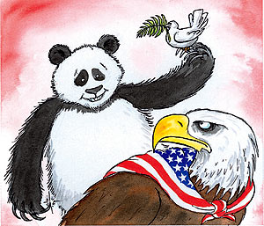

Slide 17
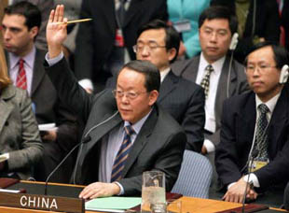

Slide 18


Slide 19
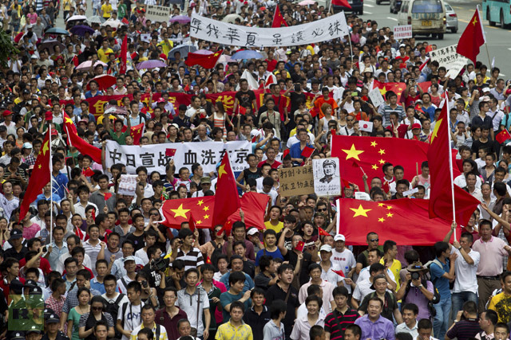

Slide 20
Internal Drivers
Culture
Ideology
Nationalism
Grand Strategy
Leadership

Slide 21
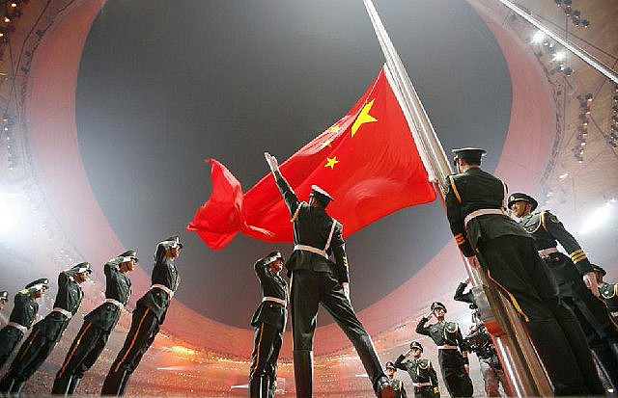

Slide 22


Slide 23


Slide 24
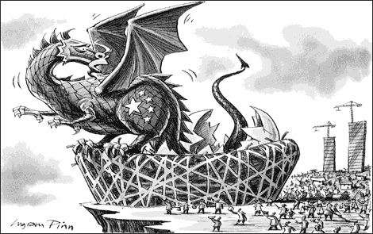

Slide 25
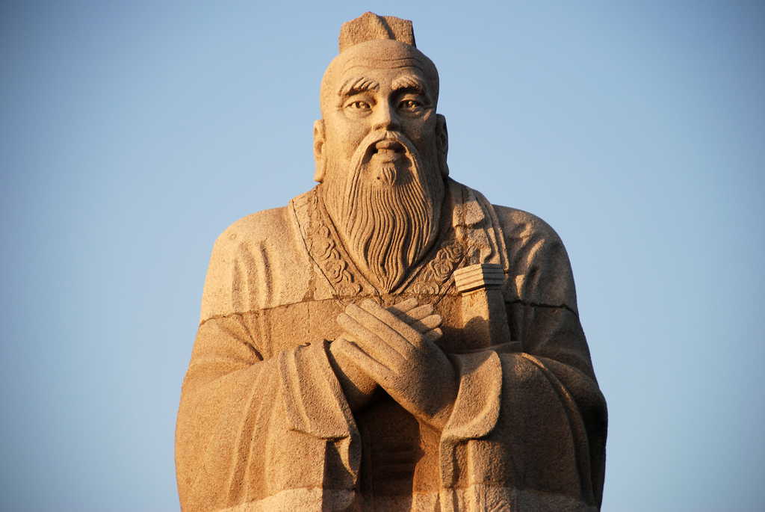
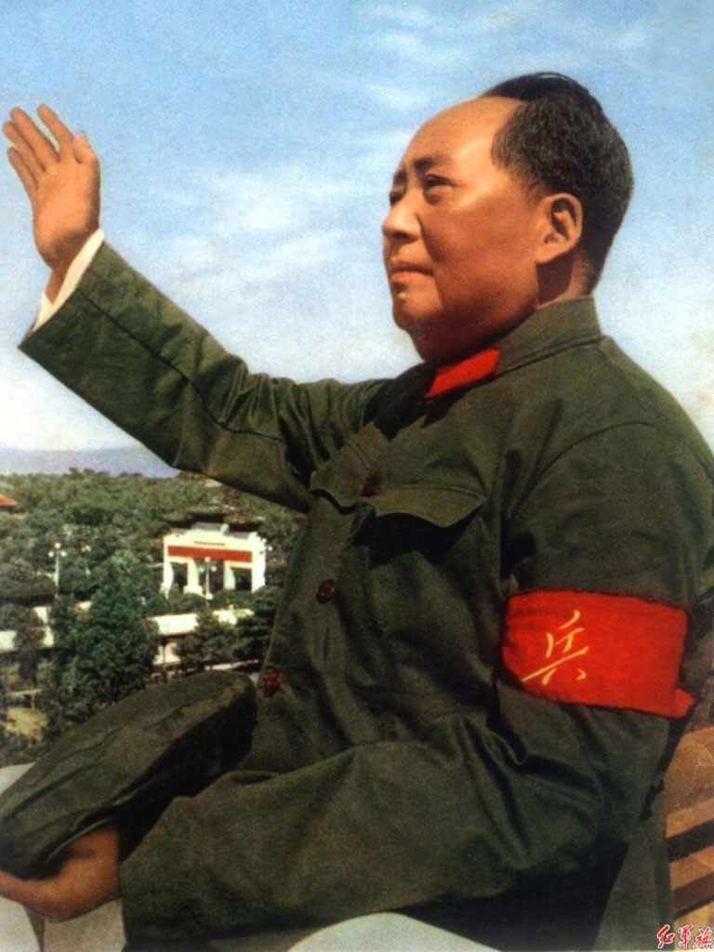

Slide 26
Internal Drivers
Culture
Ideology
Nationalism
Grand Strategy
Leadership

Slide 27
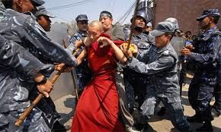

Slide 28
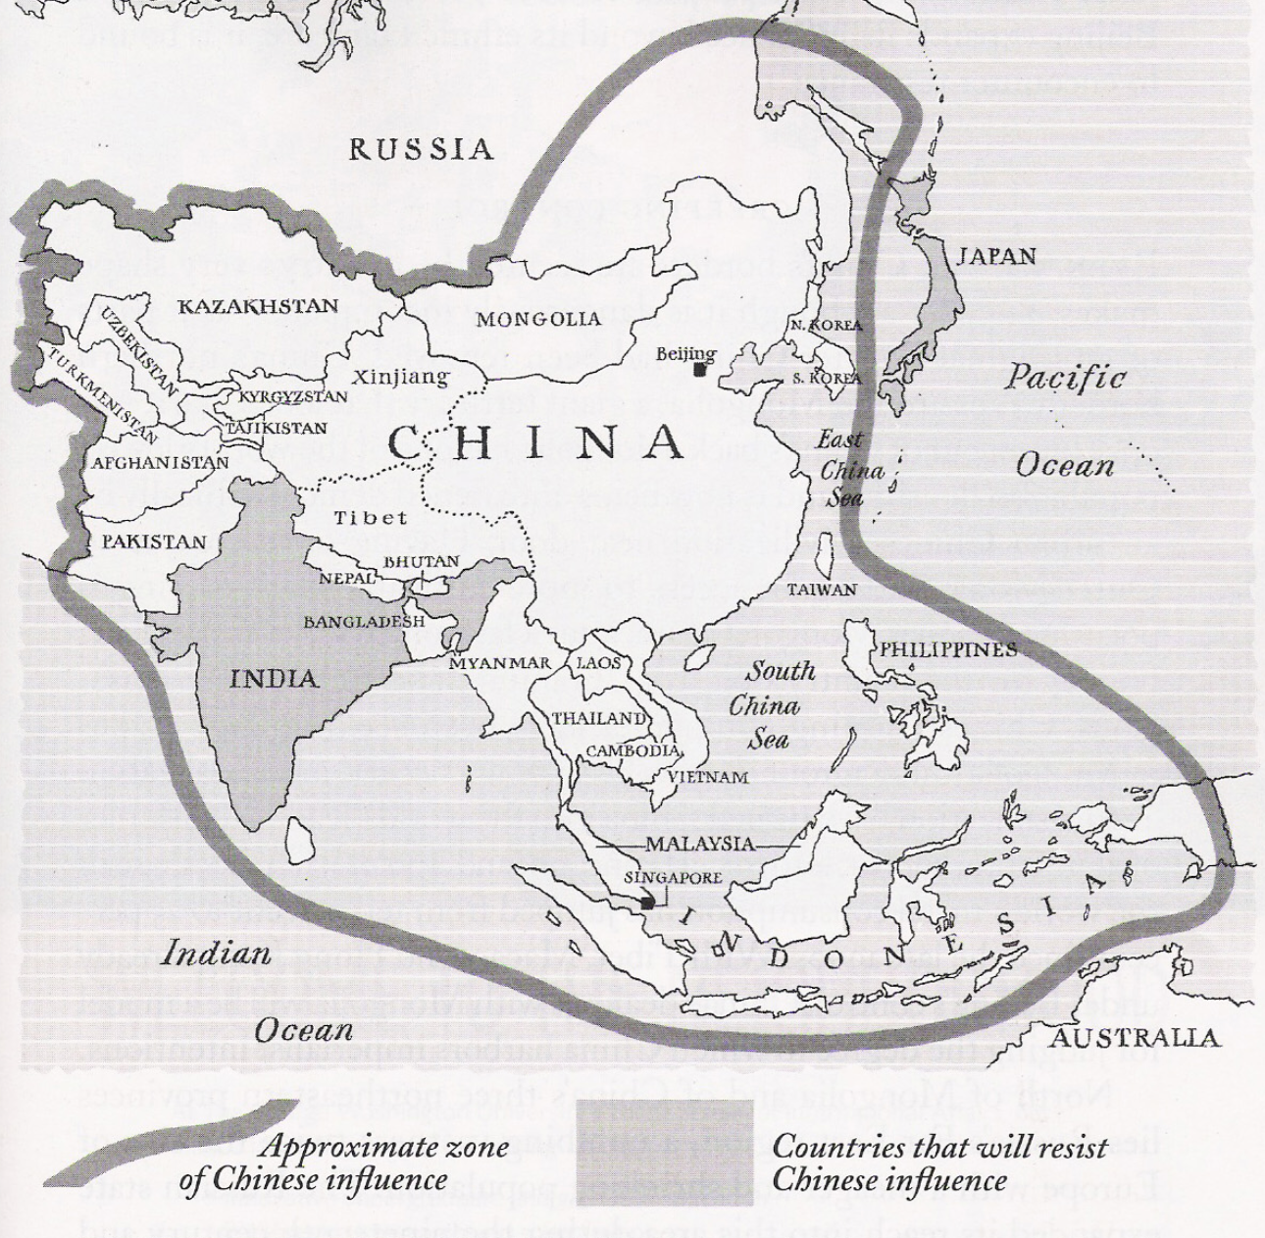

Slide 29


Slide 30
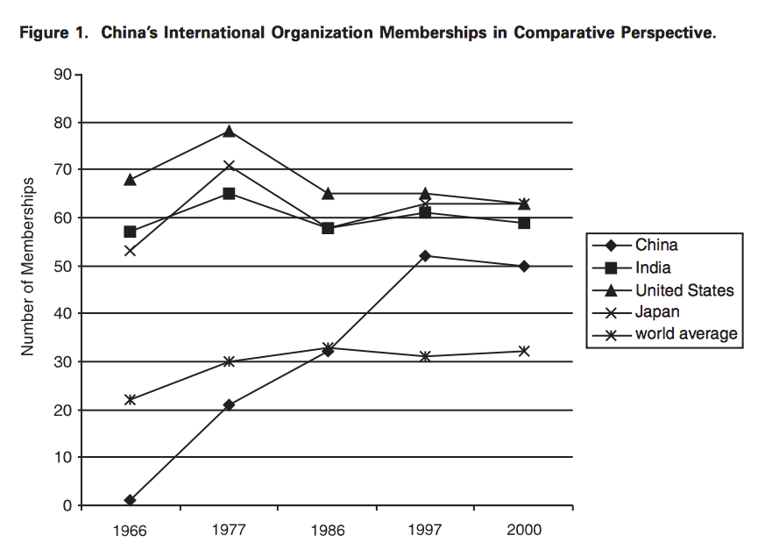

Slide 31
Internal Drivers
Culture
Ideology
Nationalism
Grand Strategy
Leadership

Slide 32
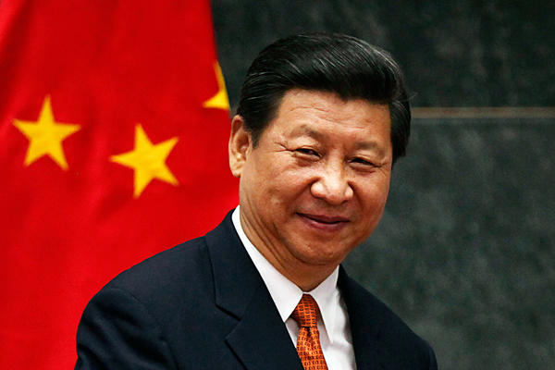

Slide 33
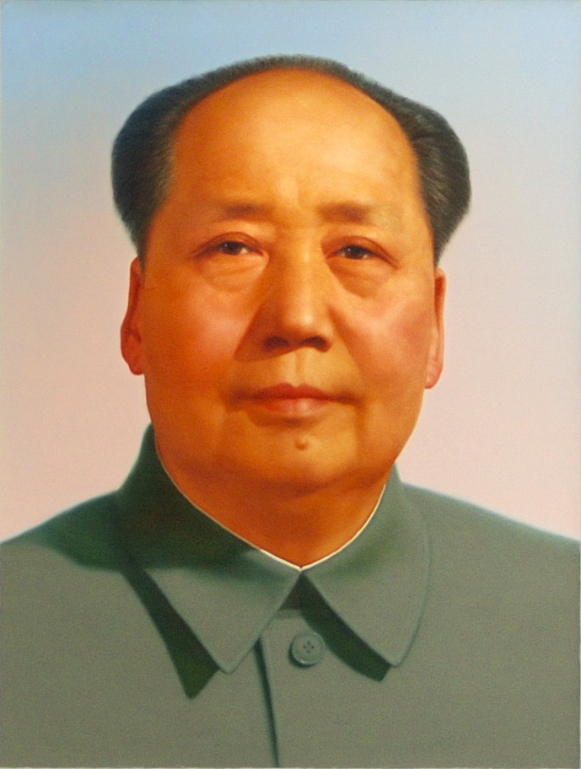

Slide 34
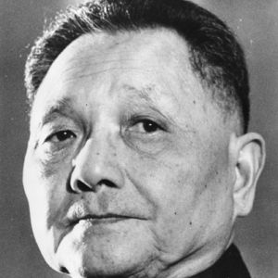

Slide 35
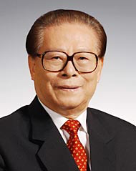

Slide 36
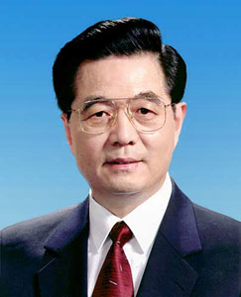

Slide 37
